Slide 1

Search for the electron’s EDM
Is the electron round?
E.A. Hinds
Centre for Cold Matter
Imperial College London
PCPV, Mahabaleshwar, 22 February 2013

Slide 2
    How a point electron gets structure
point electron
+
+
-
+
+
polarisable vacuum with increasingly
rich structure at shorter distances:
(anti)leptons, (anti)quarks, Higgs (standard model)
beyond that: supersymmetric particles ………?

Slide 3
Electric dipole moment (EDM)
electron
spin
T
+
+
-
-
edm
If the electron has an EDM,
nature has chosen one of these,
breaking T symmetry
. . . CP

Slide 4
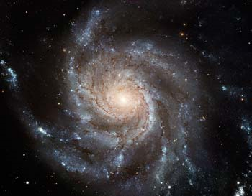
Theoretical estimates of eEDM
eEDM (e.cm)
10⁻²²
selectron
γ
10⁻²⁴
Multi Higgs
MSSM
e
e
10⁻²⁶
The interesting
region of sensitivity
Left -Right
10⁻²⁸
other
SUSY
10⁻³⁰
10⁻³²
10⁻³⁴
Insufficient CP
to make universe
10⁻³⁶
of matter
Standard Model
4

Slide 5
The magnetic moment problem
Suppose d_{e} = 5 x 10⁻²⁸ e.cm
(the region we explore)
= 1 x 10⁻¹⁹ e.a₀
~
In a field of 10kV/cm d_{e} σ ⋅ E _ 1 nHz
E
When does μ_{B}.B equal this ?
~
B _ 1 fG
d_{e}σ
This is very small
electron
5

Slide 6
A clever solution
For more details, see E. A. H. Physica Scripta T70, 34 (1997)
amplification
(Sandars)
E
ηd_{e} σ
Interaction energy
electric field
-d_{e} ηE•σ
F P
Polarization factor
Structure-dependent relativistic factor ∝ Z³
atom or molecule containing electron
6

Slide 7
Our experiment uses a polar molecule – YbF
15 GV/cm
Amplification in YbF
EDM interaction energy is a million times larger (mHz)
needs “only” nG stray B field control
7

Slide 8
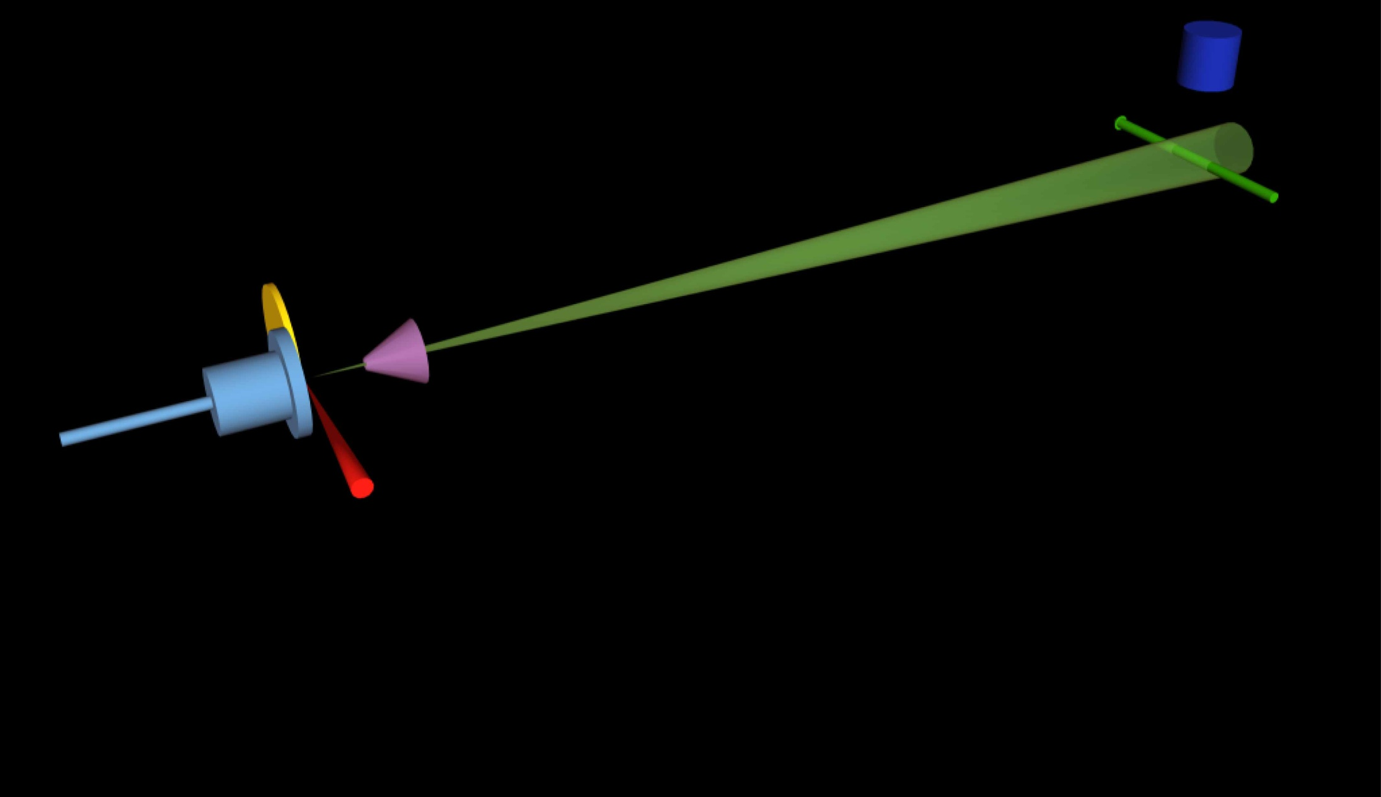
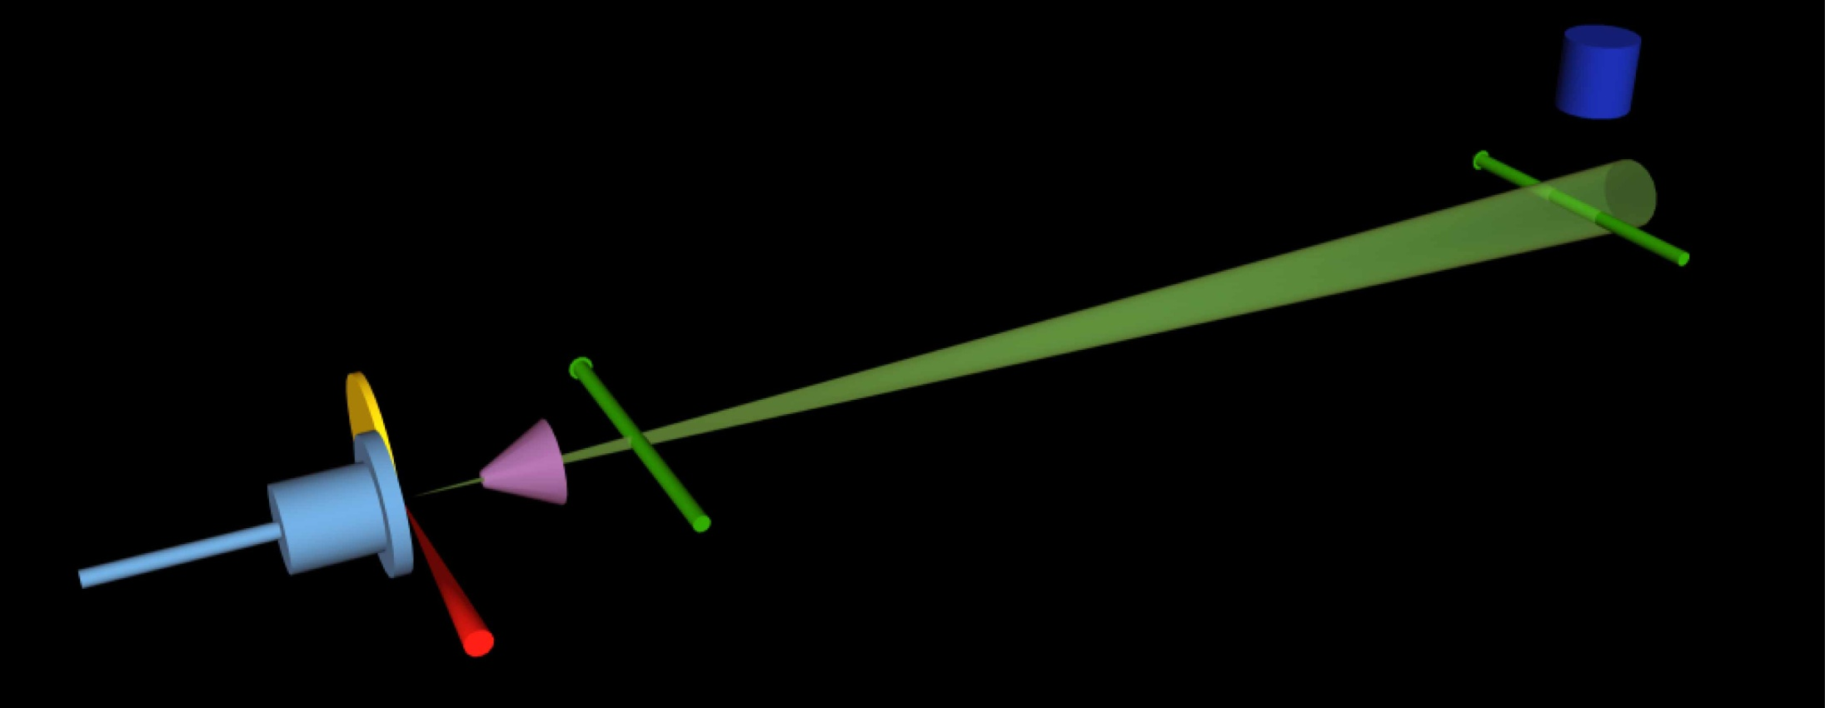
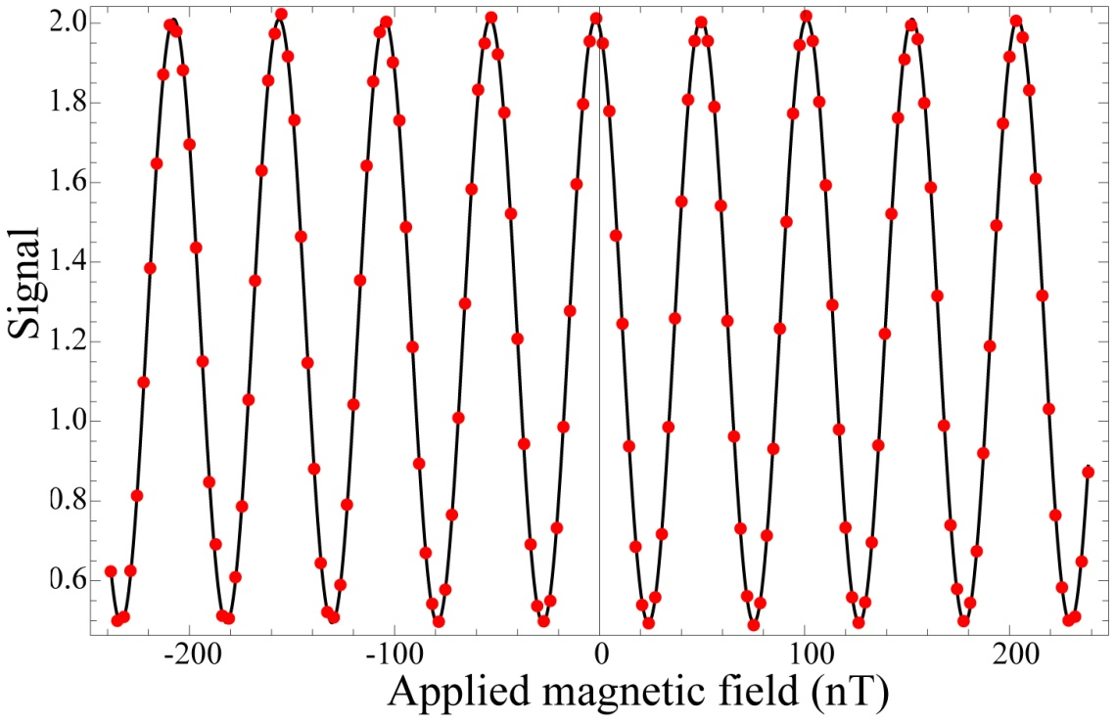
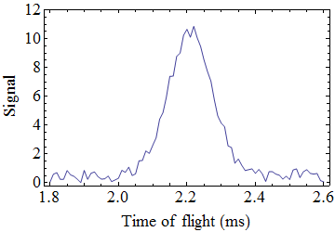
How it is done
PMT
rf pulse
HV+
rf pulse
3K beam
B
Pulsed YbF
beam
Probe
laser
HV-
Pump
laser

Slide 9
Measuring the edm
Interferometer phase φ = 2(μB + d_{e}ηE)τ/h
-
E
-E
∝ d_{e}
Detector count rate
-B
B
Applied magnetic field
9

Slide 10
Modulate everything
±E
±B
±ΔB
±rf1f
spin
interferometer
±rf2f
±rf1a
signal
±rf2a
±rfφ
±laser f
Generalisation of phase-sensitive detection
Measure all 512 correlations.
E·B correlation gives EDM signal
9 switches:
512 possible correlations
10

Slide 11
** Don’t look at the mean edm **
We don’t know what result to expect.
Still, to avoid inadvertent bias we hide the mean edm.
An offset is added that only the computer knows.
More important than you might think.
  e.g. Jeng, Am. J. Phys. 74 (7), 2006.
11

Slide 12
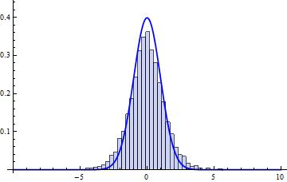
2011 Data:
6194 measurements (~6 min each) at 10 kV/cm.
EDM (10⁻²⁵ e.cm)
2
1
0
-1
-2
25 million beam shots
Distribution of
edm/σ_{edm}
Gaussian
distribution
bootstrap method
determines
probability distribution
-5
0
5
12

Slide 13
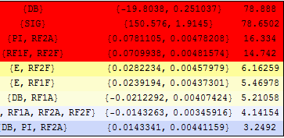
Measuring the other 511 correlations
correlation
mean
σ
mean/σ
fringe slope calibration
beam intensity
φ-switch changes rf amplitude
E drift
E asymmetry
E asymmetry
inexact π pulse
The rest are zero (as they should be) !
Only now remove blind from EDM
13

Slide 14
Current status
    Regan et al. (PRL 2002)
    Dzuba/Flambaum (PRL 2009)
    Nataraj et al. (PRL 2011)
    Previous result - Tl atoms
    d_{e} < 1.6 × 10⁻²⁷ e.cm with 90% confidence
    Kara et al. NJP 14, 103051 (2012)
    2011 result – YbF Hudson et al. (Nature 2011)
    d_{e} = (-2.4 ± 5.7 ± 1.5) ×10⁻²⁸ e.cm
    systematic - limited by statistical noise
    68% statistical
    d_{e} < 1 × 10⁻²⁷ e.cm with 90% confidence
14

Slide 15
eEDM (e.cm)
10⁻²²
10⁻²⁴
New excluded region
Multi Higgs
MSSM
d_{e} < 1 x 10⁻²⁷ e.cm
10⁻²⁶
Left -Right
10⁻²⁸
other
SUSY
We are starting to
explore this region
10⁻³⁰
10⁻³²
10⁻³⁴
10⁻³⁶
Standard Model
15

Slide 16
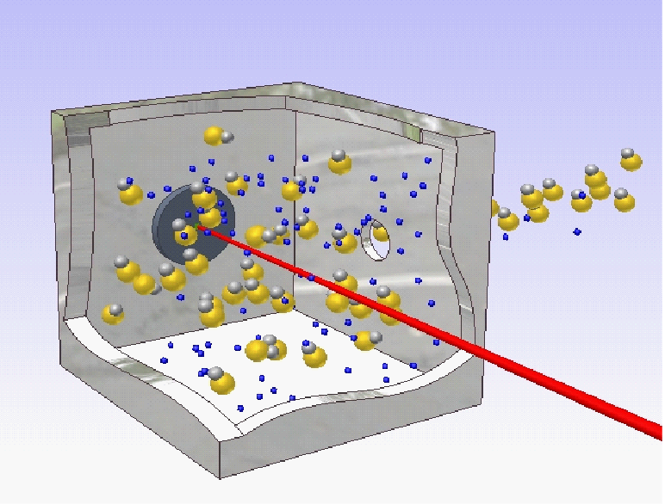
How we will improve
Phase 1 Small upgrades: 3 x improvement
– in progress
Phase 2 Cryogenic source of YbF
– almost ready
Phase 3 Laser-cooled molecular fountain
– being developed
16

Slide 17
Phase 1:
Longer interferometer
Defects emphasised
Lower background
2.5×sensitivity
Probe pol.
Pump pol.
E magnitude
Systematics emphasised
total < 10⁻²⁸ e.cm
Stray By
Stray Bx
F=1 detect
6
Now making a
2×10⁻²⁸ e.cm
EDM measurement
Probe freq
5
Pump freq
E direction
4
3
Max uncertainty (10⁻²⁹ e.cm)
2
1
0

Slide 18
Phase 2 - cryogenic buffer gas source of YbF
YbF beam
Yb+AlF₃
target
YAG
ablation
laser
3K He gas cell
18

Slide 19
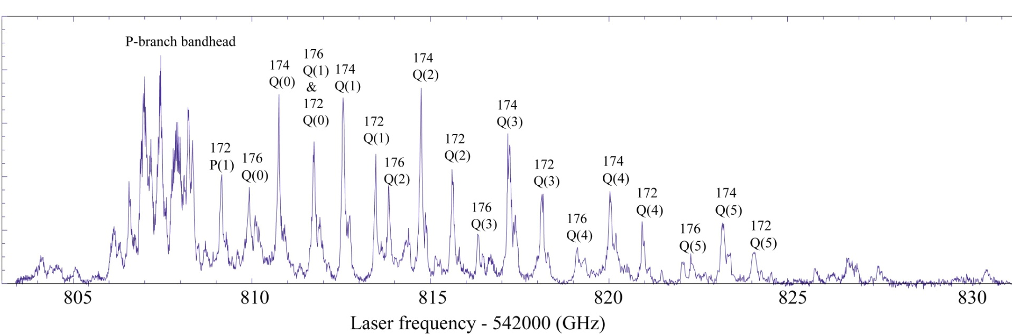
Cryogenic beam spectrum
Rotational temperature: 4 ± 1 K
Translational temperature: 5 ± 1 K
10 × more molecules/pulse
4 × longer interaction time (slower beam)
=> 10 × better EDM signal:noise ratio
=> access to mid 10⁻²⁹ e.cm range
19

Slide 20
Phase 3 – a molecular fountain
HV+
HV-
Laser cooling
1/2 sec flight time (instead of 1/2 ms)
rf pulse
=> 6×10⁻³¹ e.cm statistical (in 8 hrs)
3K beam
source
guide
laser cooling
detection
He
Tarbutt et al. arXiv:1302.2870
20

Slide 21
Other eEDM experiments in preparation
Acme collaboration, Harvard/Yale
ThO : ³Δ₁ metastable
Leanhardt group, Michigan
WC : ³Δ₁ ground state
Cornel Group JILA
HfF⁺ : ³Δ₁ ground state
Atom experiments in preparation
Cs in optical lattice: Weiss group, Penn State (next year?)
Heinzen group, Texas (2 years?)
Fr in a MOT: Tohoku/Osaka (starting 2014)

Slide 22
Current status of EDMs
d e.cm
d(muon) < 1.9×10⁻¹⁹
10⁻²⁰
neutron:
10⁻²²
d(proton) < 5×10⁻²⁴
10⁻²⁴
MSSM
electron:
d(neutron) < 3×10⁻²⁶
10⁻²⁶
Multi
Higgs
d(electron) < 1×10⁻²⁷
YbF
10⁻²⁸
Left-Right
10⁻²⁹
1960
1970
1980
1990
2000
2010
2020
2030
22

Slide 23
Summary
e- EDM is a direct probe of physics beyond SM
10⁻²²
specifically probes CP violation
(how come we’re here?)
10⁻²⁴
Multi Higgs
MSSM
10⁻²⁶
Left -Right
10⁻²⁸
other
SUSY
10⁻³⁰
we see a way to reach <10⁻³⁰
Atto-eV molecular spectroscopy
tells us about TeV particle physics:
the electron is too round for MSSM!
23

Slide 24
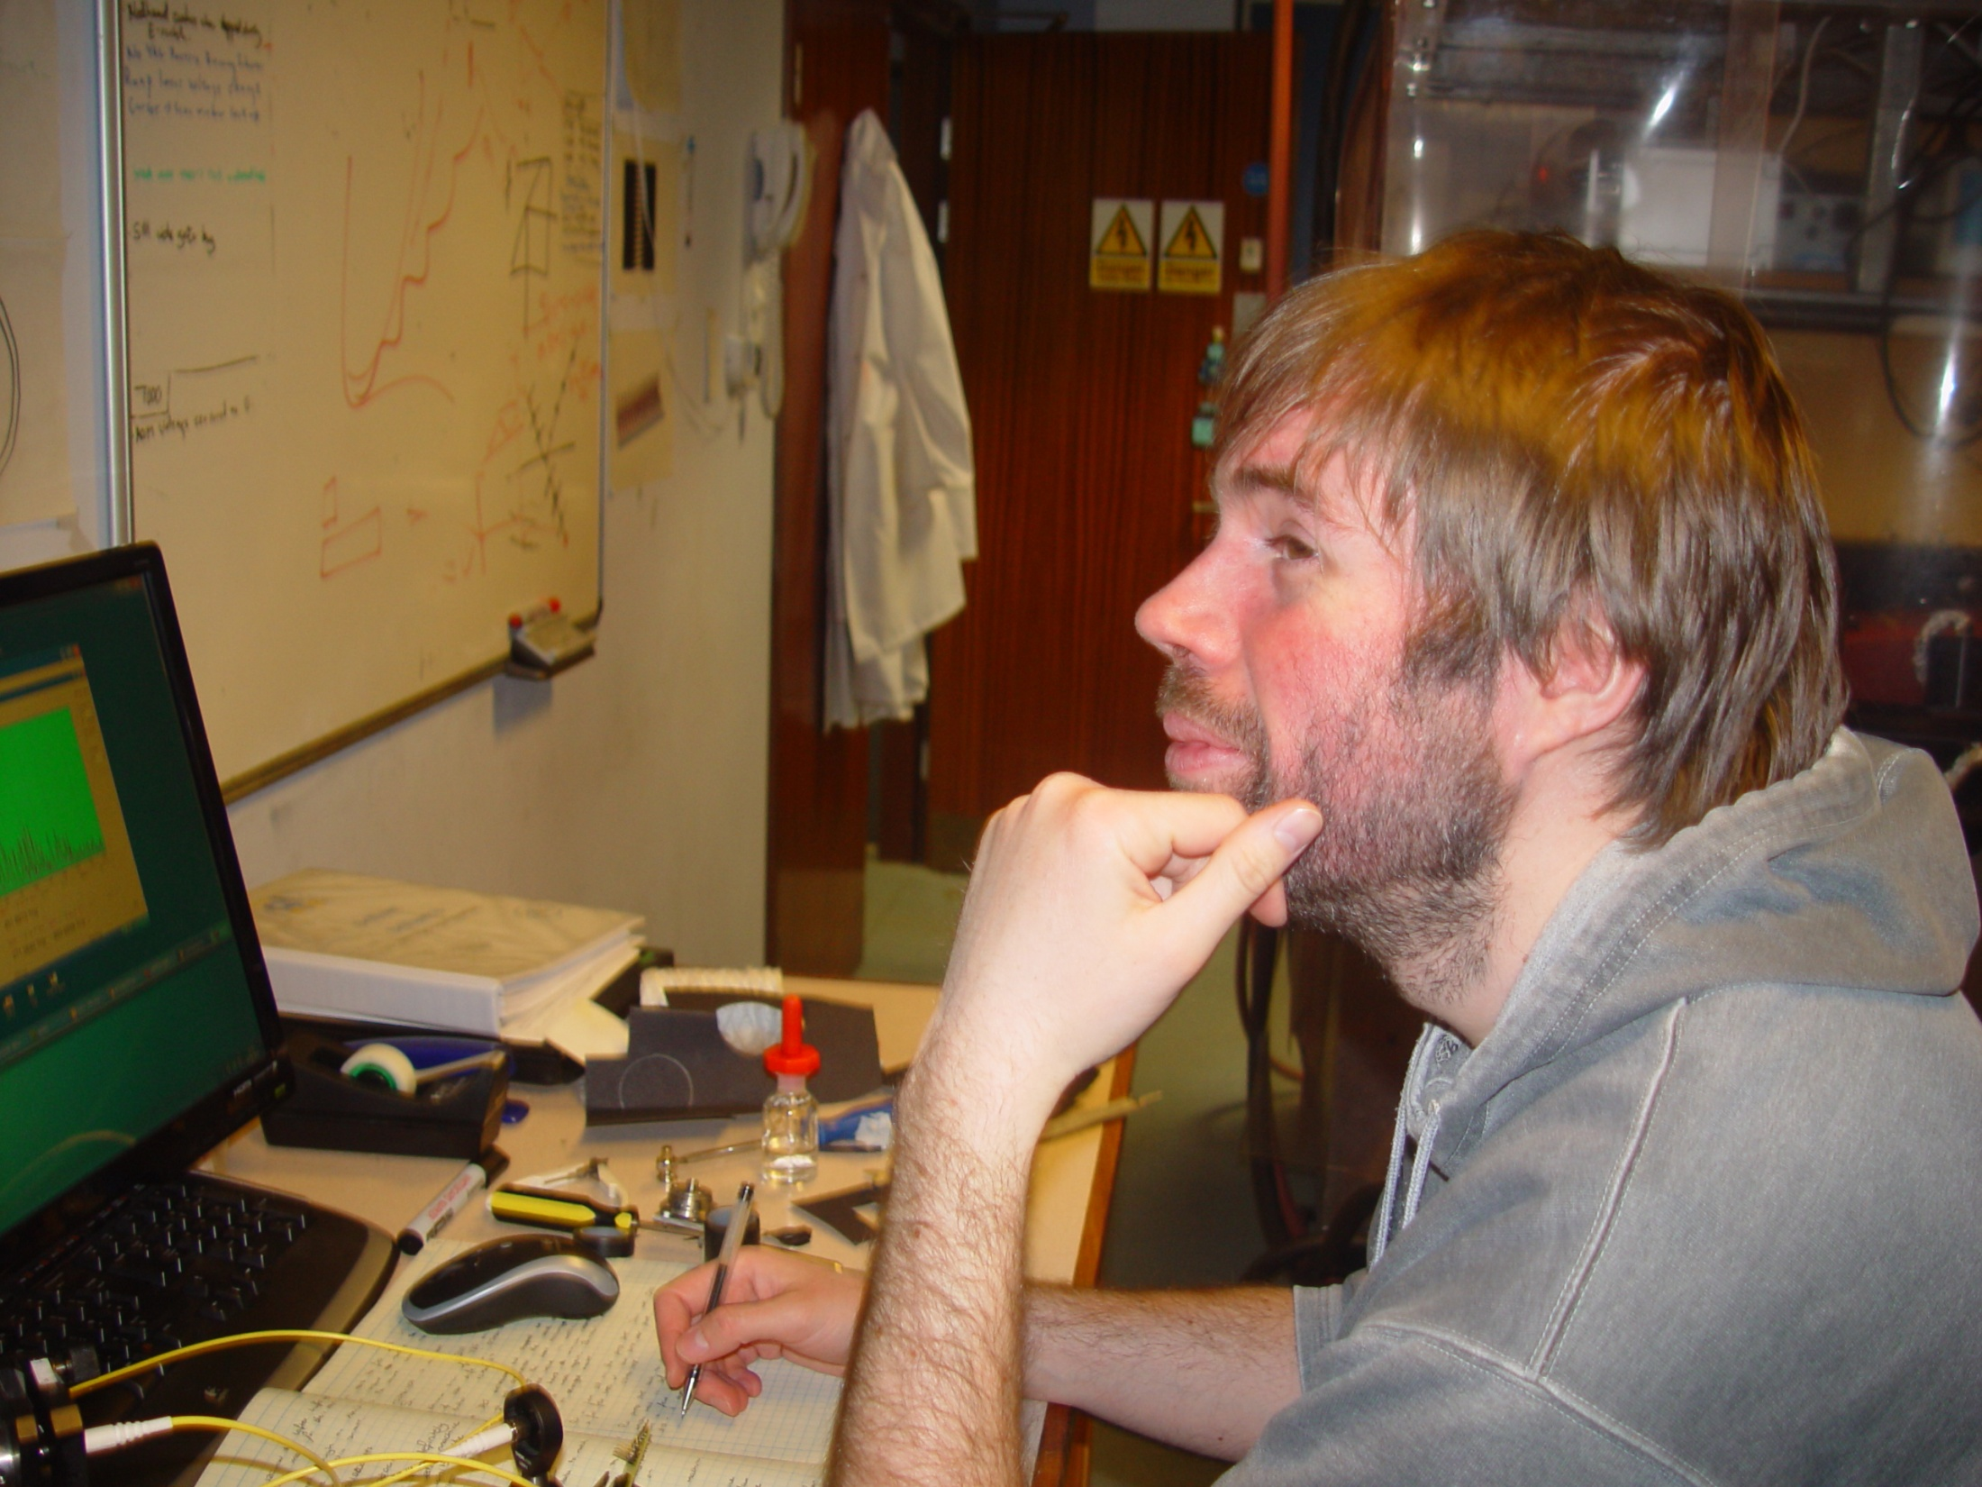
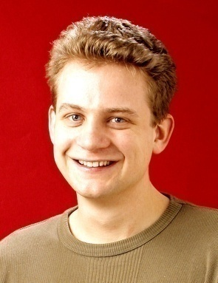
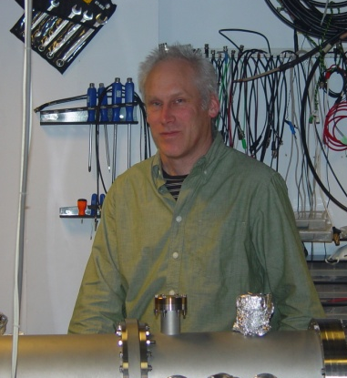
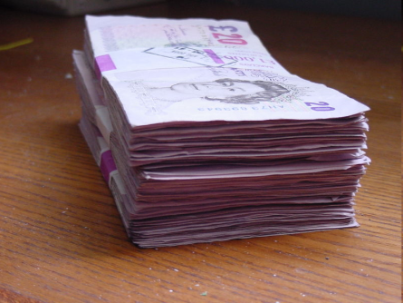


Thanks to my colleagues...
Jony Hudson
Mike Tarbutt
Ben Sauer
EDM measurement:
Joe Smallman
Jack Devlin
Dhiren Kara
Buffer gas cooling:
Sarah Skoff
Nick Bulleid
Rich Hendricks
Laser cooling:
Thom Wall
Aki Matsushima
Valentina Zhelyazkova
Anne Cournol

