Slide 1

muon g-2/EDM
PCPV2013, February 21, 2013
Tsutomu Mibe (IPNS/KEK)
photo : Oarai Beach, Ibaraki JAPAN

Slide 2
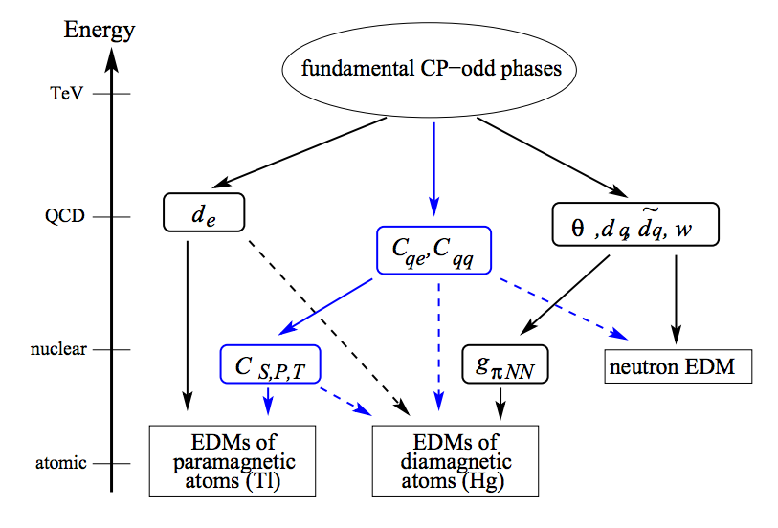
Scales of CP-odd sources and EDM
Pospelov, Ritz

Slide 3
Scales of CP-odd sources and EDM
Pospelov, Ritz
d_{τ}
d_{μ}
Lepton EDM directly proves CP-odd phases at TeV scale (and beyond?)

Slide 4
Lepton EDM limits
Particle | EDM limits (e・cm) | Standard model (e・cm)
e | 1.0×10⁻²⁷ | < 10⁻⁴¹ | ICL Nature 473, 493 (2011)
μ | 1.8×10⁻¹⁹ | < 10⁻³⁸ | BNL E821 PR D 80, 052008 (2009)
τ | 5×10⁻¹⁷ |  | Belle PLB 551, 16 (2003)

Slide 5
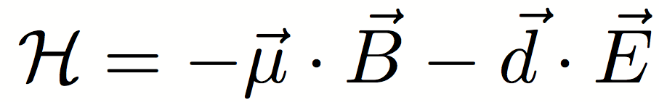
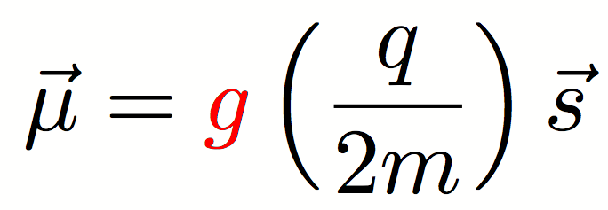
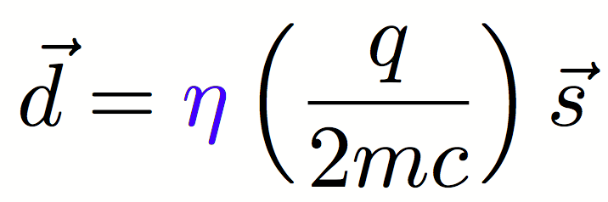
Lepton dipole moments
Interactions with static B and E-fields:
Magnetic Dipole Moment
Electric Dipole Moment
Transition Dipole Moments
cLFV process with photon radiation (e.g. μ→eγ )

Slide 6
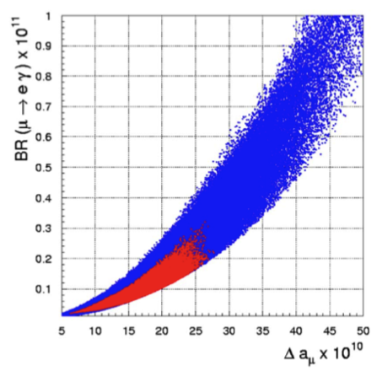
g-2, EDM and cLFV in SUSY
Large g-2 → Large cLFV
G. Isidori, F. Mescia, P. Paradisi, and D. Temes, PRD 75 (2007) 115019
Excluded by MEG
g-2 (BNL E821)
deviation from SM (g-2)

Slide 7
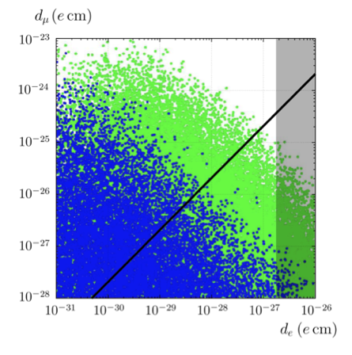
g-2, EDM and cLFV in SUSY
Large g-2 → Large cLFV → Large EDM
J. Hisano, Nagai, Paradisi
Expectation from
linear mass scaling (m_{μ}/m_{e})
muon EDM
(MEG goal)
electron EDM

Slide 8
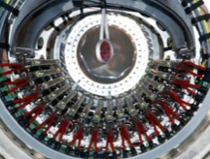
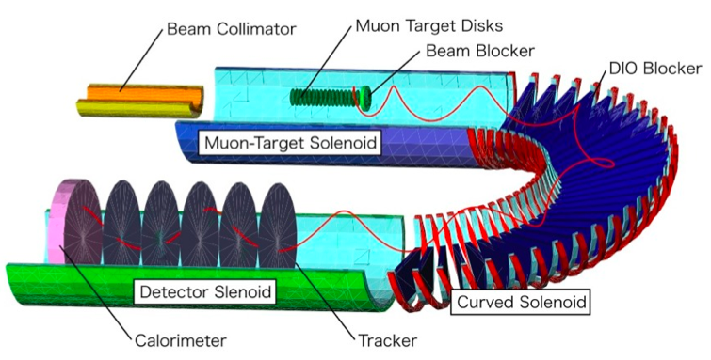
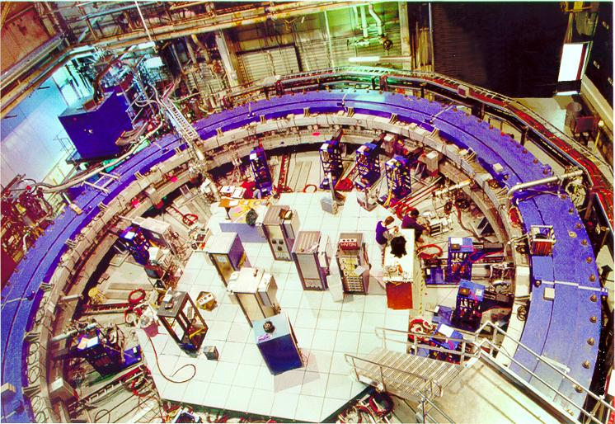
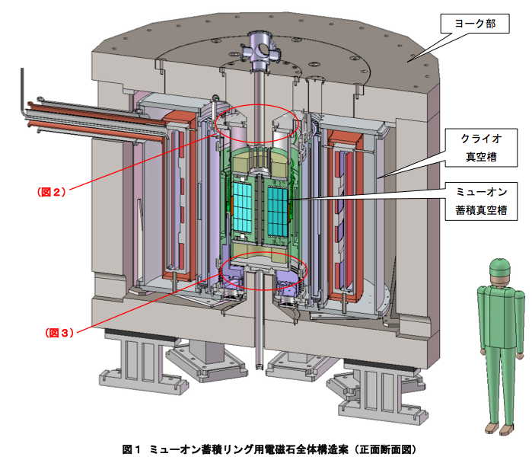
Experimental status
Past - Present
Future
MEG (PSI)
μ→eγ
Renewing upperlimit
Br < 2.4 E-12
Discovery in horizon
μ-e conv :COMET(J-PARC), mu2e (FNAL)
μ→eee (PSI)
LFV
Next stage
g-2/EDM (J-PARC,FNAL)
g-2
E821 (BNL)
g-2
EDM
a_{μ}^{exp} = 11 659 208.9 (6.3) x 10⁻¹⁰ (0.5ppm)
a_{μ}SM = 11 659 182.8 (4.9) x 10⁻¹⁰
a_{μ}^{exp} -a_{μ}SM = +3.3 σ
Hagiwara / Davier et al.
EDM
d_{μ} < 1.8 E-19 e cm (95%CL)

Slide 9
Lepton dipole moments
Interactions with static B and E-fields:
Magnetic Dipole Moment
Electric Dipole Moment
Transition Dipole Moments
cLFV process with photon radiation (e.g. μ→eγ )

Slide 10
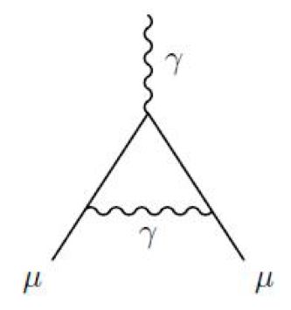
Anomalous magnetic moment
The Lande’s g factor is 2 in tree level (Dirac equation)
In quantum field theory, g factor gets corrections:
Anomalous magnetic moment
g = 2 ( 1 + a_{μ})

Slide 11
Anomalous magnetic moment
All interactions, including ones we don’t know,
appear in quantum loops, and add up to contribute a_{μ}

Slide 12

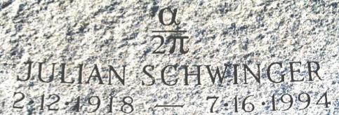
QED contributions to a_{μ}
Leading order correction
(Schwinger term,1948)
From Lepton Moments (World Scientific, 2010)
Julian Schwinger

Slide 13
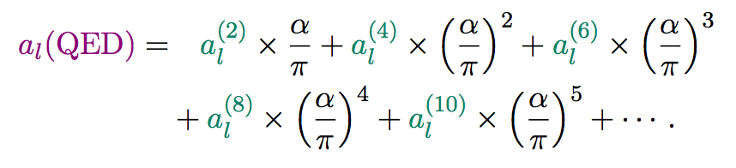
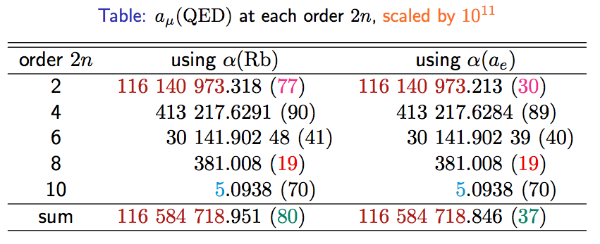
QED contributions to a_{μ} (cont.)
M. Hayakawa (tau2012)
NEW!

Slide 14
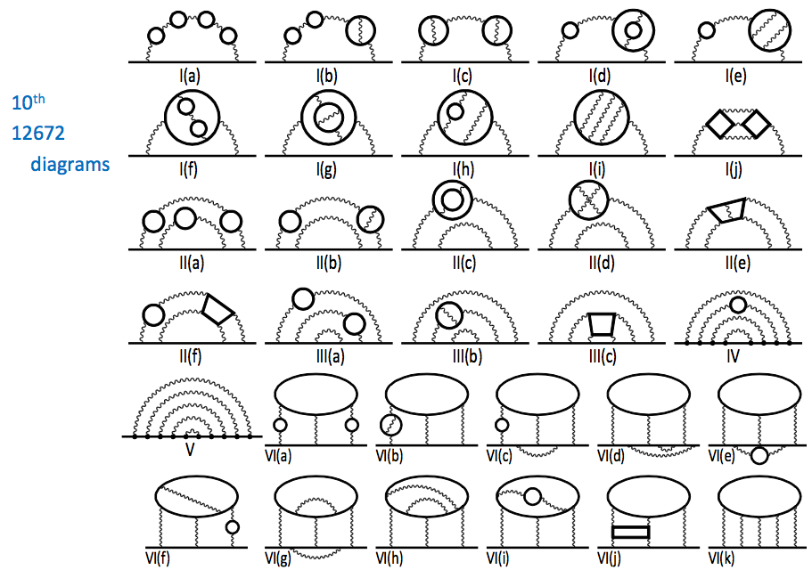
QED contributions to a_{μ} (cont.)
T. Aoyama, M. Hayakawa,
T. Kinoshita, M. Nio (PRL, 2012)

Slide 15
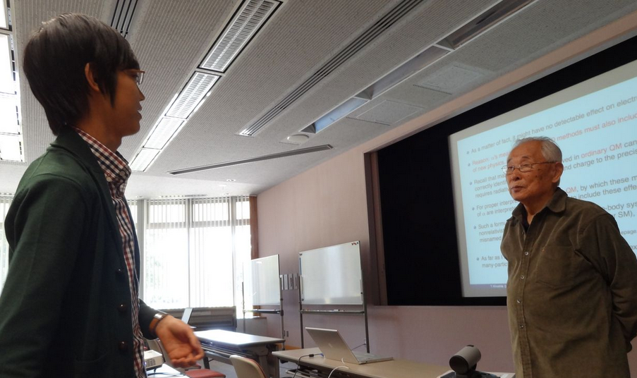
Prof. T. Kinoshita giving a lecture at KEK on 10th order QED corrections
Sohtaro Kanda (U. Tokyo, Master’s course student)
→ tomorrow’s speaker

Slide 16
Hadronic contributions to a_{μ}
An example of
Leading order
hadronic term
π⁻
π⁺
Theory requires inputs to photon-hadron coupling
Accurate data on
“e+e- →γ*→ hadrons” data (VEPP, BaBar, Belle, KLOE…)
has been used.

Slide 17
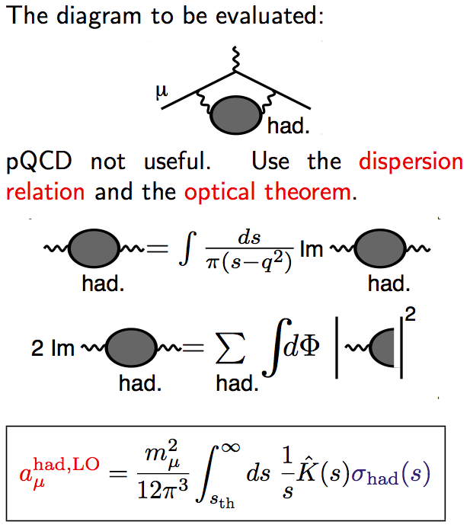
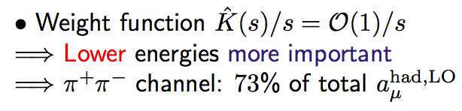
Hadronic contributions to a_{μ}
Coutesy
D. Nomura (tau2012)

Slide 18
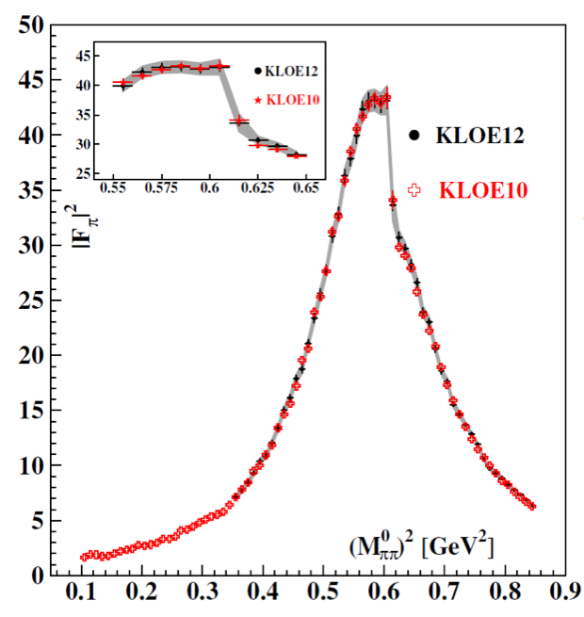
Hadronic contributions to a_{μ}
New data on e⁺e⁻→ π⁺π⁻ from KLOE
G. Mandaglio (tau2012)

Slide 19
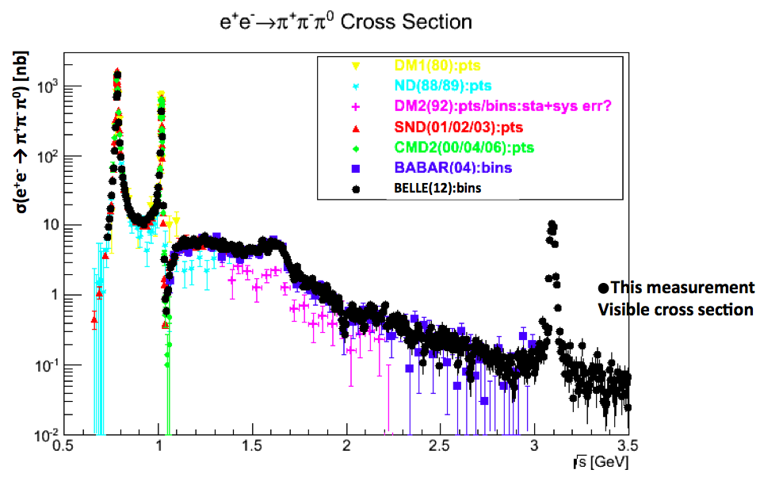
Hadronic contributions to a_{μ}
New data on e⁺e⁻→ π⁺π⁻π⁰ from Belle
J. D. Crnkovic (Tau2012)

Slide 20
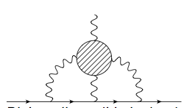
Hadronic contributions to a_{μ}
Lattice efforts making progress by Tom Blum et. al and other groups (UKQCD, ETMC, Mainz).
Lattice is especially important for evaluation of light-by-light term, which no measurement can be done.
Courtesy
Tom Blum

Slide 21
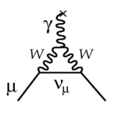
Electro-Weak contributions
Leading order
Electro-Weak loop
Relevant couplings have been accurately measured by the LEP experiments.
Contributions from Higgs-loop appears only in higher order.

Slide 22
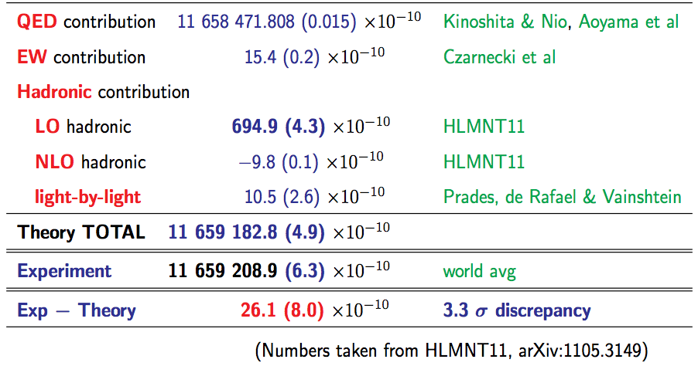
Standard Model prediction for a_{μ}
D. Nomura (tau2012)
in consistent with
DHMZ10
HLMNT11 : J.Phys.G38:085003,2011

Slide 23
Comparison with experiments
D. Nomura (tau2012)
in consistent with
DHMZ10
〜BNL E821 (0.5ppm)
HLMNT11 : J.Phys.G38:085003,2011

Slide 24
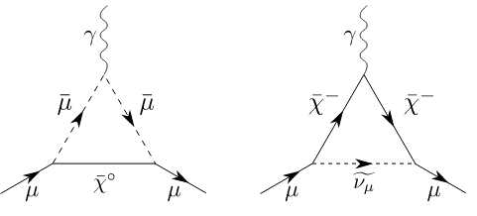

Beyond the standard model
Contributions from SUSY particles
Present uncertainty (exp + SM) : Δa_{μ} = 80 x 10⁻¹¹

Slide 25
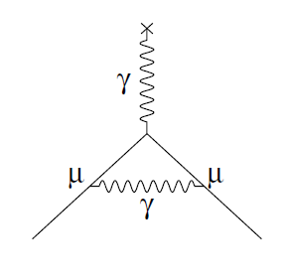
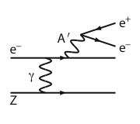
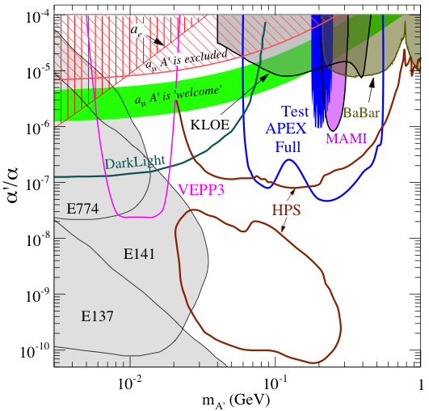
R.D. McKeown, NuFact2012
New Opportunity: Search for A’ at Jefferson Lab
BNL “g-2” expt: Δa_{μ}(expt-thy) = (295±88) x 10⁻¹¹ (3.4 σ)
No evidence for SUSY at LHC (yet)
Another solution: A’, a massive neutral vector boson
- also useful for dark matter models
3 Jefferson Lab proposals:
g – 2 preferred!
APEX test run (Hall A) – published
HPS test run (Hall B) – complete
DarkLight test run (FEL) – July 2012

Slide 26
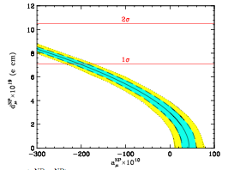
g-2 anomaly isn’t?
If the current deviation is fully from EDM?
  J.L.Feng, K. T. Matchev, Y. Shadmi, NP B613 (2001) 366
E821 exclusion (95% C.L)
G.W. Benett et. al, PRD80 (2009) 052008
d_{μ} x 10¹⁹ (e cm)
Important to push sensitivity of EDM to test this scenario
Δa_{μ} x 10¹⁰

Slide 27
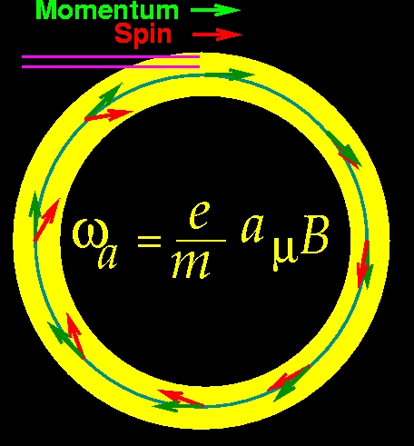
muon g-2/EDM measurements
In uniform magnetic field, muon spin rotates ahead of momentum due to g-2 = 0
a_{μ} (= (g-2)/2 ) is deduced from this residual rotation (precession). In general, spin also rotates due to B_{eff} = β×E and EDM.
general form of spin precession vector:
BNL E821 approach
γ=30 (P=3 GeV/c)
J-PARC approach
E = 0 at any γ
Continuation at FNAL with 0.1ppm precision
Proposed at J-PARC with 0.1ppm precision

Slide 28
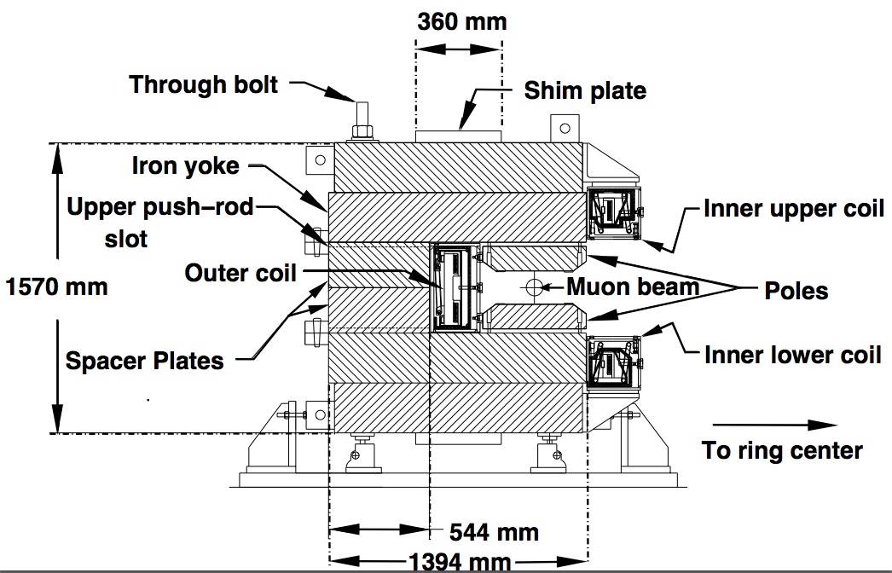
The Experiment at BNL

Slide 29

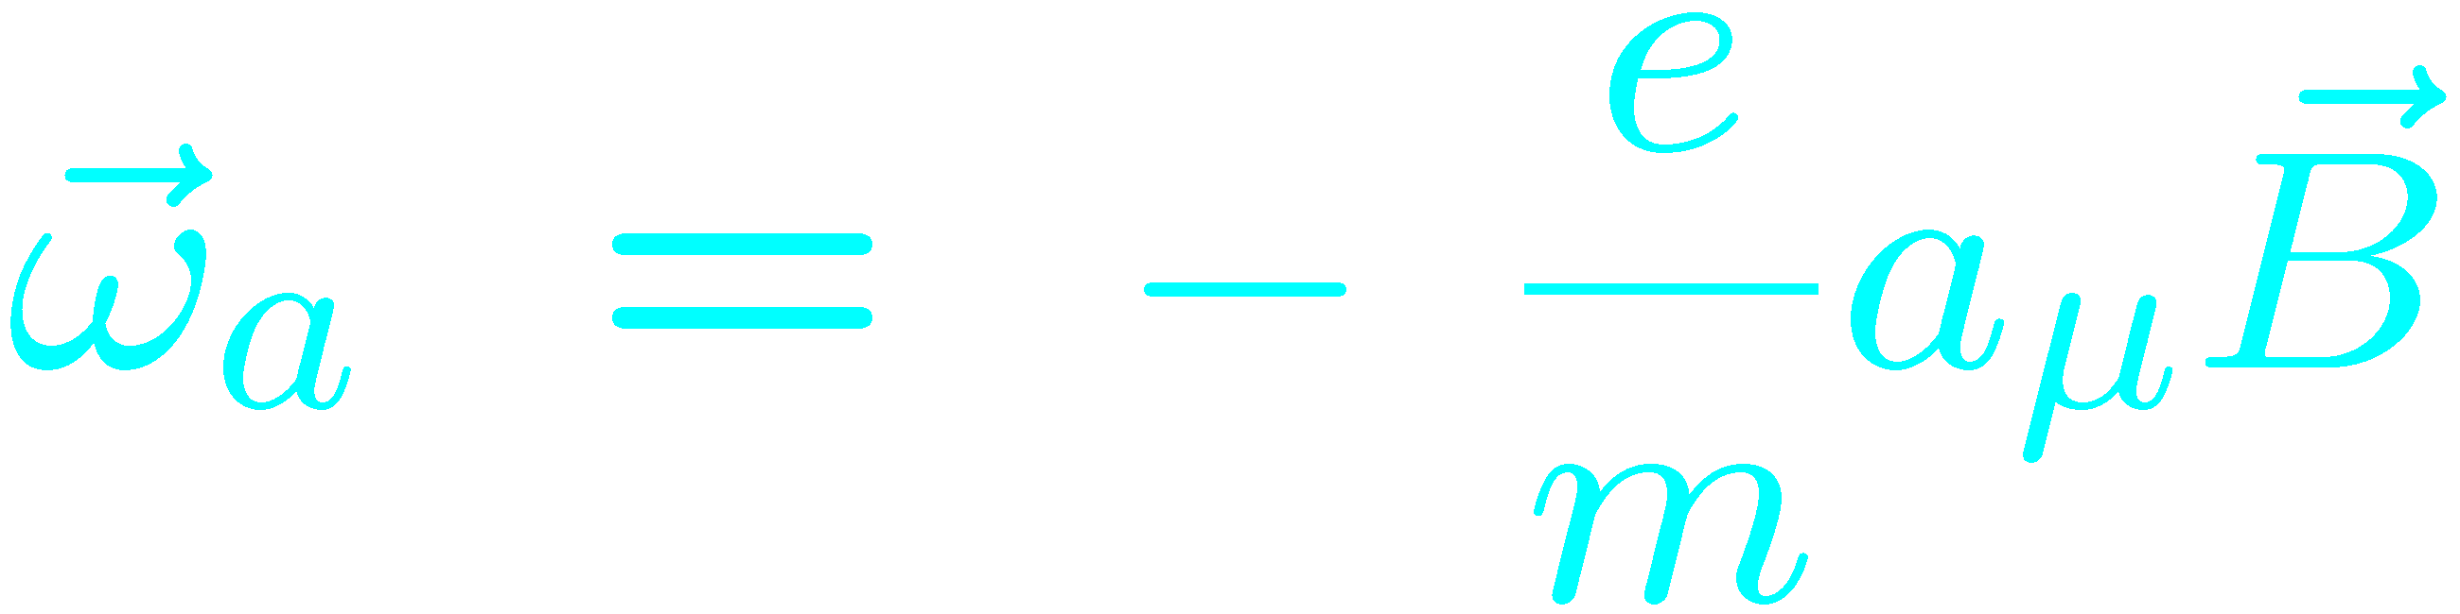
E821 Experimental Technique
25ns bunch of 5 X 10¹² protons from AGS
x_{c} ≈ 77 mm
θ ≈ 10 mrad
B·dl ≈ 0.1 Tm
Pions
Inflector
p = 3.1GeV/c
Target
(1.45T)
Injection orbit
Muon polarization
Muon storage ring
injection & kicking
focus with Electric Quadrupoles
24 electron calorimeters
Central orbit
Storage
ring
Kicker
Modules
R=711.2cm
d=9cm
R
R
θ
Electric Quadrupoles
x_{c}

Slide 30
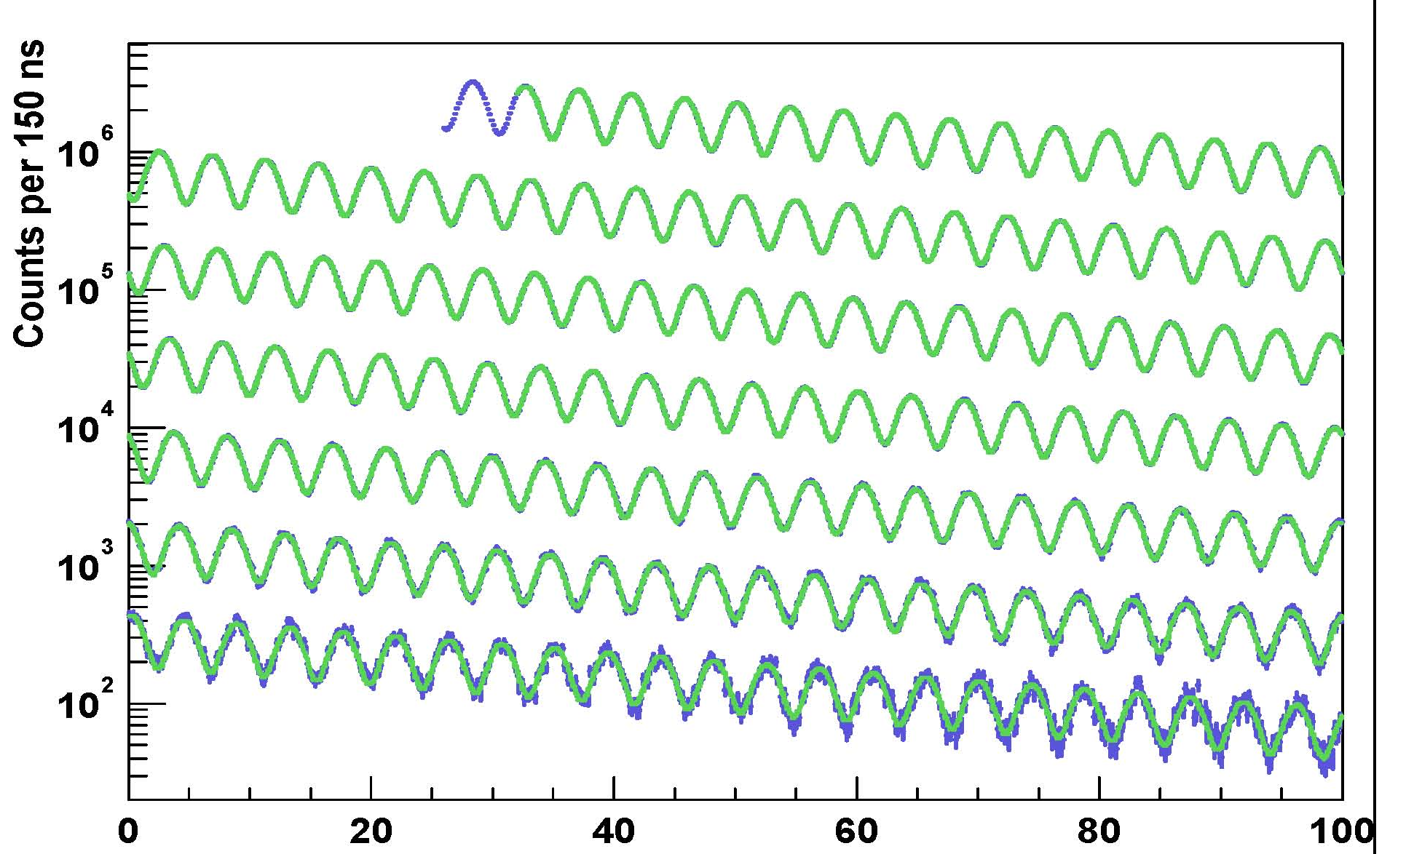
Arrival time spectrum
γτ
0 – 100 μs
100 – 200 μs
200 – 300 μs
300 – 400 μs
400 – 500 μs
500 – 600 μs
600 – 700 μs
Time modulo 100 μs

Slide 31
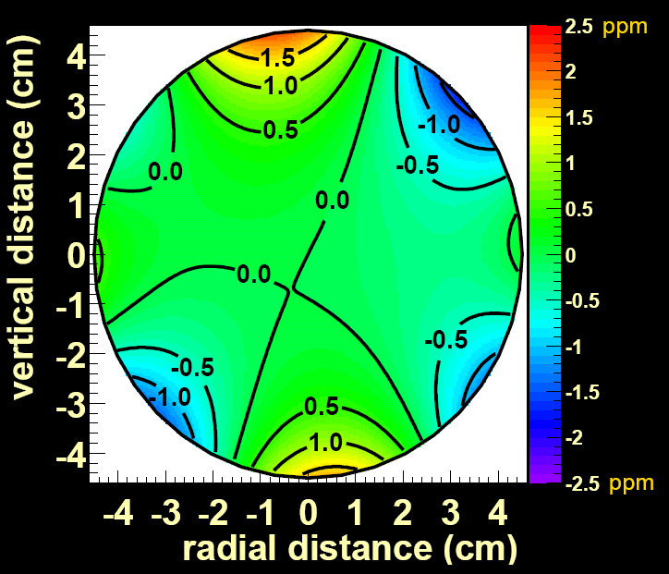

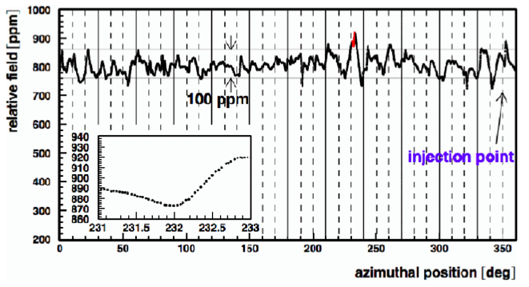
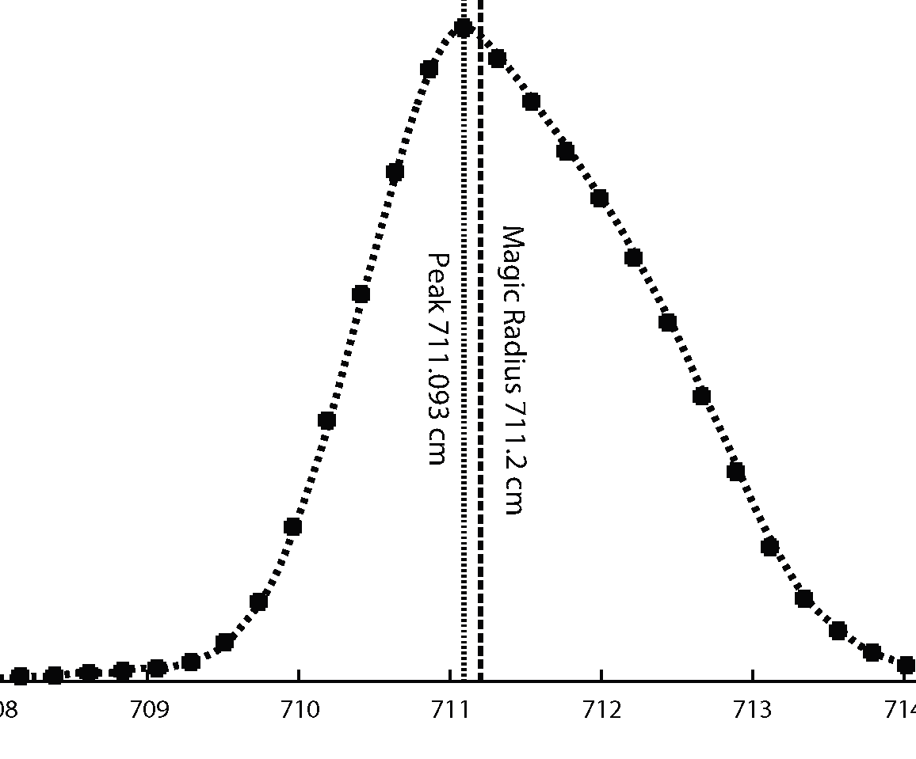
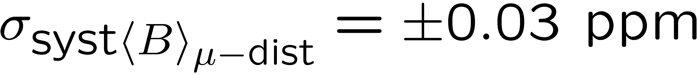
Average field uniformity ± 1 ppm
0.5 ppm contours
dist. of μ equil. radii

Slide 32
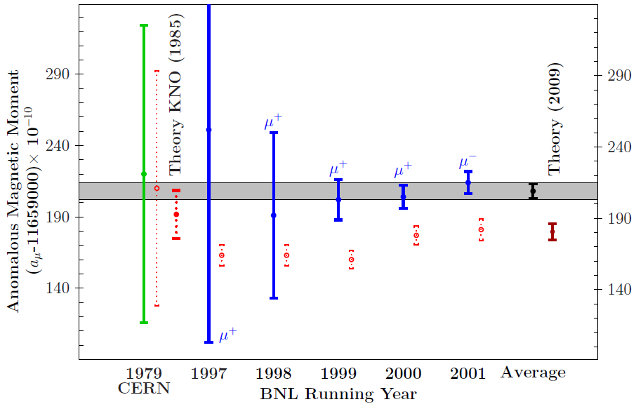
History of g-2 measurements
+e⁺e⁻ data
Experiment
Courtesy F. Jergerlehner, arXiv:0902.3360

Slide 33
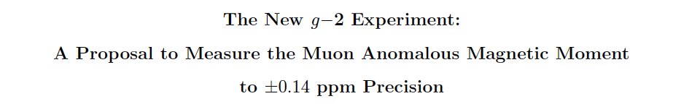
3.3 – 3.6 σ: Theory & Experiment must do better
An experiment
Equal statistical and systematic errors of 0.1 ppm
Experiment: E989 at Fermilab ≥ X4 better
  relocate the storage ring to Fermilab
  use the p-bar debuncher ring (now called the delivery ring) as a 1.9 m long decay line.
Improve on E821 d_{μ} limit by factor of 100
New detectors, electronics; improved B-field equipment muon kicker, etc
CD0 received on September 18, 2012
Building construction will begin in November 2012
Ring transport in 2013 ?
B. Lee Roberts -tau2012-Nagoya – 21 September 2012

Slide 34
muon g-2/EDM measurements
In uniform magnetic field, muon spin rotates ahead of momentum due to g-2 = 0
a_{μ} (= (g-2)/2 ) is deduced from this residual rotation (precession). In general, spin also rotates due to B_{eff} = β×E and EDM.
general form of spin precession vector:
BNL E821 approach
γ=30 (P=3 GeV/c)
J-PARC approach
E = 0 at any γ
Continuation at FNAL with 0.1ppm precision
Proposed at J-PARC with 0.1ppm precision

Slide 35
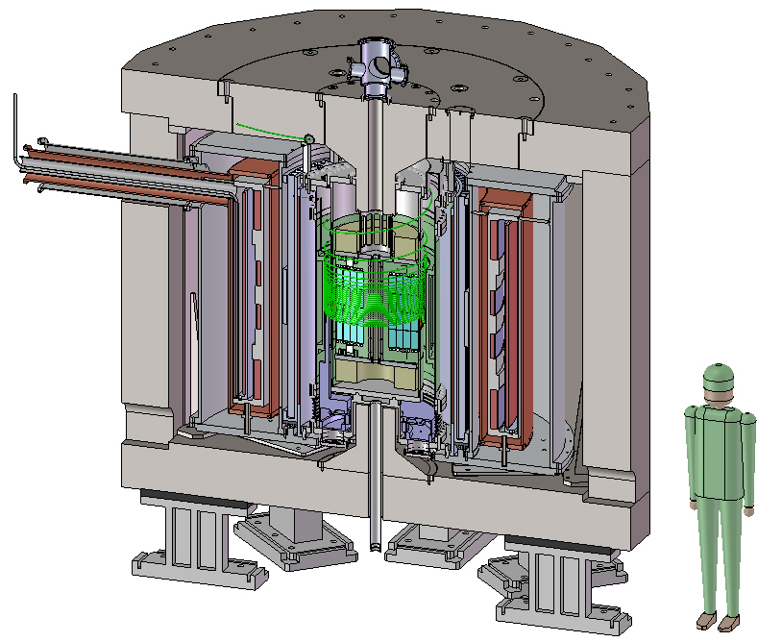
Lower energy and compact storage ring
BNL E821 / FNAL g-2
J-PARC g-2
66cm
14m
P= 3.1 GeV/c , B=1.45 T
P= 0.3 GeV/c , B=3.0 T

Slide 36
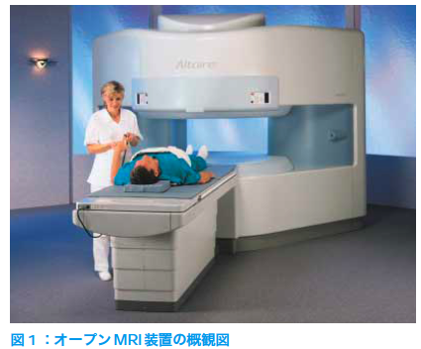
Lower energy and compact storage ring
BNL E821 / FNAL g-2
J-PARC g-2
66cm
14m
P= 3.1 GeV/c , B=1.45 T
P= 0.3 GeV/c , B=3.0 T
Advantages
  Suited for precision control of B-field
    Example : MRI magnet , 1ppm local uniformity
  Spin manipulation of muon beam
    Effective to cancel various systematics
  Completely different systematics than the BNL E821 or FNAL
Hitachi co.

Slide 37
Ultra-cold Muon
Requirement for zero E-field:
Muons should be kept stored without E-focusing
→ Beam with ultra-small transverse dispersion
Δp_{T}/p ~0

Slide 38
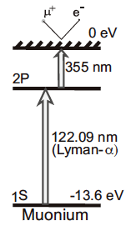
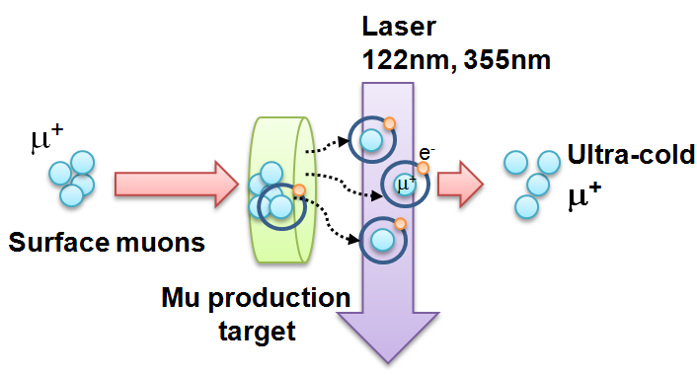
Ultra-cold Muon
Requirement for zero E-field:
Muons should be kept stored without E-focusing
→ Beam with ultra-small transverse dispersion
Δp_{T}/p ~0
Laser resonant ionization of Mu (μ⁺e⁻)
re-acceleration
p =
28MeV/c
3 keV/c
300 MeV/c
Δp_{T}/p ~3 keV / 300 MeV =1E-5

Slide 39
Comparison of experiments
 | BNL-E821 | Fermilab | J-PARC
Muon momentum | 3.09 GeV/c |  | 0.3 GeV/c
gamma | 29.3 |  | 3
Storage field | B=1.45 T |  | 3.0 T
Focusing field | Electric quad |  | Very weak magnetic
# of detected μ+ decays | 5.0E9 | 1.8E11 | 1.5E12
# of detected μ- decays | 3.6E9 | - | -
Precision (stat) | 0.46 ppm | 0.1 ppm | 0.1 ppm

Slide 40
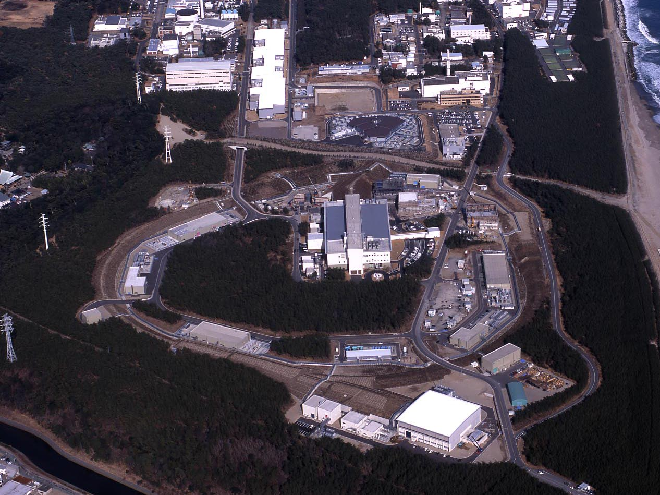
J-PARC Facility
(KEK/JAEA)
LINAC
3 GeV
Synchrotron
Neutrino Beam
To Kamioka
Material and Life Science
Facility
Main Ring
(30 GeV)
Hadron Hall
Bird’s eye photo in Feb. 2008

Slide 41
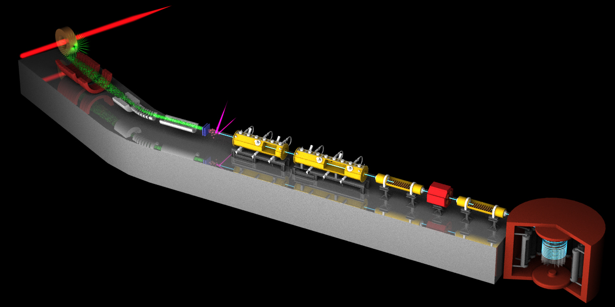
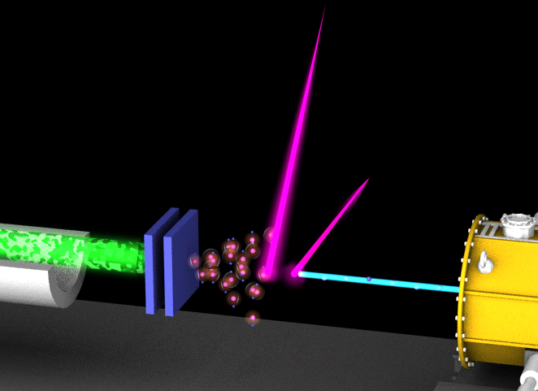
3 GeV proton beam
( 333 uA)
Graphite target
(20 mm)
Surface muon beam
(28 MeV/c, 1-2x10⁸/s)
Muonium Production
(300 K ~ 25 meV⇒2.3 keV/c)
Surface muon
Ultra Cold μ+ Source
Muon
storage
Resonant Laser Ionization of Muonium (~10⁶ μ⁺/s)
Muon LINAC (300 MeV/c)
New Muon g-2/EDM Experiment at
J-PARC with Ultra-Cold Muon Beam

Slide 42
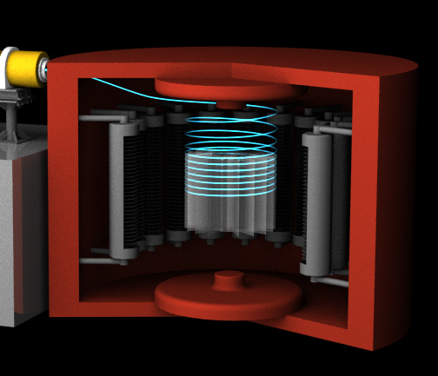
3 GeV proton beam
( 333 uA)
Graphite target
(20 mm)
Silicon Tracker
Surface muon beam
(28 MeV/c, 1-2x10⁸/s)
66 cm diameter
Muonium Production
(300 K ~ 25 meV⇒2.3 keV/c)
Surface muon
Super Precision Magnetic Field
(3T, ~1ppm local precision)
Ultra Cold μ+ Source
Muon
storage
Resonant Laser Ionization of Muonium (~10⁶ μ⁺/s)
Muon LINAC (300 MeV/c)
New Muon g-2/EDM Experiment at
J-PARC with Ultra-Cold Muon Beam

Slide 43
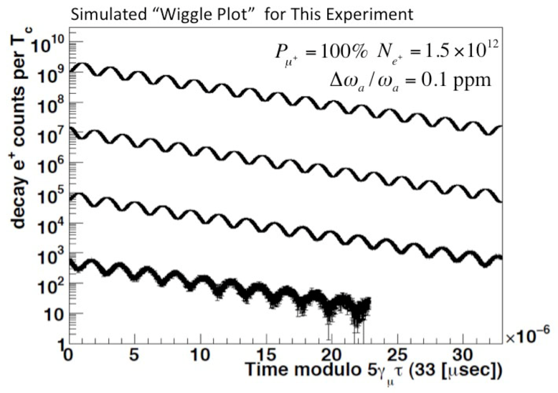
Expected time spectrum of μ→e⁺νν decay
Muon spin precesses with time.
→ number of high energy e⁺ changes with time by the frequency :
p>200 MeV/c
0.1ppm statistical uncertainty
ω
e⁺ decay time (sec)

Slide 44
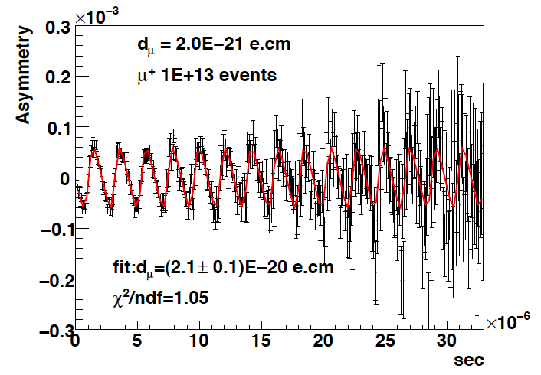
Expected time spectrum of μ→e⁺νν decay
EDM tilts the precession axis.
This yields an up-down decay asymmetry in number of e+
(oscillates with the same frequency ω)
p>200 MeV/c
current upper limit
by BNL E821
1.8 10⁻¹⁹ e・cm
d_{μ}=2E-20 e・cm
Up-down asymmetry
ω
∝EDM
e+ decay time (sec)

Slide 45
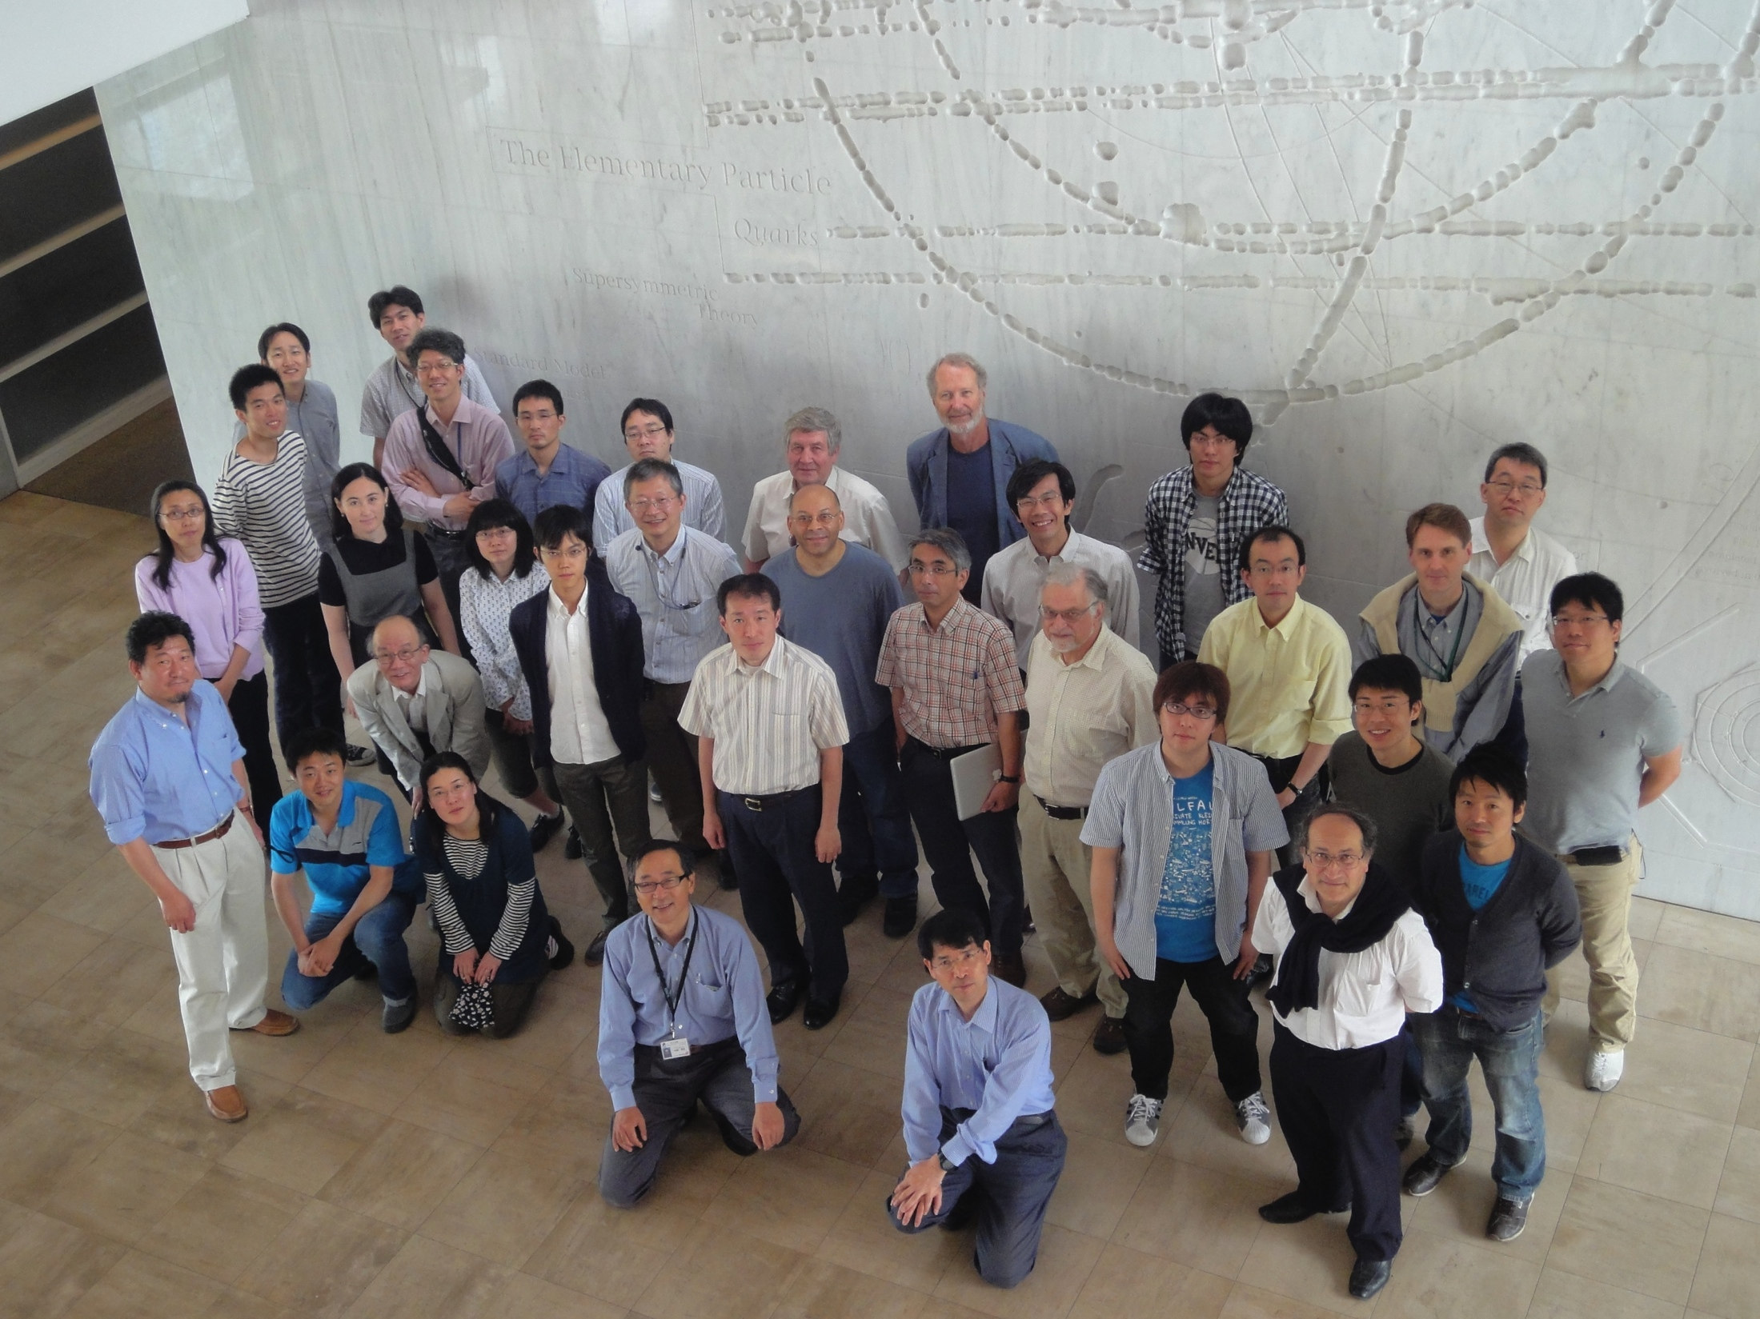
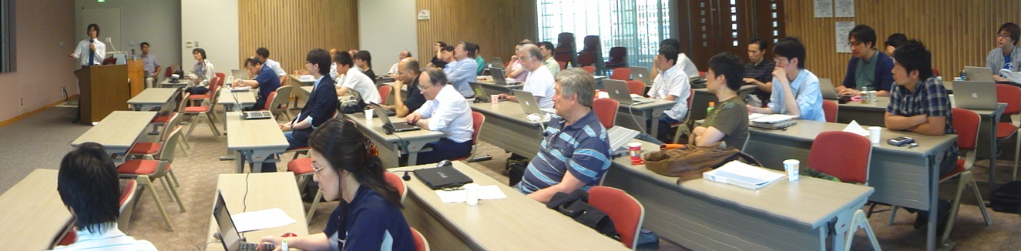
The collaboration
92 members ( …still evolving)
25 Institutions: KEK, RIKEN, U-Tokyo, TRIUMF, BNL, PMCU, CYCRC-Tohoku, Osaka, Rikkyo, TITech, SUNYSB, RAL, UCR, UNM, Victoria
7 countries: Czech, USA, Russia, Japan, UK, Canada, France
Dec 2009 : Proposal submitted
Dec 2012 : CDR submitted
Jan 2012 : Stage-1 status granted from PAC (IMSS,IPNS)
P34 →E34

Slide 46
3 GeV proton beam
( 333 uA)
Graphite target
(20 mm)
Surface muon beam
(28 MeV/c, 1-2x10⁸/s)
Muonium Production
(300 K ~ 25 meV⇒2.3 keV/c)
Surface muon
Ultra Cold μ+ Source
Muon
storage
Resonant Laser Ionization of Muonium (~10⁶ μ⁺/s)
Muon LINAC (300 MeV/c)
New Muon g-2/EDM Experiment at
J-PARC with Ultra-Cold Muon Beam

Slide 47

H-Line construction at J-PARC
Muon production
target (graphite)
H-Line
proton beam
(3 GeV)

Slide 48


H-line construction at J-PARC
Frontend capture solenoids
Bending magnet
Muon
production
target
proton
beam
Capture
solenoids
Bending
magnet
To experimental Area

Slide 49
3 GeV proton beam
( 333 uA)
Graphite target
(20 mm)
Surface muon beam
(28 MeV/c, 1-2x10⁸/s)
Muonium Production
(300 K ~ 25 meV⇒2.3 keV/c)
Surface muon
Ultra Cold μ+ Source
Muon
storage
Resonant Laser Ionization of Muonium (~10⁶ μ⁺/s)
Muon LINAC (300 MeV/c)
New Muon g-2/EDM Experiment at
J-PARC with Ultra-Cold Muon Beam

Slide 50




Development of Mu production target
Silica powders (SiO₂)
  known to be a good Mu emitter at room temp. (e.g. Used in Mu→anti-Mu conv. searches)
  Not self-standing → difficulty in laser ionization.
Silica aerogel
  Similar structure of SiO₂ grain-network. Self-standing!
  New data taken in TRIUMF S1249 experiment in 2010-2011
  Vacuum emission confirmed. Diffusion parameters being extracted.
  Next step → Optimization of structure (porous structure?, c.f. Antognini et al. (PRL108,143401,2012) )
Silica aerogel
(30mg/cc)
● Aerogel 29mg/cc
● BG
2010
2011

Slide 51


Development of Mu production target
Metals
  Thermal emission of Mu (4%) from W at high temperature (T=2000K) (PRL, Mills et al)
  W has been used in laser ionization R&Ds at KEK-MSL and RIKEN-RAL.
  Systematic studies with hot W in progress at RIKEN-RAL with upgraded laser system (K. Yokoyama / D. Tomono et al.)
R&D experiments at J-PARC.
  J-PARC : The world highest pulsed muon source.
  A new apparatus to quickly study the vacuum emission from various material is being commissioned.
  List of materials to be studied:
    Hot W and other metals
    Room temp W coated with alkali-metal (Na, Cs)
    Room temp aerogel …
To be discussed tomorrow by S. Kanda
Heated W foil (RIKEN-RAL)
commissioning at D-Line/J-PARC

Slide 52

Lyman-α Generating System
OMEGA 1 ： High Energy 212.55 nm Laser System
Fiber
Oscillator
Fiber Amp
All-Solid-State
Amplifier
Lyman-α Shifter
2nd ~ 5th HG
ω₁/5 ω₁
Krypton Gas Cell
1062.75 nm
Kr 4p⁵5p
0.1 mJ
1 J
100 mJ
@212.55 nm
ω₂
100 µJ
@Lyman-α
ω₁
ω₁
ω_{Ly-α}
OMEGA 2： Tunable 815-850 nm System
Tunable DFB
Diode Laser
100 mJ
@815-850 nm
Kr 4p⁶
ω_{Ly-α} = 2ω₁ - ω₂
OPG
OPA
Multistage Optical Parametric Process
Y. Oishi 29 Jun. 2012

Slide 53




Lyman-α Generating System
OMEGA 1 ： High Energy 212.55 nm Laser System
Fiber
Oscillator
Fiber Amp
All-Solid-State
Amplifier
Lyman-α Shifter
2nd ~ 5th HG
ω₁/5 ω₁
Krypton Gas Cell
1062.75 nm
Kr 4p⁵5p
0.1 mJ
1 J
100 mJ
@212.55 nm
ω₂
100 µJ
@Lyman-α
ω₁
ω₁
ω_{Ly-α}
OMEGA 2： Tunable 815-850 nm System
Tunable DFB
Diode Laser
100 mJ
@815-850 nm
Kr 4p⁶
ω_{Ly-α} = 2ω₁ - ω₂
OPG
OPA
Multistage Optical Parametric Process
Generation of high power Lyman-α is being tested at RIKEN.
Laser ionization of Mu to be tested at U-line/J-PARC in this year.
Y. Oishi 29 Jun. 2012

Slide 54
3 GeV proton beam
( 333 uA)
Graphite target
(20 mm)
Surface muon beam
(28 MeV/c, 1-2x10⁸/s)
Muonium Production
(300 K ~ 25 meV⇒2.3 keV/c)
Surface muon
Ultra Cold μ+ Source
Muon
storage
Resonant Laser Ionization of Muonium (~10⁶ μ⁺/s)
Muon LINAC (300 MeV/c)
New Muon g-2/EDM Experiment at
J-PARC with Ultra-Cold Muon Beam

Slide 55



Muon acceleration
0.34 MeV
β≈0.08
1.2
β≈0.15
5.1
β≈0.3
13.8
β≈0.46
42.3 MeV
β≈0.7
200 MeV
β≈0.94
μ⁺ →
RFQ
IH
IH
(IH, CDS, DAW … ?)
Disk loaded structure
Initial Acc.
Low-β
Middle-β
High-β
RFQ
IH linac
Disk loaded structure
J-PARC proton RFQ
IH structure (TITech)
KEKB electron linac
KEKB/J-PARC accelerator group + TITech + Kyoto
Beam simulations in progress. Muon acceleration test being planned at J-PARC

Slide 56
3 GeV proton beam
( 333 uA)
Graphite target
(20 mm)
Surface muon beam
(28 MeV/c, 1-2x10⁸/s)
Muonium Production
(300 K ~ 25 meV⇒2.3 keV/c)
Surface muon
Ultra Cold μ+ Source
Muon
storage
Resonant Laser Ionization of Muonium (~10⁶ μ⁺/s)
Muon LINAC (300 MeV/c)
New Muon g-2/EDM Experiment at
J-PARC with Ultra-Cold Muon Beam

Slide 57
Muon storage magnet and detector
Iron yoke
Cryogenics
Muon storage orbit
2900 mm
e+ tracking
detector
Super conducting coils
666 mm
Magnetic field： B=3T
local uniformity 1ppm
+very weak magnetic focusing (n~10⁻⁵, 1ppm/cm)

Slide 58


Spiral injection
LINAC+ beam transport
μ⁺ beam
OPERA-3D model
Iron yoke
Tunnel
Pole tip
Iron yoke
Main coil
Ray-tracing with G4 and magnet design in progress.
Acceptance has been evaluated with 3D B-field map.
mechanical structure of
vacuum chamber
H. Iinuma, H. Nakayama

Slide 59


Vertical kicker
Vertical kicker is to stop muon beam in the muon storage area
Bkick(t)=B_{peak} ×sin(ωt)
ω=π/Tkick
Stop beam vertical motion 7~9mrad
B_{peak} =1~10 gauss
Tkick=150 nsec (~20 turns of muon)
Uniformity ~1%
Pulsed current
Full scale test coil
Muon
storage
orbit
Kick
2 pairs of coil
H. Iinuma, H. Nakayama

Slide 60


Muon storage magnet and detector
Iron yoke
Cryogenics
Muon storage orbit
2900 mm
Radial tracking vanes (Silicon strip)
e+ tracking
detector
Super conducting coils
Positron track
μ decay
vertex
666 mm
60
60
60
p(e+) > 200 MeV/c

Slide 61



Silicon strip tracker
Detector module
Tracking e+ from muon decay (p = 200-300 MeV/c)
No contamination of B-field (< 1ppm) and E-field (<10mV/cm) in the muon storage region.
Efficient and stable over ~5 lifetime (33μs)
  Instantaneous rate changes by two orders of magnitude.
  Flipping spin of muon will cancel rate effect in the leading order.
Frontend
electronics
Silicon sensors
400mm
G4 simulation
K. Ueno
Efficiency of
single track finding
● Exact match
● Partial match
Number of vanes: 24-48
Elapsed time (μs)

Slide 62





Silicon-strip detector development
Test detector module (KEK)
  Studies on rate effects
  Impact to precision B-field
Frontend ASICs under development (KEK)
Software development (KEK-RIKEN-LPNHE)
T. Kakurai
Requirement (<10%)
62

Slide 63






Measured magnetic moment of detector components
ΔB/B @100mm
10ppm
1ppm
0.1ppm

Slide 64
Milestones
M1) Demonstration of the ultra-cold muon production with the required conversion efficiency leading to an intensity of 1×10⁶µ⁺/s.
M2) Muon acceleration tests with the baseline configuration of low-β muon LINAC, i.e. RFQ, and IH LINAC.
M3) Tests of the spiral injection scheme.
M4) Production of a prototype magnet and development of the field monitor with the required precision.
M5) Demonstration of rate capability of the detector system for decay positron detection.

Slide 65
Summary
J-PARC muon g-2/EDM experiment
  Precision measurement of muon g-2 (0.1ppm)
  Search for muon EDM (sensitivity< 10⁻²⁰ e・cm)
Project status
  Conceptual Design Report was released.
  Stage-1 status granted from PAC (IMSS, IPNS)
  H-Line construction has started.
  R&Ds in progress for all areas of the project
  Experiment can be started in 5 years (technically driven schedule)

Slide 66

J-PARC Material and Life science Facility
U-Line
S-Line
D-Line
Material and Life Science
Facility
g-2/EDM shares beamline with DeeMe (muon cLFV search) and Mu-HFS
Bird’s eye photo in Feb. 2008

