Slide 1

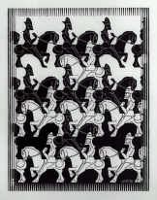
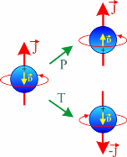

CP VIOLATION IN ELEMENTARY PARTICLES AND COMPOSITE SYSTEMS PCPV 2013, Mahabaleshwar, India February 2013
Radium Atoms to search for EDMs
  Symmetries & Conservation Laws
  Standard Model and Beyond
  Search for New Interactions
  Questions : Matter-Antimatter Asymmetry ?
  Precision Experiments
  ⇒ Field has many Experiments
  ⇒ here Focus on: Ra, Xe, μ
  ⇒ A few examples only
  ⇒ A few aspects of the full story
Klaus Jungmann, KVI, University of Groningen, NL
with many thanks to L. Willmann
Notes:
Title

Slide 2

Standard Model
&
Radium
3 families of matter - 4 force carriers

Slide 3
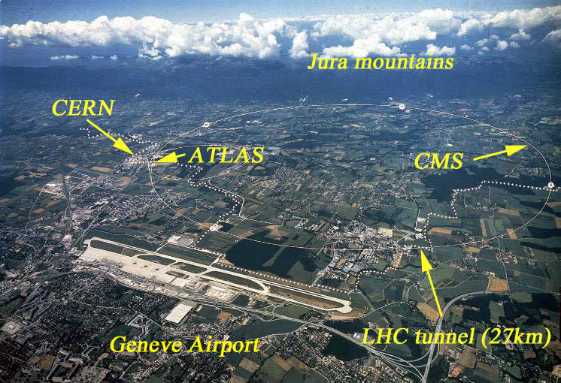
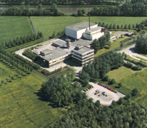
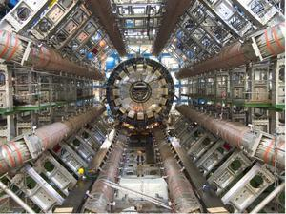
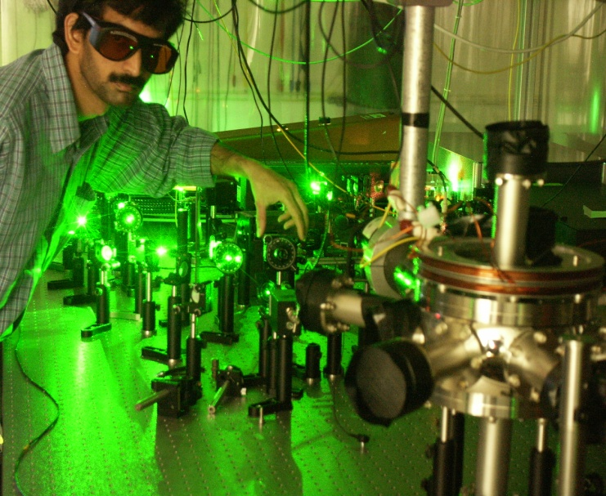
Experiments at the Frontiers of Standard Theory
Direct Search Frontier
Precision Frontier
complementary
approaches
⇔
⇔
⇔
Intensity
Frontier

Slide 4
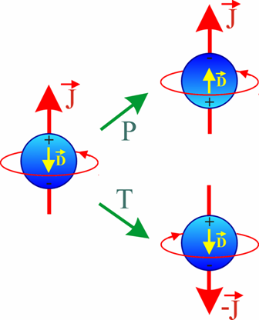
Permanent Electric Dipole Moment
violates:
Parity
Time reversal
CP- conservation
(if CPT conservation assumed)`
Standard Model value orders of magnitude
below experimental limit:
Window for
New Physics
beyond
Standard Theory

Slide 5
Permanent Electric Dipole Moment
violates:
Parity
Time reversal
CP- conservation
(if CPT conservation assumed)`
Atoms are paticularly interesting:
‘simple’ structure
large enhancements possible
well established AMO techniques
(constantly being improved)
world record values, e.g. in ¹⁹⁹Hg

Slide 6
Lines of attack towards an EDM
Free Particles
neutron
muon
proton
deuteron
bare nuclei ?
…
Hg Xe
Tl
Cs Rb
Ra Rn
…
Atoms
particle EDM
unique information
new insights
new techniques
→ challenging
technology
electron EDM
nuclear EDM
enhancements
challenging
technology
Electric
Dipole
Moment
goal:
new source of CP
electron EDM
strong enhancements
new techniques
poor spectroscopic
data
electron EDM
strong enhancements
systematics ??
YbF
PbO
PbF ,ThO
HfF⁺,ThF⁺
WN⁻…
garnets
(Gd₃Ga₅O₁₂)
(Gd₃Fe₂Fe₃O₁₂)
solid He ?
liquid Xe
Condensed State
Molecules

Slide 7
EDM Limits as of end 2012
- Why so many ?
- Which is THE BEST candidate to choose ?
Theoretical Model | d_{e} [e cm]
Standard Model | < 10⁻³⁸
SUSY | 10⁻²⁸ – 10⁻²⁶
Multi Higgs | 10⁻²⁸ – 10⁻²⁶
LeftRight Symmetry | 10⁻²⁸ – 10⁻²⁶
None is THE BEST - We need many experiments!

Slide 8
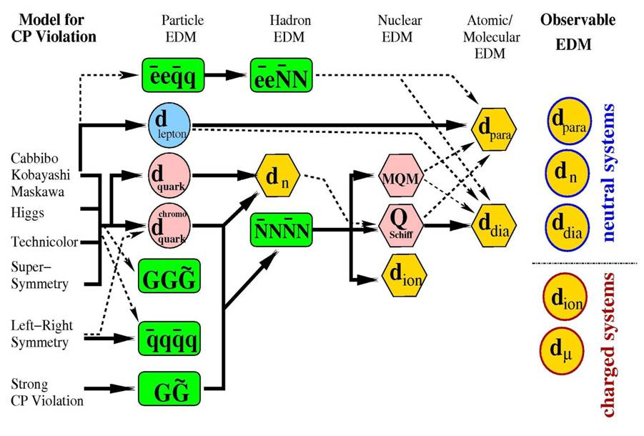
Possible Sources of EDMs
The best experiment until now- ¹⁹⁹Hg @Seattle –
Leaves somewhat restricted room for SUSY …

Slide 9
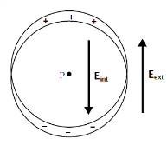

Enhancements of particle EDMs
P. Sandars, 1968
go for heavy systems, where Z>>1, e.g. Hg, Xe
take advantage of enhancements, e.g. Ra
consider molecules such as YbF, RaF, …

Slide 10
Atomic Enhancement Factors
for Electron EDM
Particle |  | Rb | Cs | Th | Fr | Ra | PbO | YbF
Enhancement |  | 24 | 125 | 585 | 1 150 | 40 000 | 60 000 | 1 600 000

Slide 11
EDMs of atoms of experimental interest
Z | Atom | [S/(e fm3)]e cm | [10⁻²⁵ η] e cm | Expt.
2 | ³He | 0.00008 | 0.0005
54 | ¹²⁹Xe | 0.38 | 0.7 | Seattle, Ann Arbor, Princeton,Tokyo, Mainz-PTB-HD-KVI
70 | ¹⁷¹Yb | -1.9 | 3 | Bangalore,Kyoto
80 | ¹⁹⁹Hg | -2.8 | 4 | Seattle
86 | ²²³Rn | 3.3 | 3300 | TRIUMF
88 | ²²⁵Ra | -8.2 | 2500 | Argonne,KVI
88 | ²²³Ra | -8.2 | 3400
KVI
KVI
slide from Victor Flambaum

Slide 12
R coefficient in Neutron decay
Goal: 0.5%
Nuclei (⁸Li):
R = -0.0009(22)
Final State Interaction ~7⋅10⁻⁴
R coefficient and
EDMs similar sensitive to
New Physics

Slide 13
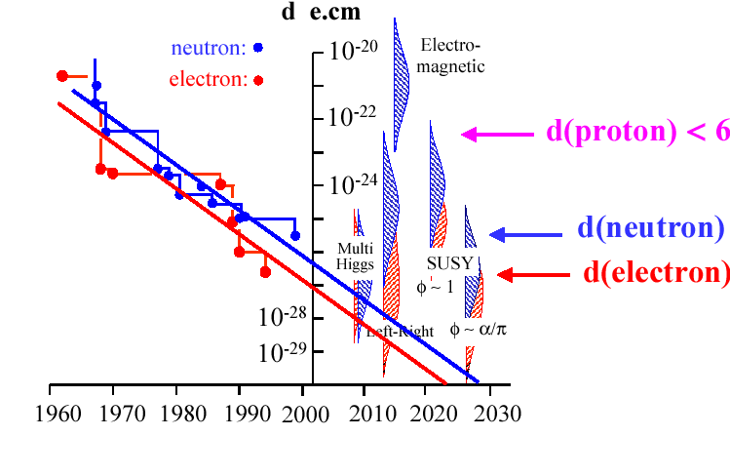
Limit on EDMs vs Time
molecules
¹⁹⁹Hg (2009)
•
goal ¹²⁹Xe
²¹³Ra
d_{e} (SM) < 10⁻³⁷

Slide 14
Generic EDM Experiment
Preparation
of
“pure“ J state
Interaction
with
E - field
Analysis
of
state
η contains all physics –
“e cm” values by themselves
not very helpful
μ_{x}= eħ/2m_{x}
Polarization
Spin Rotation
Determination
of Ensemble
Spin average
Electric Dipole Moment: d = η μ_{x} c⁻¹ J
Spin precession : ω_{e} =
d•Ε Ε×J
h |Ε×J |
Example: d=10⁻²⁴ e cm, E=100 kV/cm, J=1/2
ω_{e} = 15.2 mHz

Slide 15
Generic EDM Experiment Sensitivity
P Polarization
ε Efficiency
N Average Trap Population
T Measurement Time [s]
Spin Coherence Time (≅ 1cycle) [s]
E Electric Field [V/cm]
~1
~1
10⁶
10⁶
1 s
10⁵ V/cm
Need to understand systematics
h
δ d =
< ~10⁻²⁸ e cm
P ε √ N *T* τ Ε
⇒ Work on
  high Polarization , high Field
  high Efficiency
  long Coherence Time
one day gives more statistics than needed to
reach previous experimental limits
d_{x} = d_{Ra} /enhancement
same physics sensitivity as ¹⁹⁹Hg due to enhancement factors

Slide 16
Enhancements of particle EDMs
go for heavy systems, where Z>>1, e.g. Hg, Xe
take advantage of enhancements, e.g. Ra

Slide 17
EDMs of atoms of experimental interest
Z | Atom | [S/(e fm3)]e cm | [10⁻²⁵ η] e cm | Expt.
2 | ³He | 0.00008 | 0.0005
54 | ¹²⁹Xe | 0.38 | 0.7 | Seattle, Ann Arbor, Princeton,Tokyo, Mainz-PTB-HD-KVI
70 | ¹⁷¹Yb | -1.9 | 3 | Bangalore,Kyoto
80 | ¹⁹⁹Hg | -2.8 | 4 | Seattle
86 | ²²³Rn | 3.3 | 3300 | TRIUMF
88 | ²²⁵Ra | -8.2 | 2500 | Argonne,KVI
88 | ²²³Ra | -8.2 | 3400
d_{n} = 5 x 10⁻²⁴ e cm η, d(³He)/ d_{n} = 10⁻⁵
slide from Victor Flambaum

Slide 18
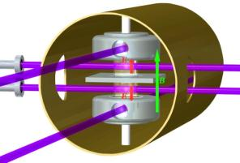
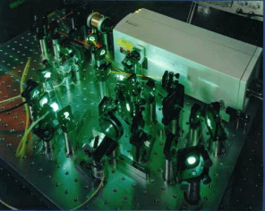
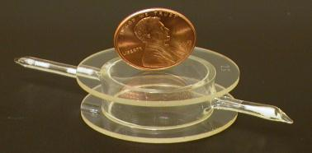
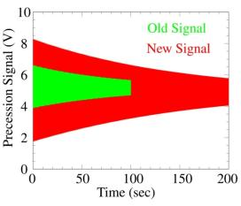
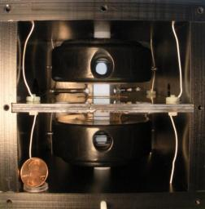
Hg EDM University of Washington, Seattle
ω₁
ω₂
E
ω₃
E
ω₄
Spin coherence time: 300 sec
Electrical Resistance: 2×10¹⁶ Ω

Slide 19
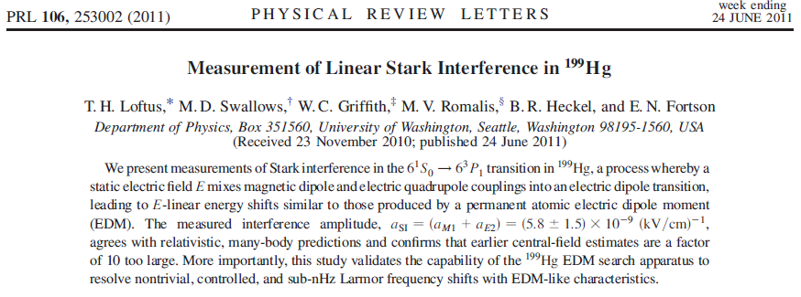
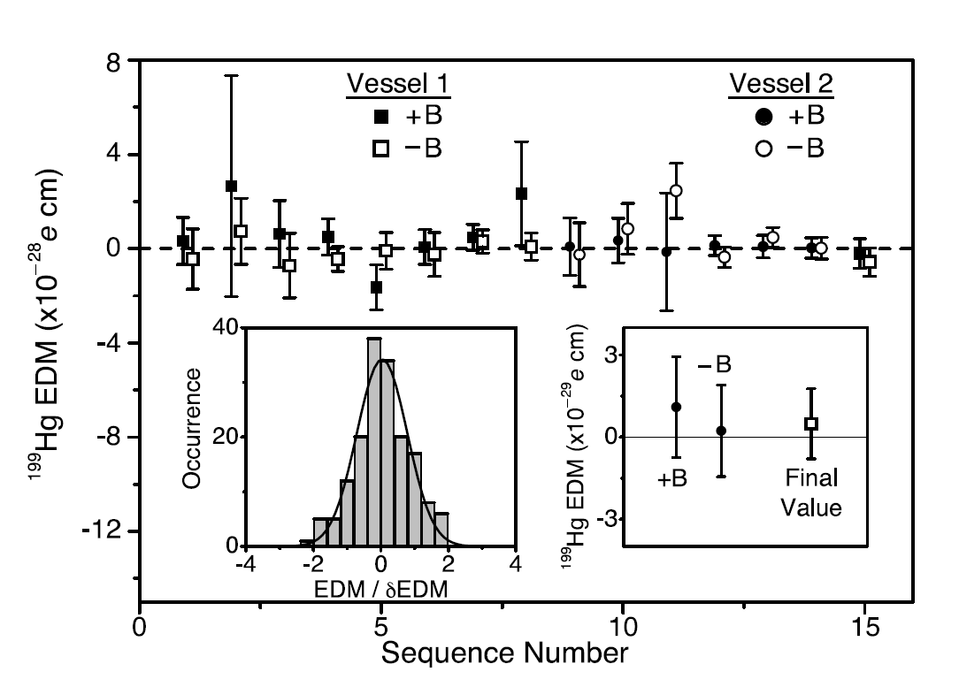
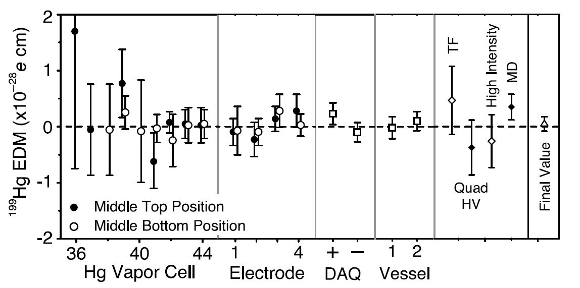
Hg EDM University of Washington, Seattle II
1 year data ⇒ factor 7 improvement
⇒ Going on in a structured way
d(¹⁹⁹Hg) = (0.49±1.29_{stat}±0.76_{syst})×10⁻²⁹ e cm
translates into
|d(¹⁹⁹Hg)| < 3.1×10⁻²⁹ e cm (95% C.L.)
Systematic limits expected factor of 5 further lower
W. C. Griffith, M. D. Swallows, T. H. Loftus, M. V. Romalis, B. R. Heckel, E. N. Fortson , Phys. Rev. Lett. 102, 101601 (2009)

Slide 20
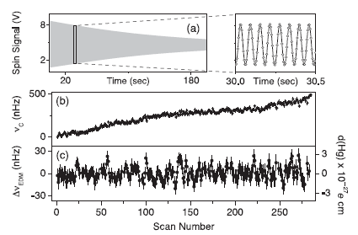
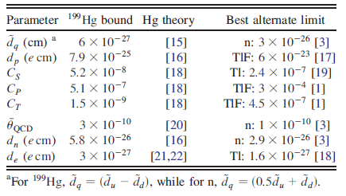
clean analysis
extraction of
various limits
from two-electron
atom EDM limits

Slide 21
EDMs of atoms of experimental interest
Z | Atom | [S/(e fm3)]e cm | [10⁻²⁵ η] e cm | Expt.
2 | ³He | 0.00008 | 0.0005
54 | ¹²⁹Xe | 0.38 | 0.7 | Seattle, Ann Arbor, Princeton,Tokyo, Mainz-PTB-HD-KVI
70 | ¹⁷¹Yb | -1.9 | 3 | Bangalore,Kyoto
80 | ¹⁹⁹Hg | -2.8 | 4 | Seattle
86 | ²²³Rn | 3.3 | 3300 | TRIUMF
88 | ²²⁵Ra | -8.2 | 2500 | Argonne,KVI
88 | ²²³Ra | -8.2 | 3400
KVI
d_{n} = 5 x 10⁻²⁴ e cm η, d(³He)/ d_{n} = 10⁻⁵
slide from Victor Flambaum

Slide 22
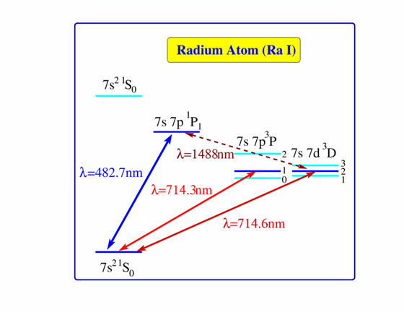
TRIμP
Radium Permanent Electric Dipole Moment
Benefits of Radium
near degeneracy of ³P₁ and ³D₂
⇒ ~ 40 000 enhancement
some nuclei strongly deformed
⇒ nuclear enhancement
50~1000 (?is Schiff operator correct?)
6
³D : electron spins parallel
⇒ electron EDM
¹S : electron Spins anti-parallel
⇒ atomic / nuclear EDM
Ra also interesting for weak interaction effects
  Anapole moment, weak charge
(Dzuba el al., PRA 6, 062509)

Slide 23
Deformed Nuclei
Enhancement of Dipole Moments

Slide 24
IS475 @ ISOLDE
Measurements of octupole collectivity in
odd-mass Rn, Fr and Ra isotopes
CERN-ISOLDE (J. Pakarinen, T. Stora, D. Voulot, F.Wenander),TU Darmstadt (Th. Kröll),GANIL (E. Clément), U Groningen KVI (K. Jungmann, J. Van de Walle, L. Willmann, H.W. Wilschut),U Jyväskylä (T. Grahn, P. T. Greenlees, R. Julin, P. Nieminen),U Kentucky (S.W. Yates),U Köln (A. Blazhev, N. Warr),Lawrence Livermore L (E. Kwan, M. A. Stoyer, C.-Y. Wu),KU Leuven (M. Huyse, P. Van Duppen),U Liverpool (P.A. Butler, R.-D. Herzberg, D.T. Joss, R.D. Page, P. Papadakis, M.Scheck),U Lund (J. Cederkäll),U Michigan (T. Chupp, W. Lorenzon),TU München (V. Bildstein, R. Gernhäuser, R. Krücken, D. Muecher, N. Nowak, K.Wimmer),U Oslo (A.Bürger, M. Guttormsen, A.-C. Larsen, H.T.Nyhus, S. Siem, H.Toft, G. Tveten),U Rochester (D. Cline, A. Hayes),HIL U Warsaw (K. Hadynska-Klek, J. Iwanicki, P. Napiorkowski, D. Pietak, J. Srebrny, K. Wrzosek-Lipska, M. Zielinska),U West Scotland (A. Andreyev, J.F. Smith)
Spokesperson: P.A.Butler (Liverpool)
Abstract
It is proposed to study octupole correlations in odd-mass Rn, Fr and Ra
isotopes using Coulomb excitation at 4.5-5 MeV.A. These data are
necessary to interpret EDM measurements in terms of time-reversal
violating interactions.
First Beamtime@ISOLDE 2012 on ²²¹Rn

Slide 25
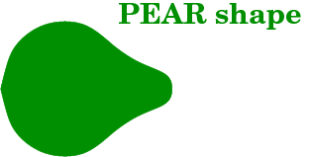

B(E3,0⁺  3⁻) in ²²⁴Ra?
Octupole collectivity – Macroscopic
ISOLDE IS475
Multipole expansion of the shape:
2^{L}-pole and L=3 ⇒ Octupole

Slide 26
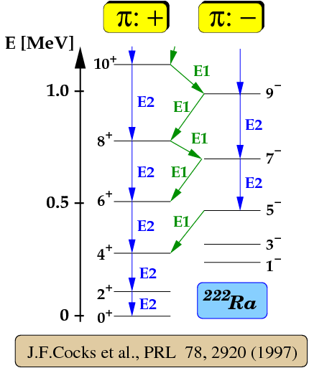
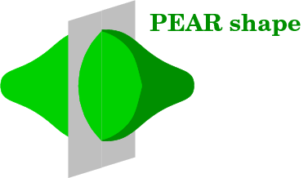
B(E3,0⁺  3⁻) in ²²⁴Ra?
Octupole collectivity – Macroscopic
ISOLDE IS475
Multipole expansion of the shape:
2^{L}-pole and L=3 ⇒ Octupole
Reflection Asymmetric

Slide 27
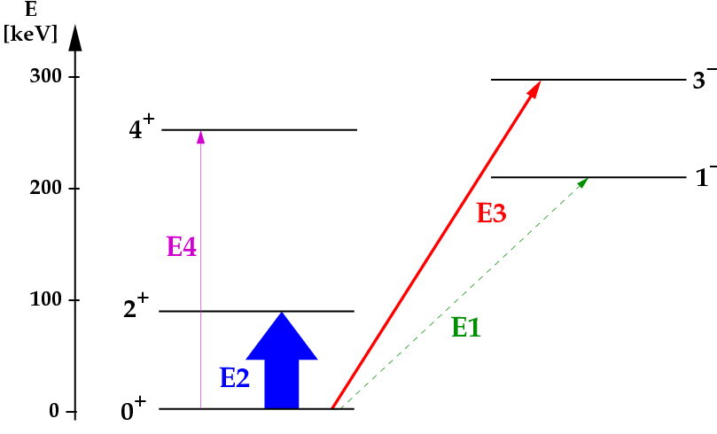
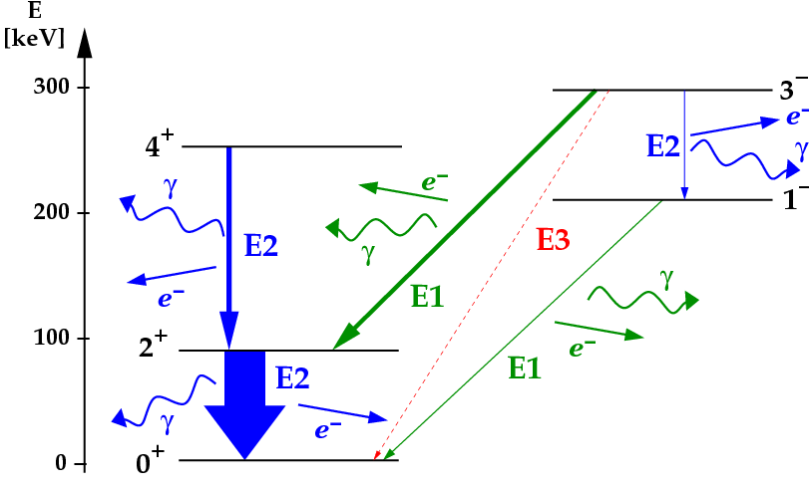
Measure B(E3,0⁺3⁻) strengths
Why Coulomb excitation?
ISOLDE IS475
Excitation-process
Decay-process
E1 10⁴-10⁶x more probable
Principle:
Populate 3⁻ level with E3 in Coulex ⇒ observe E1(and E2) decay γ ray(s)

Slide 28
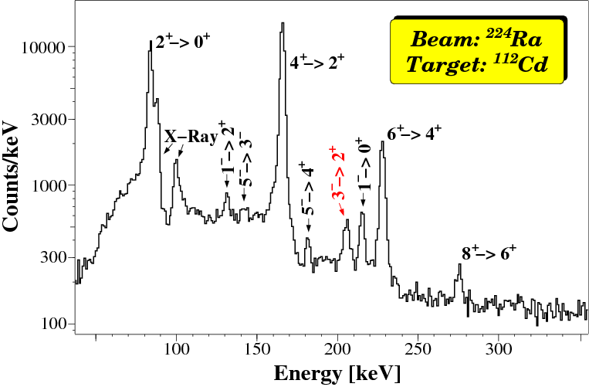
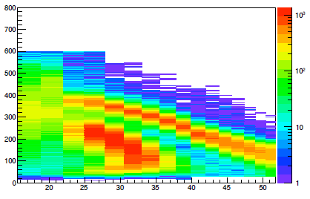
Kinematics and γ-ray spectra
ISOLDE IS475
Experimental Information
(Inverse) reaction kinematics
γ-ray Spectrum
Target recoils
Energy [MeV]
Doppler
correction
Projectiles
Polar angle θ [º]
Split in 4 angular ranges
4x 9 γ-ray yields

Slide 29
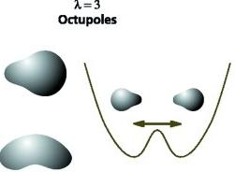
Radium Atom: Nuclear Structure
Partial Nuclear Level scheme
Enhancement due to
Octupole deformation
²²⁵Ra
Figure from I. Ahmad & P. Butler, Ann. Rev. Nucl. Part.Sci.43,71(1993)
Figure from R. Lucas, Europhysics news 31,71(2001)
Theory
J. Engel, J. Dobaczewski et al.
Nuclear enhancement: 50 - 500

Slide 30
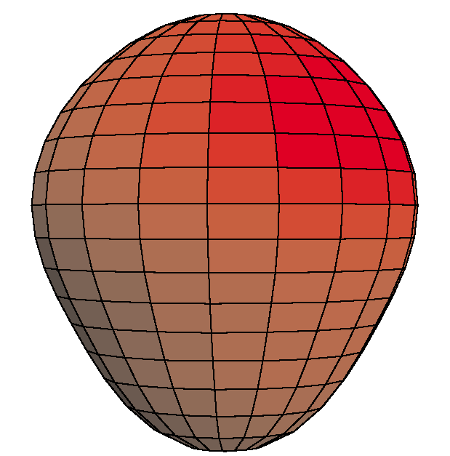
EDM of ²²⁵Ra enhanced
Closely spaced parity doublet – Haxton & Henley (1983)
Large intrinsic Schiff moment due to octupole deformation
    – Auerbach, Flambaum & Spevak (1996)
Relativistic atomic structure (²²⁵Ra / ¹⁹⁹Hg ~ 3)
– Dzuba, Flambaum, Ginges, Kozlov (2002)
²²⁵Ra:
I = ½
t_{1/2} = 15 d
Parity doublet
|α⟩
|β⟩
Enhancement Factor: EDM (²²⁵Ra) / EDM (¹⁹⁹Hg)
Skyrme Model | Isoscalar | Isovector | Isotensor
SIII | 300 | 4000 | 700
SkM* | 300 | 2000 | 500
SLy4 | 700 | 8000 | 1000
Ψ⁻ = (|α⟩ − |β⟩)/√2
Ψ⁺ = (|α⟩ + |β⟩)/√2
55 keV
Schiff moment of ²²⁵Ra, Dobaczewski, Engel (2005)
Schiff moment of ¹⁹⁹Hg, Ban, Dobaczewski, Engel, Shukla (2010)
from Peter Mueller
Notes:
30

Slide 31
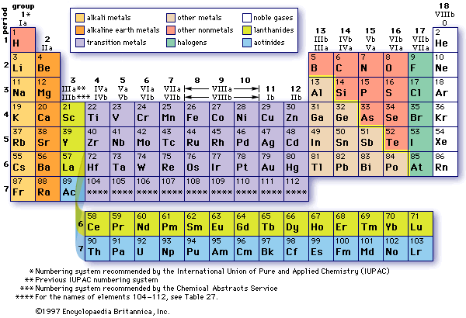
Laser Cooling Chart
TRIμP
Ba
Ra
Next Species

Slide 32

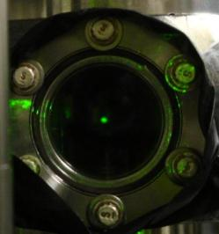


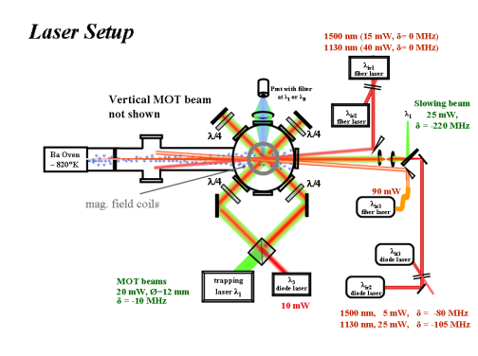
TRIμP
Efficient Trapping of Barium Atoms
5d6p ³D₁
λ = 413.3 nm
λ =
667.7 nm
1 % trapping efficiency!
λ =
659.7 nm
● repumping on
● repumping off
● MOT signal
● Doppler-free beam signal (*100)
● repumping on
● repumping off
MOT
MOT
> 10⁶ trapped atoms
S. De, L. Willmann, 3 Oct 2007
S. De, L. Willmann, 3 Oct 2007

Slide 33
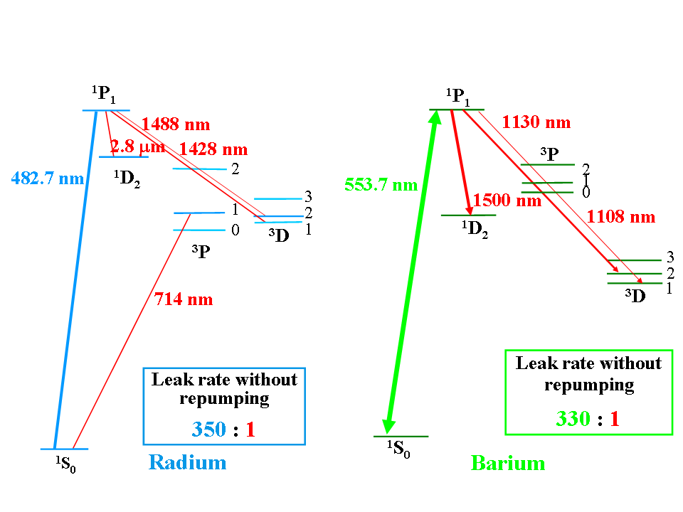
TRIμP
Radium – Barium Optical Trapping
very similar level schemes – very similar leak rates
Cooled and trapped on intercombination line
with Zeeman slower
(Argonne: Phys. Rev. Lett. 98, 093001, 2007)
~7∙10⁻⁷ cooling & trapping efficiency
from atomic beam
~20 ²²⁵Ra (7000 ²²⁶Ra) atoms trapped
Cooled and trapped on resonance line
with many laser repumping
(KVI: S. De, L. Willmann et al., Phys.Rev. A79,41402(R) ,2009)
~10⁻² cooling & trapping efficiency
from atomic beam
10⁶ Ba atoms trapped
method transferrable to Radium

Slide 34
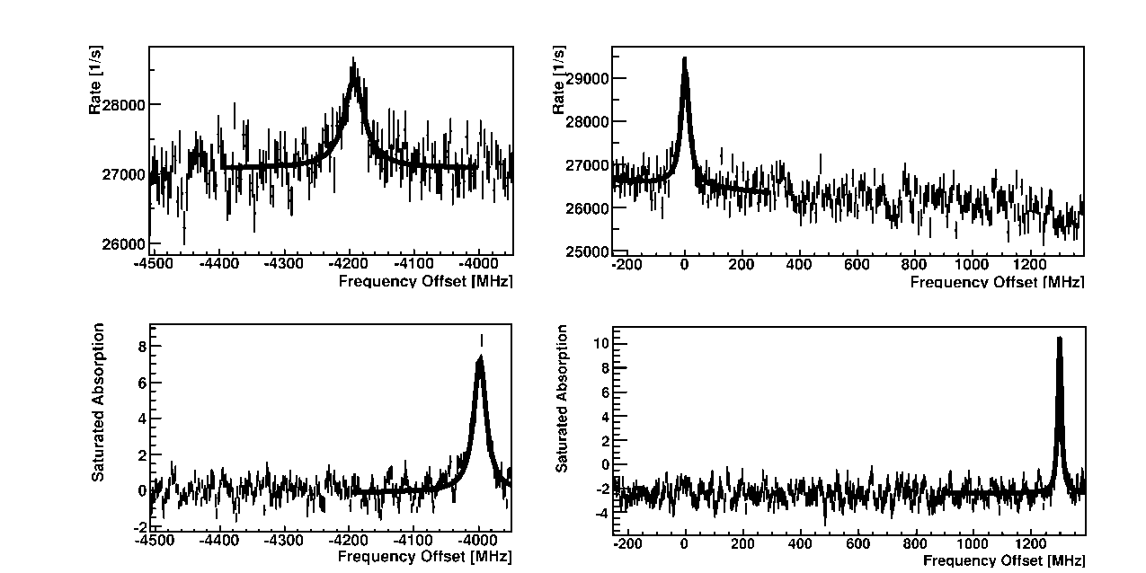
²²⁵Radium Spectroscopy
7s² ¹S₀ - 7s7p ¹P₁: Strong transition, laser cooling
F = 1/2 – F’ = 1/2
F = 1/2 – F’ = 3/2
7s7p ¹P₁
F’
3/2
1/2
7s7p ³P
7s6d ¹D₂
2
1
0
F’
3/2
1/2
¹³⁰Te₂
¹³⁰Te₂
482.7 nm
Accuracy of transition frequency:
4 MHz relative to ¹³⁰Te_{2,}
F=1/2->F’=3/2 @ 20715.7210(1)cm⁻¹
2100 MHz (0.03cm⁻¹) Rasmussen, Z.Phys 87, 607 (1934)
Hyperfine Structure:
    4198(4) MHz
    4195(4)MHz (Wendt et al. Z. Phys. D4, 227 (1987))
F
1/2
7s² ¹S₀

Slide 35
²²⁵Radium Spectroscopy
7s² ¹S₀ - 7s7p ¹P₁: strong transition, first stage cooling
7s7p ¹P₁
F’
3/2
1/2
²²⁵Ra,
¹S₀ (F=1/2) - ¹P₁ (F’=1/2)
Δν_{FWHM} = 30 (1) MHz
7s7p ³P
7s6d ¹D₂
2
1
0
F’
3/2
1/2
483 nm
Absolute Frequency:
Offset from a ¹³⁰Te₂ line
627( 5) MHz (L. Willlmann et al., KVI (2010)
F
1/2
→ Relevant input for atomic theory

Slide 36
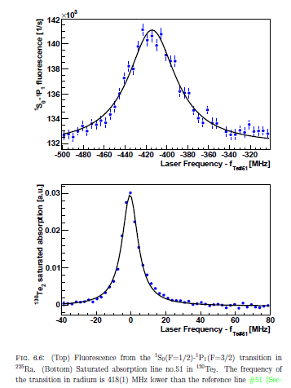
7s7p ¹P₁
F’
3/2
1/2
7s7p ³P
7s6d ¹D₂
2
1
0
F’
3/2
1/2
483 nm
F
1/2
from B.Santra, PhD thesis, KVI (2012)

Slide 37
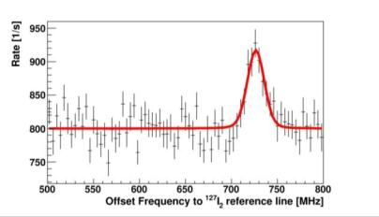
²²⁵Radium Spectroscopy
7s² ¹S₀ - 7s7p ³P₁: weak transition, second stage cooling
7s7p ¹P₁
F’
3/2
1/2
F=1/2 – F’=3/2
7s7p ³P
7s6d ¹D₂
2
1
0
F’
3/2
1/2
714.3 nm
Absolute Frequency:
Offset from a ¹²⁷I₂ line
726( 5) MHz (L. Willlmann et al., KVI (2010)
702(30) MHz (N. D. Scielzo et al., PRA 73, 010501(R) (2006))
F
1/2
→ Relevant input for atomic theory
Notes:
Similarly, laser spectroscopy of the singlet ‘’s’’ to triplet ‘’p’’ transition in Ra was performed from weak source. The absolute frequency is determined using a15 component of the R(116)(2-9) transition in I2 molecule as a frequency reference. The absolute frequency is determined. This is a factor of 6 improvement compared to the reported values.
measure the absolute frequency of the transitions with the comb

Slide 38
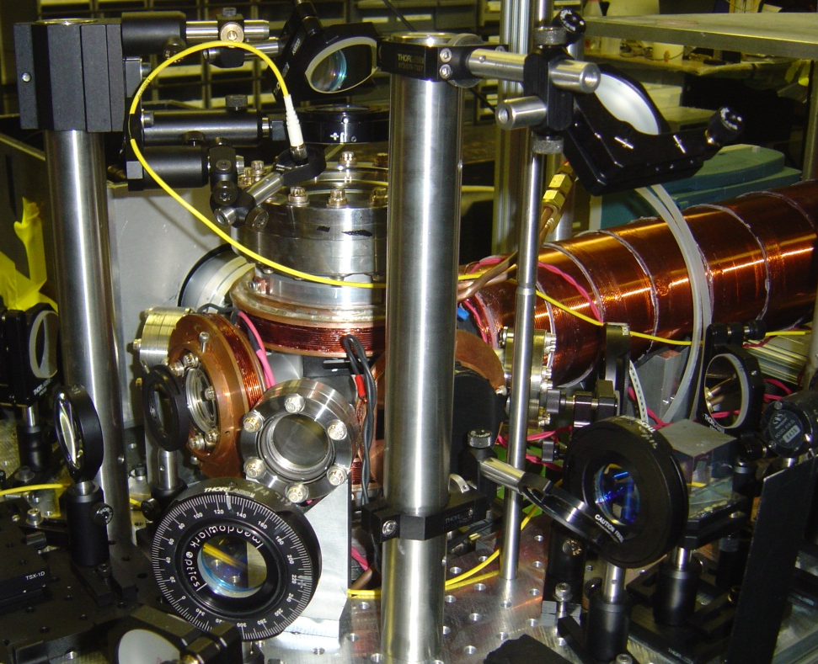
Trapping of ²²⁵Ra and ²²⁶Ra Atoms
¹P₁
Key ²²⁵Ra frequencies, lifetimes measured
Scielzo et al. PRA (2006)
²²⁵Ra laser cooled and trapped!
Guest et al. PRL (2007)
Repump
³P₁
³D₁
Laser-cooling
Ra atom trap!
¹S₀
100x Ra atomic beam
From Peter Mueller, ANL

Slide 39
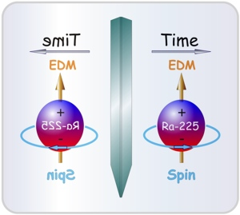
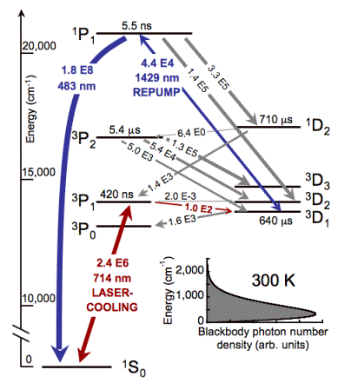
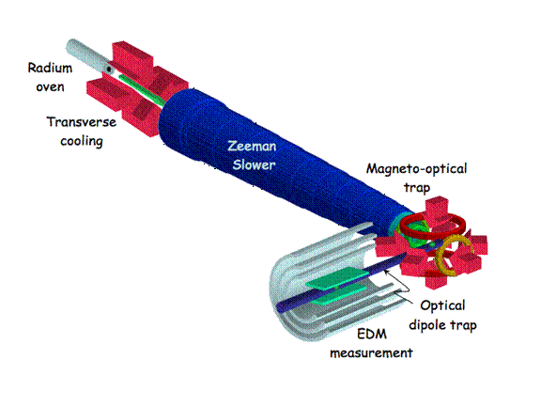
Argonne Radium EDM

Slide 40
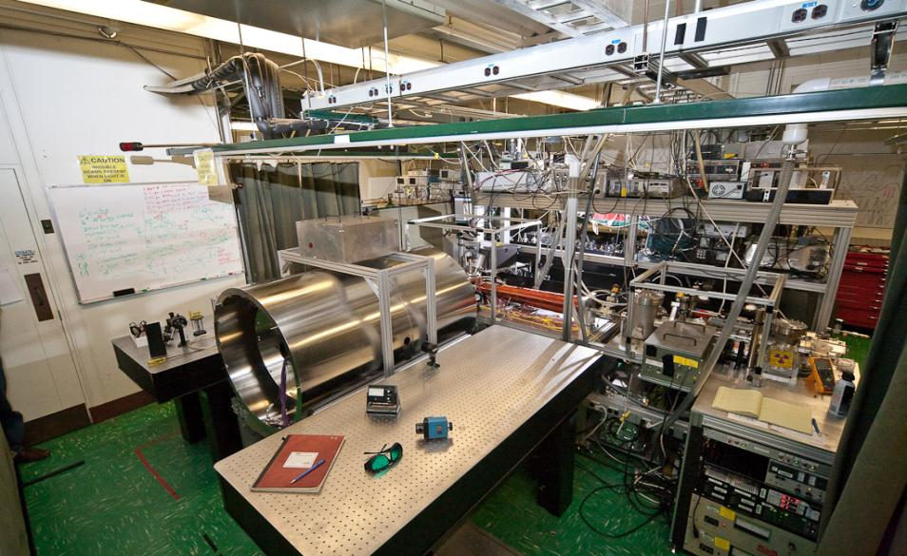
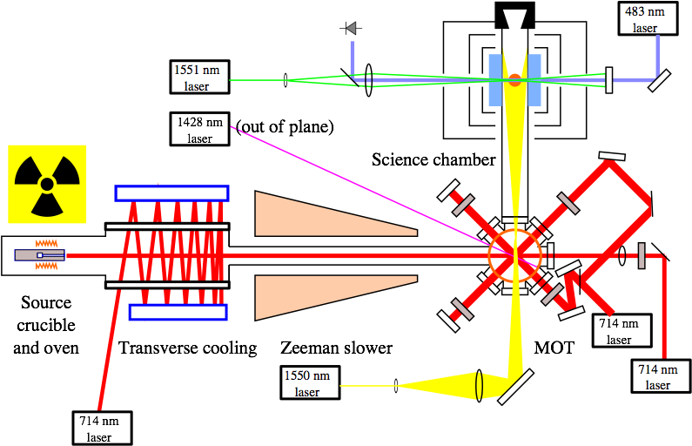
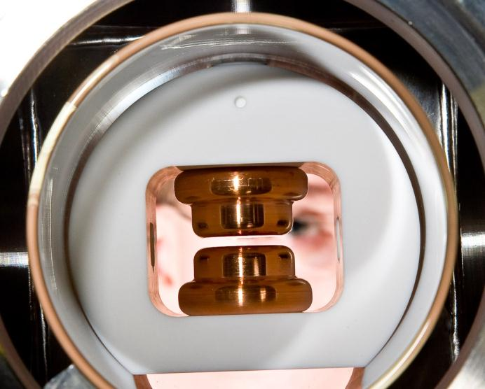
Radium EDM Setup @ Argonne
E=100 kV/cm
10W
(from P. Mueller)

Slide 41
Key Issues for Ra
Sources of Radium Isotopes
Efficient laser cooling on strong transition: 483 nm
  Close leaks with additional lasers
demonstrated with Ba
S.De et al., PRA 79, 041402(R) (2009)
Magneto-optical trapping: 714 nm
J.R. Guest et al., PRL 98, 093001(2007)
  Lower trap temperatures
  Efficient loading to an optical dipole trap
Optical Dipole trapping
7s7p ¹P₁
7s7p ³P
7s6d ³D
7s6d ¹D₂
2
1
0
3
2
482.7 nm
Cooling
1
714.3 nm
Trapping
7s² ¹S₀

Slide 42
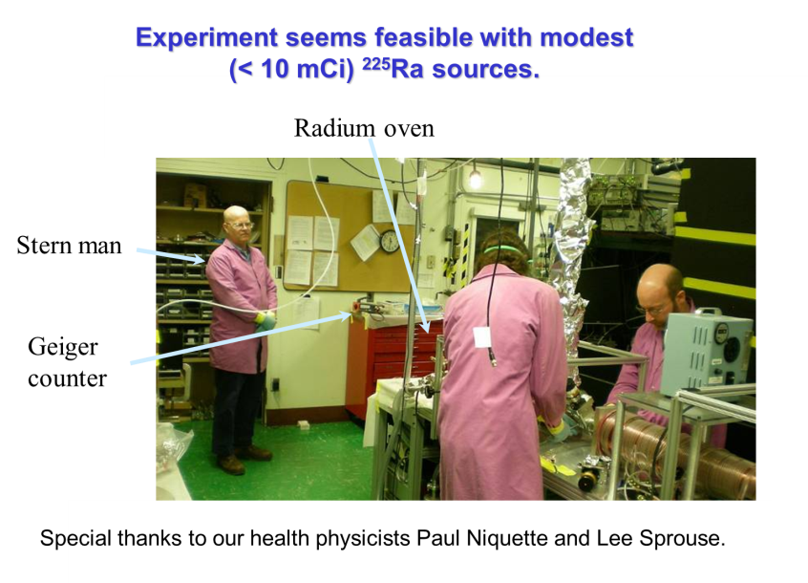
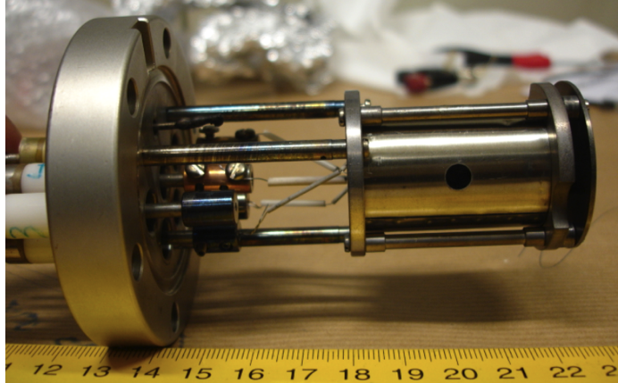
Sources & Isotopes
²²⁵Radium (from sources)
  Electrochemical extraction
  from ²²⁹Th source (ANL)
  regular filling required
  Long lived ²²⁹Th source in
  an oven (TRIμP@KVI)
Isotope Production Facilities
ISOLDE, CERN ( flux ~ 10⁹/s)
FRIB, MI, USA ( flux ~ 10⁹/s)
ISOL@MIRRHA even higher
Argonne
National Lab
Once filled with
²²⁹Th 10μCi
Isotope | Half life (τ_{1/2}) | Nuclear spin (I)
²²⁵Ra | 14.9 days | 1/2
²²³Ra | 11.4 days | 3/2
²¹³Ra | 2.74 min | 1/2

Slide 43
Radium cooling
Parameter | 483 nm | 714 nm
Maximum deceleration (a) | 330 x 10³ m/s² | 3 x 10³ m/s²
Distance to stop 300 m/s (d) | 0.14 m | 15 m
Doppler cooling limit (T_{D}) | 700 μK | 9 μK
Recoil limit (T_{R}) | 180 nK | 83 nK
transition leak rate 1:350
indispensible repumping
0.1 m slowing section
60 % of all atoms
transition leak rate 1:25000
1 m slowing section
0.06% of all atoms
0.6% with repumping

Slide 44
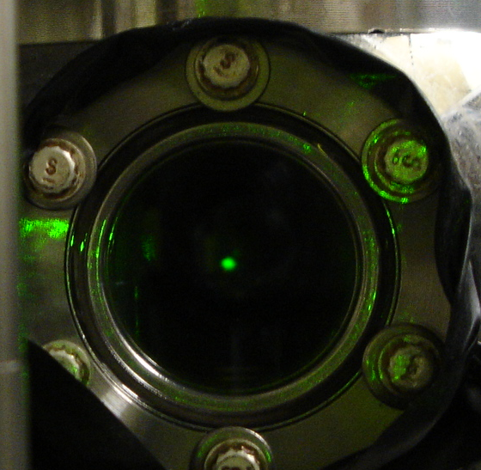
Heavy alkaline earth: Ba
Efficient capture from atomic beam: >1%
multi-color, multi level laser cooling
S.De et al. PRA 041402 (2009)
Alternate way pursued at Argonne Lab (Ra): < 10⁻⁶
single color, two-level laser cooling
Guest et al. PRL 98 093001 (2007)
Notes:
Needs to be nicer

Slide 45
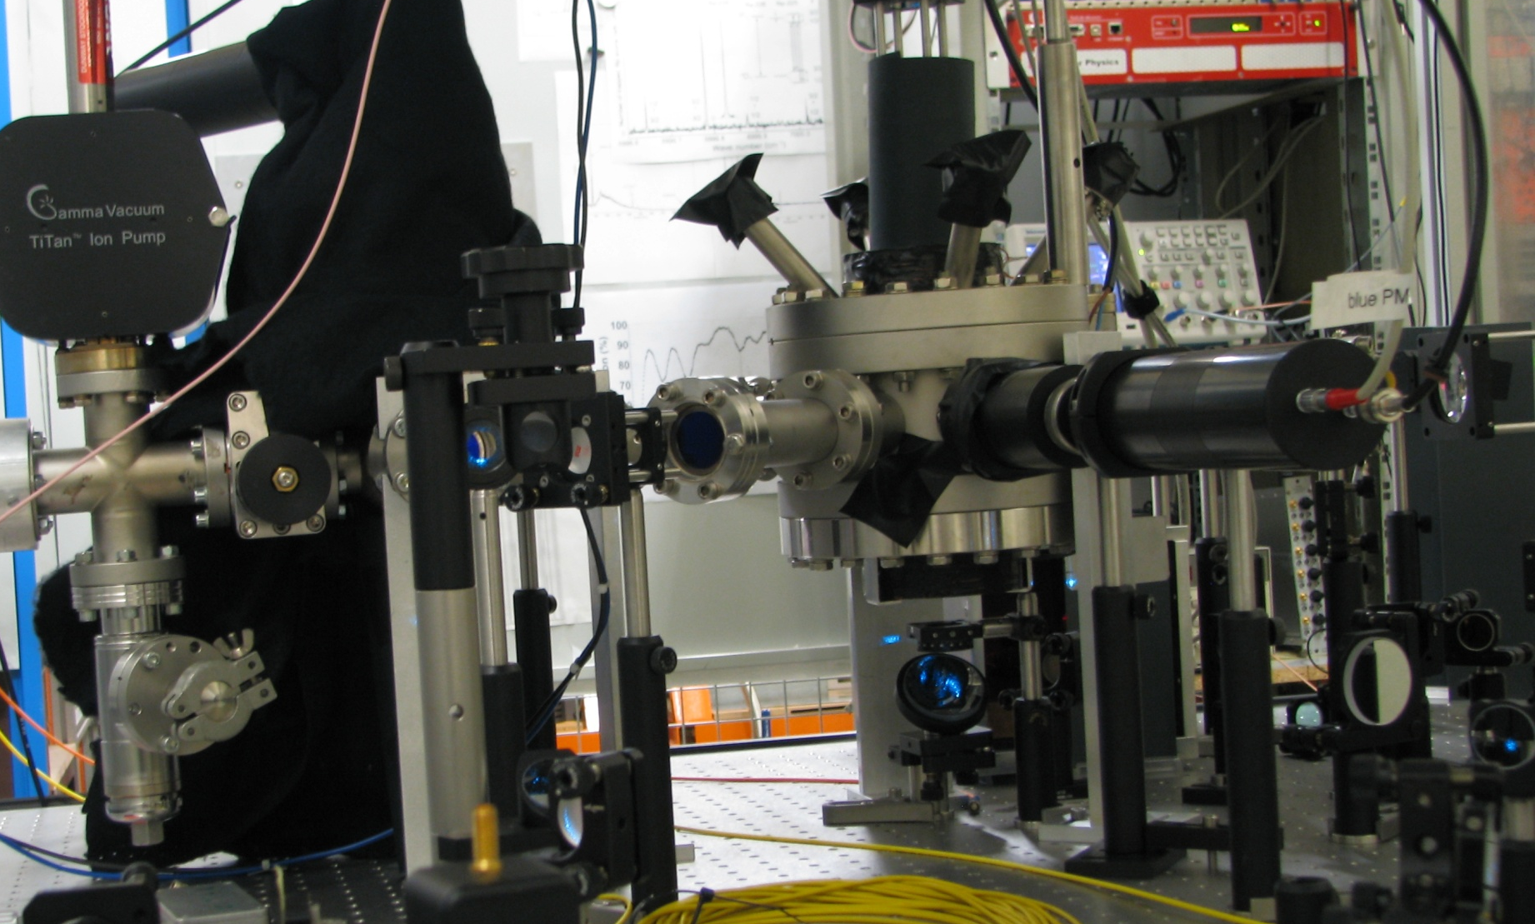
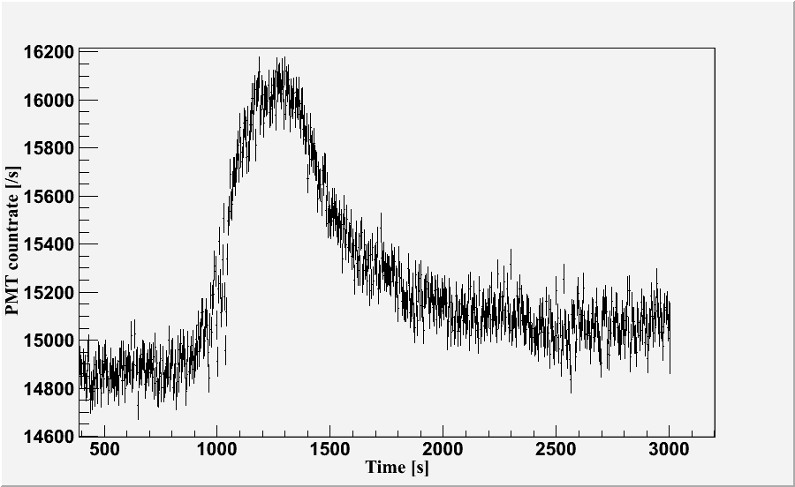
Towards an experiment
²²⁹Th ²²⁵Ra + α
Slowing laser
beams
Ra
Source
483nm +
repumpers
7s7p ¹P₁
7s7p ³P
7s6d ³D
7s6d ¹D₂
2
1
0
3
Ti: Sappire laser @ 966 nm
Second harmonic generation (KNbO₃) @ 483 nm
Semi-conductor Diode lasers @ 714 nm
50mW, several lasers with offset lock
Repump lasers
2
482.7 nm
Cooling
1
714.3 nm
Trapping
7s² ¹S₀
Notes:
45

Slide 46
EDMs of atoms of experimental interest
Z | Atom | [S/(e fm3)]e cm | [10⁻²⁵ η] e cm | Expt.
2 | ³He | 0.00008 | 0.0005
54 | ¹²⁹Xe | 0.38 | 0.7 | Seattle, Ann Arbor, Princeton,Tokyo, Mainz-PTB-HD-KVI
70 | ¹⁷¹Yb | -1.9 | 3 | Bangalore,Kyoto
80 | ¹⁹⁹Hg | -2.8 | 4 | Seattle
86 | ²²³Rn | 3.3 | 3300 | TRIUMF
88 | ²²⁵Ra | -8.2 | 2500 | Argonne,KVI
88 | ²²³Ra | -8.2 | 3400
d_{n} = 5 x 10⁻²⁴ e cm η, d(³He)/ d_{n} = 10⁻⁵
slide from Victor Flambaum

Slide 47
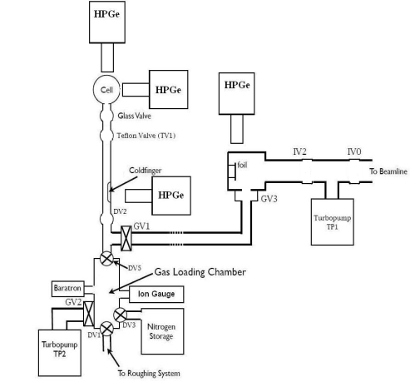



Towards a Rn EDM Experiment at TRIUMF
T. Chupp and C. Svensson
Magnitude of EDM ~ Z³
Radon isotopes possibly octupole deformed
Rn is predicted to be ~ 600 times more sensitive than ¹⁹⁹Hg
6. Push with N₂
to trap gas in cell
1. Implant ^{121,123}Cs
into catcher foil
3. Coldfinger at LN₂
temperature to absorb
the atoms locally
4. Warm coldfinger
2. Heat foil to
diffuse atoms
into system
5. Fill chamber with N₂

Slide 48





Radon-EDM Experiment
+
TRIUMF E929
T. Chupp (Michigan) & C. Svensson (Guelph)
-
Funding: NSF, DOE, NRC, NSERC
TRIUMF
Produce rare ion radon beam
Collect in cell
Comagnetometer
Measure free precesion
(γ anisotropy/β asymmetry)
β₃
^{221/223}Rn EDM projected sensitivity
Facility | Detection | S_{d} (100 d)
ISAC | γ anisotropy | 2 x 10⁻²⁶ e-cm
ISAC | β asymmetry | 1 x 10⁻²⁷ e-cm
FRIB | β asymmetry | 2 x 10⁻²⁸ e-cm
~ 5x10⁻³⁰ for ¹⁹⁹Hg
Courtesy of Tim Chupp
Notes:
48

Slide 49
EDMs of atoms of experimental interest
Z | Atom | [S/(e fm3)]e cm | [10⁻²⁵ η] e cm | Expt.
2 | ³He | 0.00008 | 0.0005
54 | ¹²⁹Xe | 0.38 | 0.7 | Seattle, Ann Arbor, Princeton,Tokyo, Mainz-PTB-HD-KVI
70 | ¹⁷¹Yb | -1.9 | 3 | Bangalore,Kyoto
80 | ¹⁹⁹Hg | -2.8 | 4 | Seattle
86 | ²²³Rn | 3.3 | 3300 | TRIUMF
88 | ²²⁵Ra | -8.2 | 2500 | Argonne,KVI
88 | ²²³Ra | -8.2 | 3400
KVI
slide from Victor Flambaum

Slide 50



Future EDM Search from ³He/¹²⁹Xe Clock Comparison
W.Heil, U. Schmidt, L. Willmann et al. Mainz –Heidelberg - Groningen
present limit d_{Xe} < 3×10⁻²⁷ ecm
goal gain 3 orders of magnitude
note d_{Hg} < 3,1×10⁻²⁹ ecm

Slide 51




Magnetic Field Shielded Room at PTB Berlin
7 layers of magnetic shielding ⇒ residual field < 2nT
LT_{c}- SQUID
J. Bork, et al., Proc. Biomag 2000, 970 (2000)
³He (4.5 mbar )
magnetic guiding field
≈ 0.4 μT (Helmholtz-coils)
6 cm
Notes:
Outer cube: 15m, inner 3m
equiped with

Slide 52


³He Free Spin-Precession Signal
SQUID
p_{He}= 4.5 mbar
P_{He}= 15%
R =2.9 cm
d = 6 cm
d
R
³He:
¹²⁹Xe:
→ wall relaxation
→ limiting factor
C. Gemmel et al., Eur.Phys.Jour. D57,303 (2010)

Slide 53




³He / ¹²⁹Xe clock comparison to get rid
of magnetic field drifts
406.68
drift ~ 1pT/h
B [nT]
406.67
δν ∼ 10⁻⁵ Hz/h
406.66
0
5
1
0
1
5
2
0
t [h]
¹²⁹Xe
(4,7 Hz)
³He
(13 Hz)
!
!
slide from W. Heil

Slide 54





Subtraction of deterministic phase shifts
I. Earth‘s rotation
ΔΦ = Φ_{He}- γ_{He} / γ_{Xe}⋅ Φ_{Xe}
Φ_{rem} = ΔΦ - Φ_{Earth}
II.
+ Φ (t)_{spin-coupling}
Phase residuals
Φ_{rem}
slide from W. Heil

Slide 55

Dewar housing the LT_{c}-SQUIDs
Pb-glass cylinder
³He/¹²⁹Xe cell

Slide 56

³He , ¹²⁹Xe clocks based on free spin precession
yield best limit due to long spin coherence times
in Lorentz violating Standard Model extension
(Kostelecky)
limiting parameter
for experiment
M. Burghoff et al.,
arXiv 1008.0579
⇒ new limit on the bound neutron

Slide 57
muon EDM
method for charged particles

Slide 58

KVI

Slide 59





Permanent Electric Dipole Moment in a Ring
Spin precession
in (electro-)
magnetic field

Slide 60




Muon EDM – A Parasitic Measurement
3 methods for analysis:
dμ < 1.8 ⋅10⁻¹⁹ ecm (95% C.L.)
Fermilab: factor ~100
Adelmann, Kirch, Onderwater, J. Phys. G: Nucl. Part. Phys. 37 085001 (2010)

Slide 61

Muon EDM – A Parasitic Measurement
3 methods for analysis:
dμ < 1.8 ⋅10⁻¹⁹ ecm (95% C.L.)
Adelmann, Kirch, Onderwater, J. Phys. G: Nucl. Part. Phys. 37 085001 (2010)

Slide 62


Sikorsky S64F 12.5 T hook weight (Outer coil 8T)

Slide 63
Permanent Electric Dipole Moment in a Ring
X⁺
X⁺
X⁺
Spin precession
in (electro-)
magnetic field
X⁺

Slide 64

from CJG Onderwater

Slide 65
Some Candidate Nuclei for EDM in Ring Searches
Nucleus
Spin J
μ/μ_{N}
Reduced Anomaly
a
T _{1/2}
¹³⁹₅₇La
7/2
+2.789
-0.0305
¹²³₅₁Sb
7/2
2.550
-0.1215
¹³⁷₅₅Cs
7/2
+2.8413
0.0119
30y
²²³₈₇Fr
3/2
+1.17
<0.02
22 min
⁶₃Li
1
+0.8220
-0.1779
²₁H
1
+0.8574
-0.1426
⁷⁵₃₂Ge
1/2
+0.510
+0.195
82.8 m
¹⁵⁷₆₉Tm
1/2
+0.476
0.083
3.6 m
Method works also for highly charged ions
More complete lists:
I.B. Khriplovich, K. Jungmann
GSI EDM Workshop, 1999

Slide 66








The Importance of Informal Meals
International Symposiua on
LEPTON MOMENTS
Heidelberg, Germany
1: 08 - 12 June 1999
Centerville, Cape Cod, MA
2: 09 - 12 June 2003
3: 19 - 22 June 2006
4: 1 9- 22 July 2010
ECT* workshops
Many, many
Ring EDM experimenst
can work for ALL ions
d,p
²¹³Fr
Up to now mostly in
THEORY
μ
It’s time for an after
conference party
@ Mahabaleshwar !

Slide 67
Summary
Atomic EDMs are experimentally accessible
Atomic Physics technology
EDM sensitivity scales approx. with Z³
Relatively easy to interpret
High potential : Ra, Xe …
Stay tuned
⇒ Work in progress :
Atoms Still yield the Best Limits !

