Slide 1
Role
CP Violation in Elementary particles and Composite Systems, 2013
ICTS, TIFR, Mumbai, 18th Feb 2013 (Lecture)
Geetha Gopakumar Nair
Tokyo Metropolitan University, Japan
<number>

Slide 2
Outline
General aspects about molecular calculations
Importance of multi-reference correlation methods in molecules
Relativistic effects in Quantum Chemistry
Application to fundamental physics
Photoassociation spectroscopy in ultracold polar molecules in an optical lattice
LiX (X-alkaline-earth-metal) – mp/me variation studies - open shell
HgYb - Nuclear EDM measurement – closed shell
<number>

Slide 3
Importance of multi reference correlation methods in molecules
Reference
Roland Lindh, The winter school, Helsinki, 12-16 Dec 2011
Multiconfigurational and multireference methods, Peter R. Taylor and Jeppe Olsen, Sep 2011
Electronic structure calculations, Attila G. Csaszar, Eotvos Universiy, Budapest, Hungary
Introduction to nondynamical correlations, C. David Sherrill, School of Chemistry and Biochemistry, Georgia Institute of Technology
Post HF methods lectures by Andrew S. Ichimura, CIT
R. J. Bartlett, Int. J. Mol. Sci. 2002, 3, 579-603
How accurate is the CASPT2 method? Zahra Azizi et al.,PCCP, 2006,8,2727-2732
<number>

Slide 4
Electron correlation -Post HF
Hartree-Fock method
Add more (excited) determinants and reoptimise the atomic basis coefficients
HF orbitals
Multi-Configuration SCF
(CASSCF, RASSCF)
Add more determinants with fixed atomic basis coefficients
Single reference electron correlation
methods - MPn, Configuration
Interaction (CI),
Coupled Cluster method (CCM)
Add more determinants with fixed atomic basis coefficients
Multi reference electron correlation
Methods : MR-CI , CASPT2
Full CI
(exact result)
Courtesy: Attilla G.Csaszar presentation
<number>

Slide 5
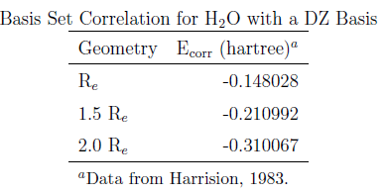
Dynamical and Non-dynamical Correlations
HF level - Inter electronic repulsions are considered in an average way.
HF neglects instantaneous electron-electron repulsions.
Correlation energy is the difference between Full CI and HF.
Correlation energy is obtained by fully allowing the electrons to see and avoid each other – correlation related to movement of electrons –“Dynamic Correlation”
At R > Re, as electrons are further apart, dynamical correlation should become less important .
Correlation increases with stretching..
Some correlation is missing in HF. It does not account for nearly degenerate electron configurations – “Non Dynamic Correlation”
Courtesy: Prof. David Sherrill, Georgia Institute of Technology
<number>

Slide 6
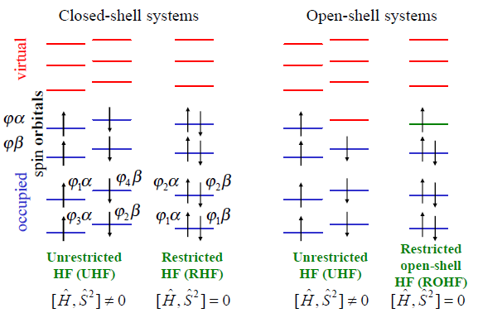
Restricted and Unrestricted HF methods
UHF: Different orbtials for different spins
RHF: Same orbital for both spin states
ROHF: Same orbital's for occupied α and β spin states
Different orbital for unmatched α spin state
<number>

Slide 7
H2 molecule
Ground state in a minimal basis: one atomic 1s orbital on each atom
Two AOs leads to two MOs
Φ2 = N1 (χA - χB) - Anti bonding MO
Φ1 = N1 (χA + χB) - Bonding MO
<number>

Slide 8
Ground state wave function
Slater determinant with two electrons in the bonding MO (ground state)
Ф0 = φ1α(1)φ1β(2) − φ1α(2)φ1β(1)
= φ1(1) φ1(2) [α(1)β(2) − α(2)β(1)]
∼ (χA (1) + χB(1))(χA (2)+χB(2))
Expand the Slater determinant
Factor the spatial and spin part
Ф0 = (χA (1)χA(2) + χA (1)χB(2) + χB (1)χA(2)+ χB (1)χB(2)
Four terms in
the AO basis
(χA (1)χA(2) and χB (1)χB(2)
(χA (1)χB(2) and χB (1)χA(2)
Ionic terms
Covalent terms
Two electrons in one AO
Two electrons shared between two AOs
<number>

Slide 9
H2 Potential energy Surface
E
H------H
At dissociation limit, H2 must
separate into two neutral H atoms
Bond stretching
H-H
At the RHF level, the wave function, φ is 50% ionic and 50% covalent at all bond lengths
H2 molecule does not dissociate correctly at the RHF level!!!
H2 RHF dissociation consequences
Energies of stretched bonds too large - Affects transition state structures
Potential well steep hence (1) short equilibrium bond lengths
(2) large binding energy
Improper curvature of PEC – too high vibrational frequencies
Wave function is too ionic – dipole moments are too large
<number>

Slide 10
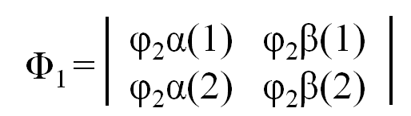
Remedy for this problem
Add flexibility by removing fixed ratio for each terms
[At large inter nuclear separations, the wave function should be 100% covalent (ionic terms should be zero)]
Starting with a different trial function
Slater determinant with two electrons in the anti bonding MO (excited state)
Ф0 ∼ (χA (1)χA(2) - χA (1)χB(2) - χB (1)χA(2) + χB (1)χB(2)
Four terms in
the AO basis
(χA (1)χA(2) and χB (1)χB(2)
(χA (1)χB(2) and χB (1)χA(2)
Ionic terms
Covalent terms
Two electrons in one AO
Two electrons shared between two AOs
<number>

Slide 11
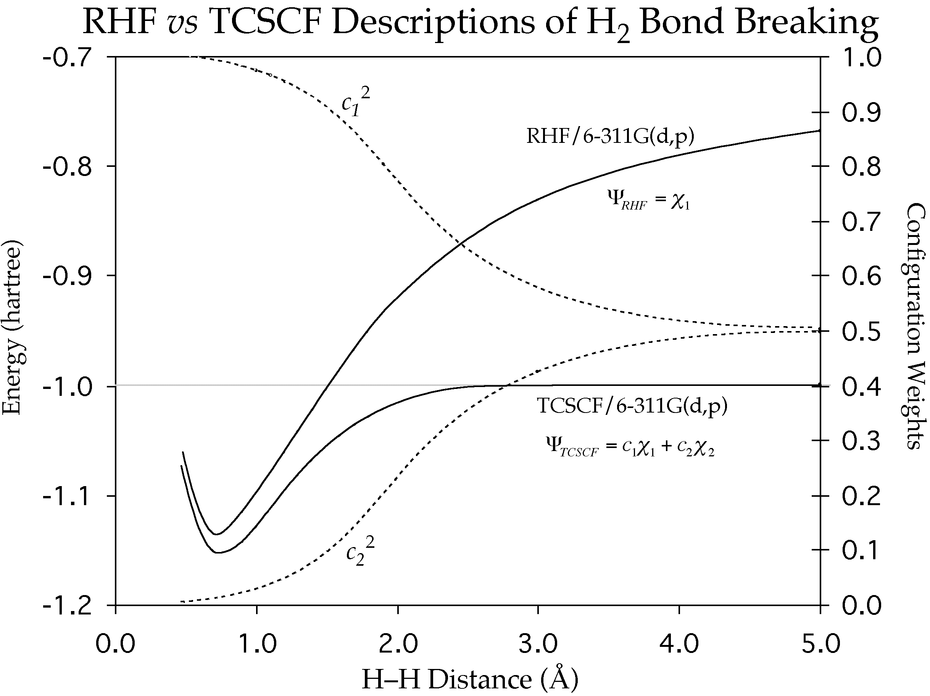
New trial function: Linear combination of Фo and Ф1
(Two Configuration SCF)
Ionic terms
Covalent terms
At R > Re
a1 = -a0 (ionic terms) zero
= ΨCI, an example of CI
Incl. of anti-bonding character
-allows electrons to be farther apart – non dynamical correlation
Lower energy than RHF
(two variational parameters).
<number>

Slide 12
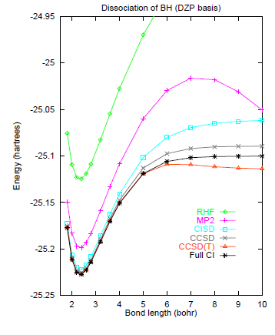
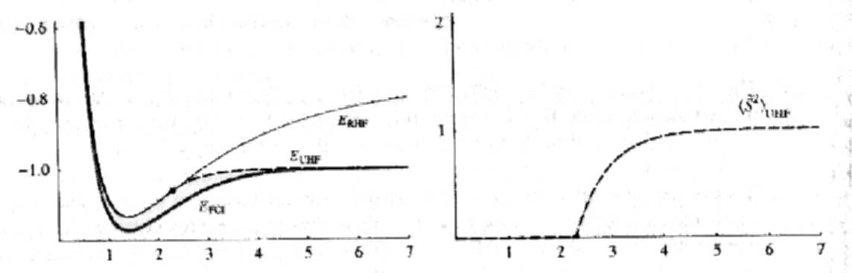
Near degeneracy at large distances between bonding and anti-bonding MOs is bad for energy denominators in MP2
With regular RHF orbitals, even correlated MP2, CISD, CCSD, CCSD(T) can fail
RHF Vz. UHF
RHF and UHF good at short R
RHF not good at larger separations – UHF falls towards FCI
RHF remains singlet
UHF – incorrect spin – intermediate of a singlet and triplet
H2 molecule – RHF, UHF, FCI
<number>

Slide 13
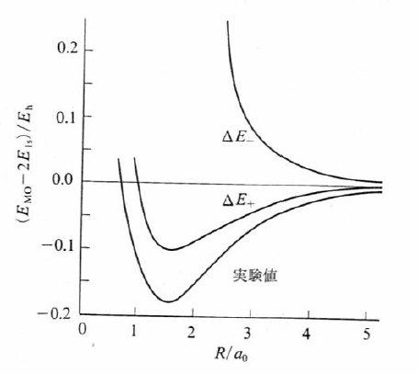
H2 molecule
Re (calculated) = 0.85 Å
Re (HF limit) = 0.741 Å
Re (experiment) = 0.741 Å
De (calculated) = 260 kJ/mol
Experiment
De (HF limit) = 351 kJ/mol
De (experiment) = 457 kJ/mol
Ref: Abe san’s lecture

Slide 14
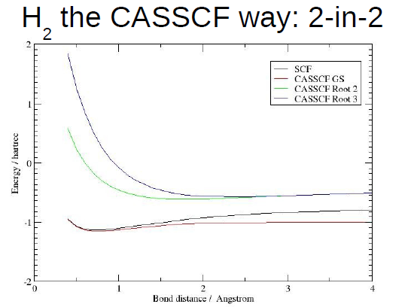
We need to include all near degenerate determinants in our reference (non dynamical)
Need to find orbital to minimize the energy of the mixture of near degenerate determinants (MCSCF)
A special case of MCSCF which takes full CI in a given active space(CASSCF)
Need to use multi-configurational references for subsequent treatment of dynamical correlation- MRPT, MRCI, MRCC, CASPT2
The CASSCF wave function has the correct asymptotic behavior
Prof. Lyndh, Winter school, Helsinki, 2011
<number>

Slide 15
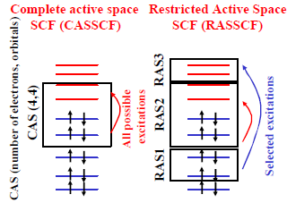
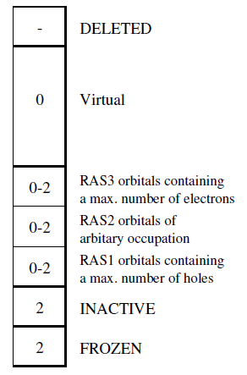
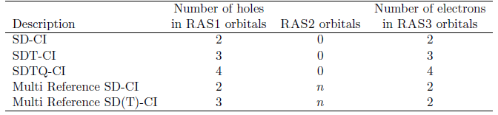
What is CASSCF and RASSCF?
Electron occupancy
in RASSCF
RASSCF = CASSCF when
RAS1= RAS3 = zero
Types of wave functions
using RASSCF
<number>
Ref. MOLCAS manual

Slide 16
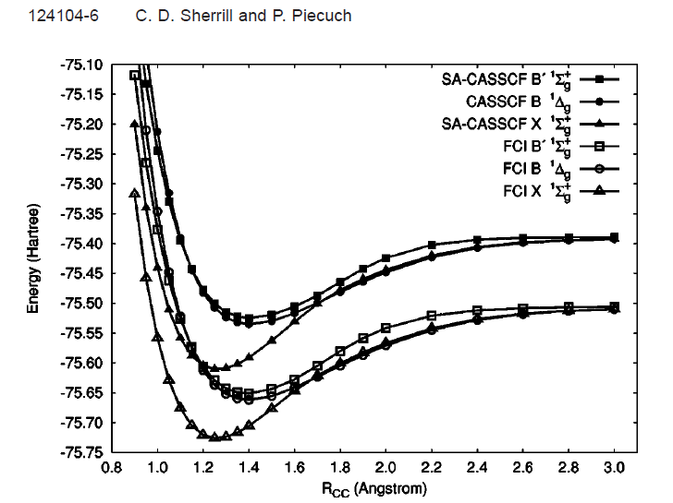
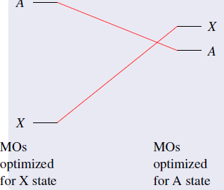
MCSCF - excited state
Separate calculations on the individual states
Root flipping
SA-CASSCF – MO is optimized w.r.to (weighted)average energy of the states of a particular symmetry
Advantage :
Single set of orbitals with different coefficients describe all the states
CASSCF states are orthogonal to each other
<number>

Slide 17
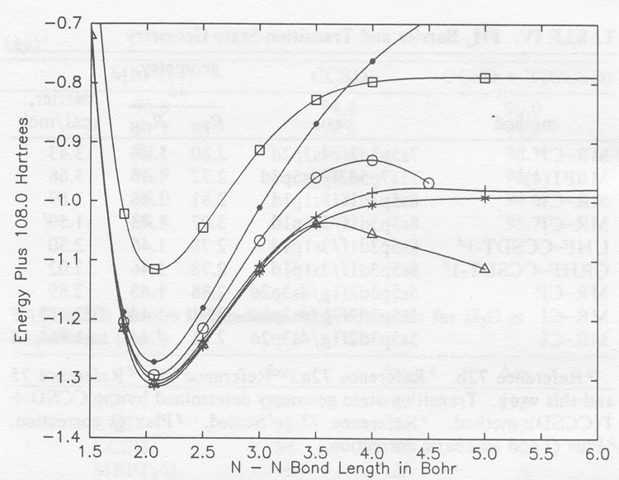


Slide 18






Perturbation Theory : Partition of Hamiltonian : H = H0 + V
Hilbert space : P (reference space) + Q (secondary space) = 1
Wave operator Ωα |α > = |Ψ >
BLOCH equation
Single-State (SS-CASPT2)
We need Ω1α and E2α
k : all states within the CAS orthogonal to α
Qαsd = states obtained by applying double excitation
operator on α
Multi-State (MS-CASPT2)
We need Ω1α and E2α (α = 1,2, …..,d)
β space : (1,2,…..,d)
MR- Ω : linear combination of SS Ω
Ref:J.Finley, Chhemical Physics Letters, 288, 299-306(1998)
<number>
Notes:
Total Hamiltonian = zeroth order Hamiltonian + Perturbation
The first order wave operator can be obtained from H0.
Ho is the zeroth order Hamiltonian ; where F is the generalized one body Fock operator and the sum over k includes all states within the CAS space and Qsd are states obtained by doublet excitation with respect to alpha.
We arrive at the below first order equation, which could be solved iteratively with the states generated by double excitations from the reference. With first order wave function, the second order energy can be obtained.
Multi state CASPT2
The zeroth order Hamiltonian is given by H0, where beta runs over the complete CAS space and k runs over the space orthogonal to the beta space.

Slide 19
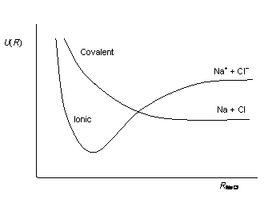
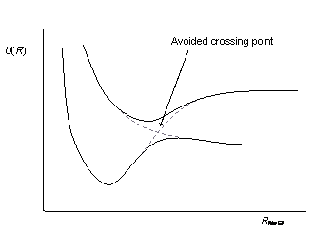
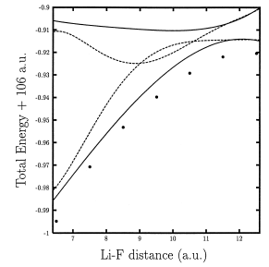

Why MS-CASPT2?
Mixing of ionic and covalent PECs of
NaCl
CASSCF is not a good reference
Strong mixing of reference with the secondary space - PT2 fails
SS-CASPT2 can be inadequate at avoided crossings (same symmetry states cannot cross each other – adiabatic approximation)
Ionic-neutral curve crossing of LiF molecule
Avoided crossing of mixed w.f of NaCl energies
<number>
Ref:J.Finley, Chhemical Physics Letters, 288, 299-306(1998)

Slide 20
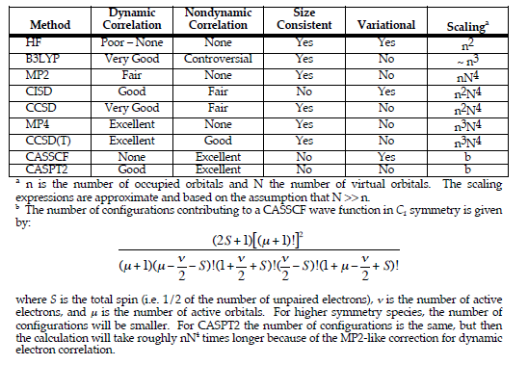
Summery of methods for treating electron correlation
<number>

Slide 21
Relativistic effects in Quantum Chemistry
Reference
Relativistic effects in atoms and molecular properties, M. Illias, V. Kello, M. Urban, acta physica slovaca vol. 60, No.3, 259-391 (2010)
An introduction to relativistic Quantum Chemistry, Bernd Hess
Relativistic Electronic Structure calculations for atoms and molecules, Markus Reiher and Bernd A Hess, Modern Methods and Algorithms of Quantum Chemistry (2000)
<number>

Slide 22
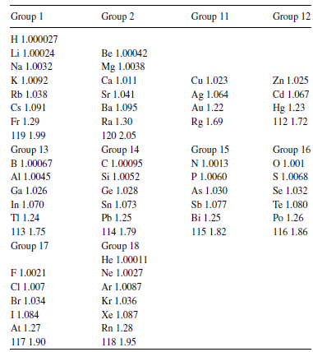

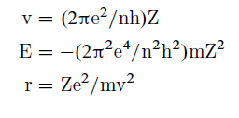
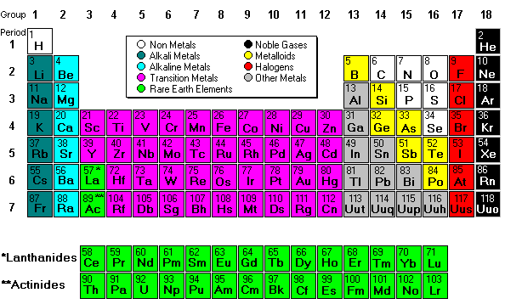
Calculated m/m0 for ground state n=1
Relativistic effects in atoms
m, m0 are the masses at velocity v and zero
Bohr’s model for hydrogen like species
(H to Na) -1-3 : less than 1%
K – 4 : 0.9% to 3.6%
Rb – 5 : ~ 8%
Cs – 6 : ~ 10%
All other elements : more than 10%
Ref: Relativistic methods for Chemists, edited by M. Baryzs and Y. Ishikawa, Chapter 2 by John S. Thayer, Relativistic effects and the chemistry of the heavier main group elements
<number>
Notes:
Einstein’s special theory of relativity states that the mass of any moving object changes as its velocity changes :
From relativistic mass, we can calculate the radius of the s orbit: This value decreases as the relativistic effect for s orbital is the strongest. This is called orbital contraction. This causes changes in bond length of the molecules formed from these atoms and also their atomic properties.

Slide 23
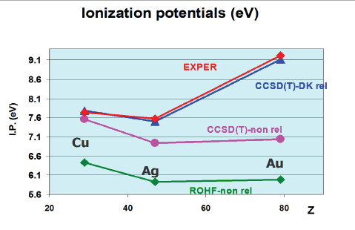
Relativistic effects in properties (coinage elements)-Group 11
29Cu: [Ar]3d104s1
47Ag: [Kr]4d10 5s1
79Au: [Xe]5d104f146s1
Cu, Ag, Au – ROHF and NR- CCSD(T)
Electron correlation effects are similar
Cu – NR CCSD(T) result is close to expt.
Ag – NR CCSD(T) result is differing by 0.5eV
Au – NR CCSD(T) result is misleading
One component scalar relativistic DK –
Close to experiment
Apart from electron correlation – relativistic treatment is also important
Non-relativistic Hamiltonian
Non-relativistic Hamiltonian + correlation
Relativistic Hamiltonian (at different approximations)
Atoms and Molecules are neither Relativistic or Non Relativistic – The magnitude of relativistic effects are related to the accuracy required for the property under consideration
<number>
Notes:
Physical and Chemical properties ultimately depend on the energies and spatial distributions of electrons in the atoms.

Slide 24

Relativistic Calculations in Molecules
Z<40 – relativistic effects are small (except nuclear dependent)
Computationally expensive
Molecular calculation: expansion techniques (Gaussians)
No. of small comp. = 2 * No. of large comp.
Coupling of spin and spatial wf – complex wf
- prevents handling of spin and point group symmetry separately
<number>

Slide 25




Slide 26


Douglas-Kroll (DK) transformation
(Ann. Phys. 82(1974)89)
Expansion parameter:
FW transformation : (1/c)
DK transformation : V ext
W n is an anti-Hermitian operator
Idea: Block diagonalisation of the Dirac operator
Identify: odd operators (couples LS or SL) : cαp
even operators (couples LL or SS) : (β -1), V
Find: A unitary matrix which removes the odd terms
[Electronic bound + continuum
states defined just by h+] - complete elimination of small component
2nd order in Vext DK2 (good for chemical appli.)
DK2- Hess, PRA 32(1985) 756, Hess, PRA 33(1986) 3742
DK3- Nakajima, Hirao, JCP, 113 (2000) 7786
DKH – infinite order – Reiher, Wolf, JCP, 121 (2004) 2037; JCP, 121(2004) 10945
<number>

Slide 27

Transformed two component Hamiltonian
Spin free terms (kinematics, scalar relativistic terms)
Spin-orbit terms (spin-spin, spin-orbit terms)
How can we separate these terms?
Why are we separating the terms into SF and SO terms?
Many center 2-electron SO integrals are computationally expensive ~ similar order - computation of 2 electron integrals over small basis
How do we compute SO effects in molecules? – first order Perturbation theory
Define a pseudo one-center mean field SO operator (MFSO)
RASSI-SO - MOLCAS
Spin-free states are obtained first using scalar terms (Sz is not defined)
Using H = scalar term + MFSO, Basis : spin-free states
Hess et al., Modern electronic structure theory, Part I, ed. D.R. Yarkony,
Advanced series in physical chemistry, Vol.2, p 152-278(1995)
Dirac relation
<number>

Slide 28
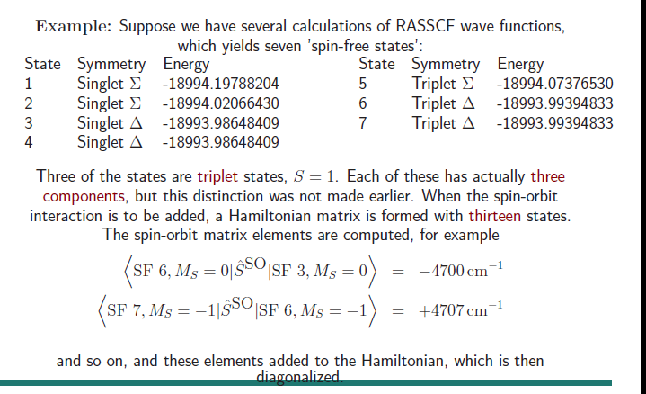
<number>

Slide 29

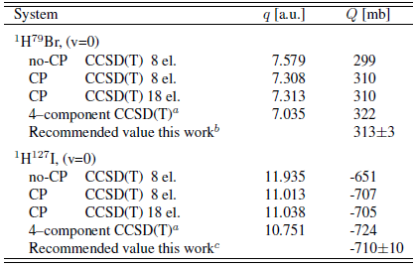
Property Calculations (Change of Picture)
U+XDU = X decoupled
Nuclear quadruple moments
4%
9%
<number>

Slide 30
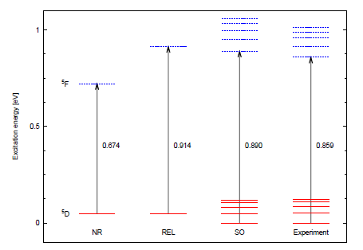
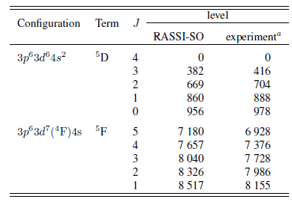
Spin-orbit effects in atomic calculations
26Fe atom
MRCI-SD method
NR –non-relativistic
REL – DKH scalar
SO – RASSI-SO
SO splitting 5D ~ 22cm-1
SO splitting 5F ~ 110 cm-1
<number>

Slide 31
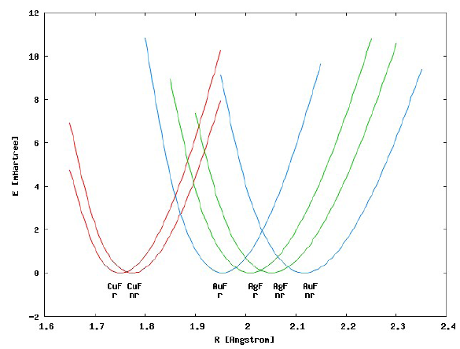
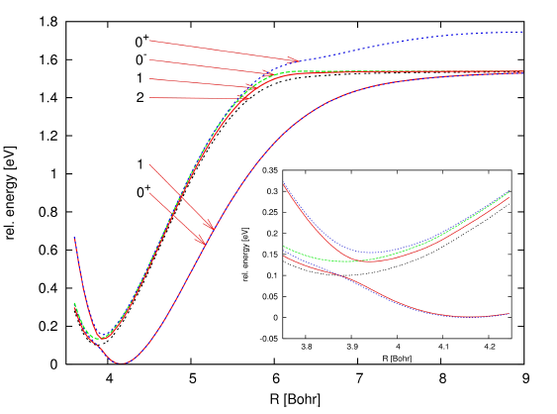
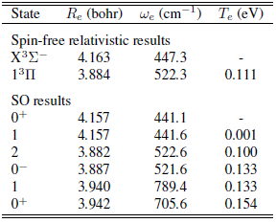
Spin-orbit effects in molecular geometries
Contraction of bond lengths
InN
CuF Re < AuF Re < AgF Re
Avoided crossings:
3Σ(0),3Π(0)
3Σ(1),3Π(1)
3Σ(2),3Π(0-)
Not affected
<number>

Slide 32
Photoassociation spectroscopy in ultracold polar molecules
Reference
Ultracold Photoassociation spectroscopy: Long range molecules and atomic scattering, Kevin M. Jones et al., Reviews of Modern physics, 78, 2006
<number>

Slide 33
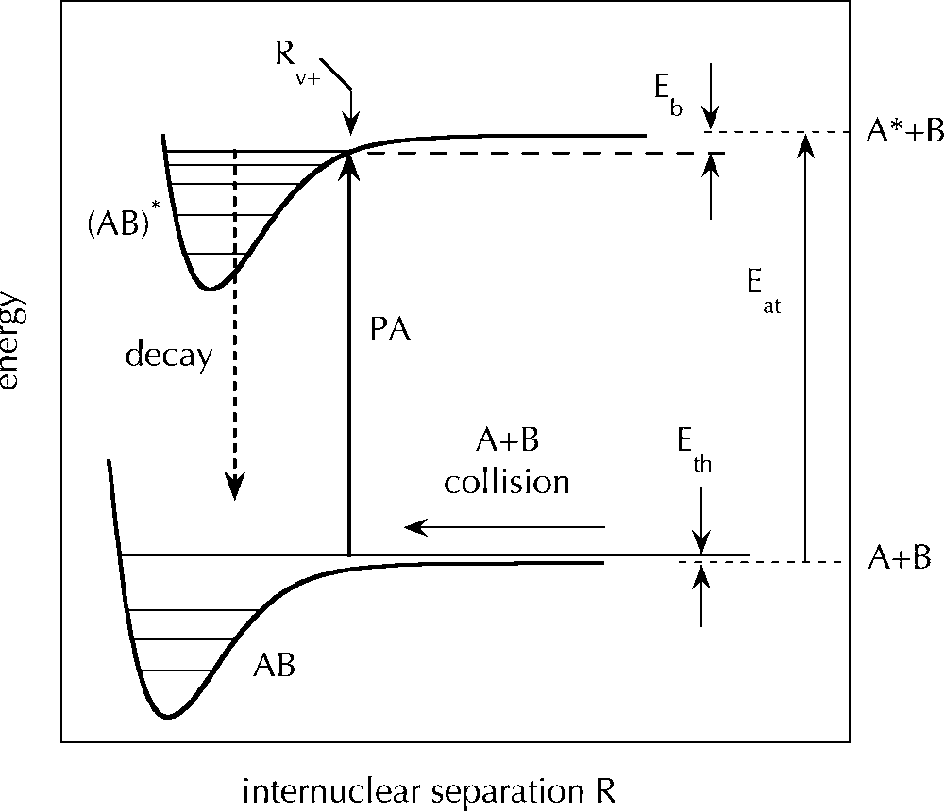
Photo association (PA) of cold atoms : collision associated with light
PA laser : S (ground) – P (excited)
Kevin M. Jones et al, Rev. of Modern Physics, 2006
A pair of ultra cold ground-state atoms absorbs a photon, creating a molecule in an excited ro-vibrational electronic state. Thro spontaneous emission the molecule decays to high lying vibrational state of the ground/excited meta stable state. Subsequently, through Raman pumping, stimulated emission brings the molecule to v=0 ground electronic state
<number>
Notes:
Find the ppt presentation from where I obtained the above graph…
<number>

Slide 34
Why polar molecules?
The interest in polar molecules stems from the fact that polar
molecules have permanent dipole moments. This allows them to
strongly interact with an external electric fields and with each
other by long range dipole-dipole forces.
Rb
Cs/K
Yb
Yb
Long-range dipole-dipole interactions between molecules can create new types of highly-correlated many-body states.
Why ultra cold(< 1mK) polar molecules?
Long measuring times
Narrow line widths
High resolution
Slow molecules
Dr. A. Vutha’s talk on reducing statistical uncertainty
<number>

Slide 35
What is the contribution from Quantum chemists?
Search of new types of ultracold polar molecule as candidates for the study of long range dipole-dipole interactions - permanent dipole moment (PDM) is an indicator of the strength of these interactions.
Estimation of PDM can lead to understanding of interactions between molecules, Bose-Einstein condensation, Fermi degeneracy etc
PDMs, TDMs and spontaneous emission rates to determine the type of laser for photoassociation spectroscopy experiments
Precise measurement of molecular vibrational-rotational transition frequency- Measurement of variance of mp/me (proton to electron mass ratio) and α (fine structure constant)
Frequency uncertainty ~ Stark effect can be estimated from vibrational PDM and TDMs.
Lifetime of single vibrational quantum state can be obtained from PDM - important requisite while designing experiments
Computation of molecular properties – Parity violation/Parity-time violation
Non-radiative charge-transfer processes – examining the PDMs with avoided crossings
<number>

Slide 36
Polarization factor of molecules
FrSr: d = 3.47 D, B = 0.36 GHz
Abe, Gopakumar, Hada
YbLi: 4Σ d = 6.09 D, B = 3.6 GHz
Gopakumar, Abe, Hada
YbF: d = 3.7 D, B = 6.7 GHz
Aoki san’s
presentation
Aoki’s
Kajita-san’s
calculation

Slide 37
Why alkaline-earth-metal-Li molecules?
Li being the lightest atom can be easily laser-cooled in ground state
Alkali-Li molecules - Large PDM hence lifetime of single quantum state is short - not advantageous for experiments
Alkaline-earth –metal - Li molecules – PDM smaller than alkali-Li molecules ~ long lifetime of state advantageous for experimentalists
Nuclear spin of X is zero – choosing 6Li(nuclear spin =1)-fermionic or
7Li (nuclear spin = 3/2) –bosonic molecules could be formed
Simple energy structure due to zero nuclear spin of even alkaline-earth-metal atoms
<number>

Slide 38
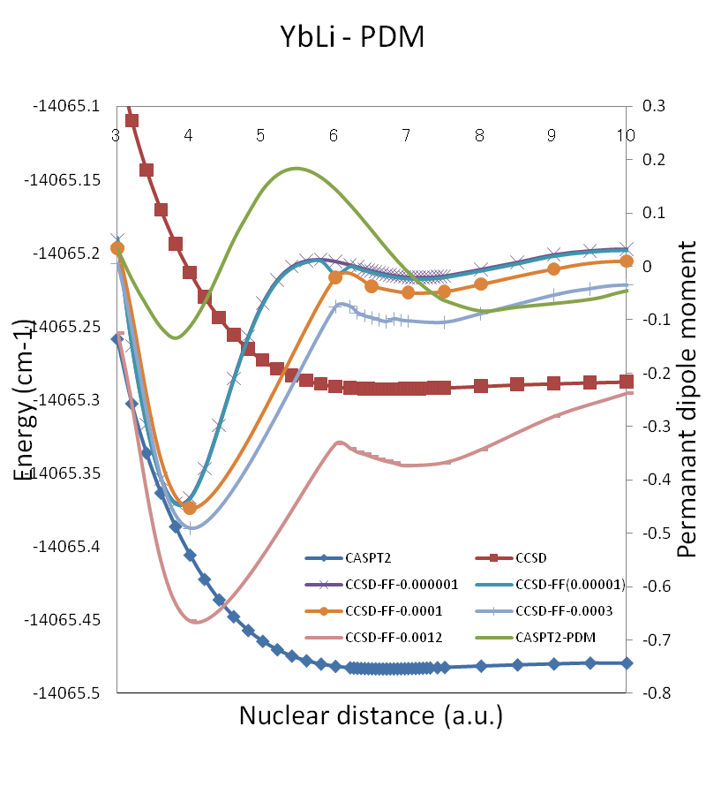
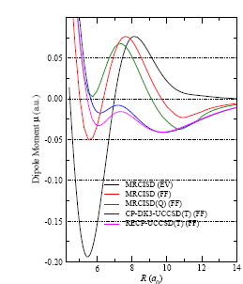
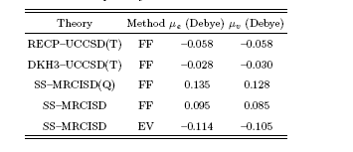


Experiment/ theory work -
Experiment- simultaneous MOT of 174Yb and 6Li
M. Okano et al, App. Phys,B, 98, 691 (2010) , Hideaki Hara al, PRL,106, 205304 (2012)
Computation – Ground and excited states of LiYb molecule
Absolute PDM is of same order by all correlation methods
- Not a probable candidate for long range dipole-dipole interaction studies
Re (CASPT2) = 6.69 au, Re(CCSD(T)) = 6.70 au
<number>

Slide 39

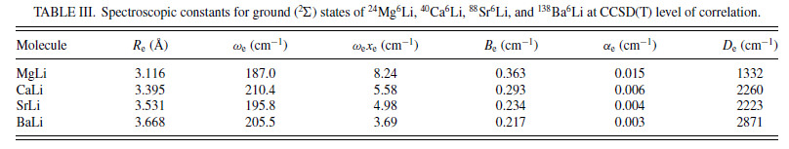
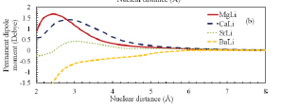
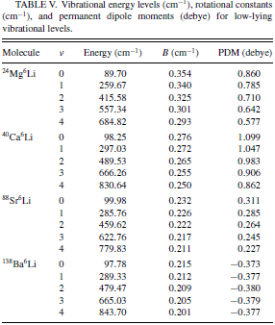
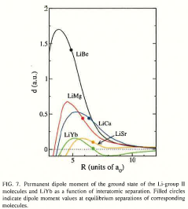

Searching for other probable candidates : alkaline-earth-metal-Li molecules
PECs (CCSD(T)) and PDMs (FFPT)
Similar trend in PDM
<number>

Slide 40
Calculation details – Ground state of
MOLCAS 7.2 software
C2v Point group symmetry
Third order Douglas-Kroll-Hess (DKH) –relativistic Hamiltonian with relativistic basis set (ANO-RCC) – all molecules
Potential energy curves and spectroscopic constants – CCSD(T) level of correlation
Excitations are considered from Li(1s,2s), Mg(2p,3s), Ca(3p,4s), Sr(4p,5s) and Ba(5s,5p,6s)
Electronic PDM using finite field perturbation theory - parameters (± 0.001 a.u to ± 0.0001 a.u.) - starting from CCSD(T) energy
Electronic PDM at CASPT2 level – as expectation value as a check
Numerical vibrational wave functions - Numerov method – vibrational PDM and TDM matrix elements
BSSE (basis super position error) is negligible – largest ANO-RCC basis set
<number>

Slide 41
Spontaneous and black-body transition rates in alkali-earth-Li molecules
Black arrows – spontaneous emission
4
3
2
1
0
Yellow arrows – Black-body emission
Orange arrows – Black-body absorption
4
3
2
1
0
Notes:
<number>

Slide 42
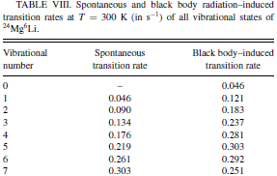
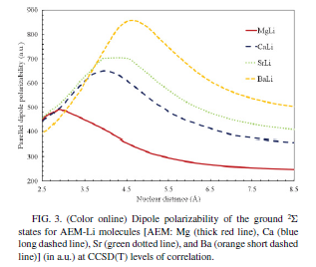
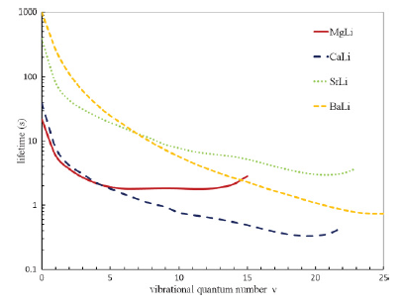
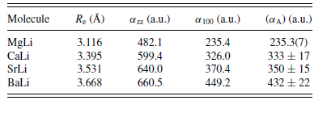
Additional checks : Radiative lifetimes, dipole polarizability
Radiative transition : Spontaneous emission +
Black-body emission + Black-body absorption (300K)
Dipole polarizability
(second derivative of energy)
Low lying vib levels
Spont. Tran. Rate < BB tran.rate
Lifetime is limited by BB trans. Rate
High lying vib levels
Spon. Tran. Rate > BB tran. Rate
Contribution from overtone transitions
(an-harmonicity of the PEC)
Lifetime of v=0, J=0 vibrational state
6Li24Mg =22s , 6Li40Ca = 39s ,
6Li88Sr = 380s and 6Li138Ba = 988s
<number>

Slide 43
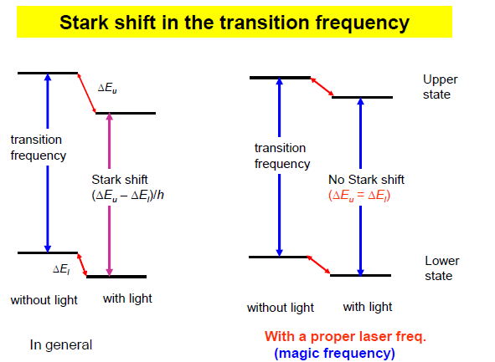
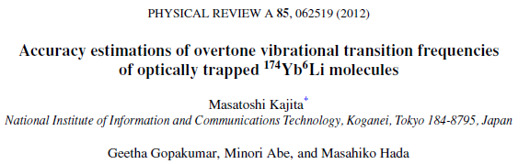
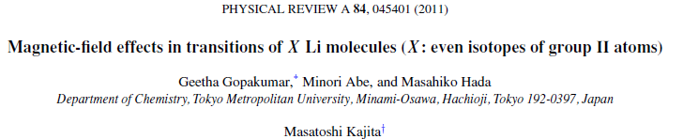
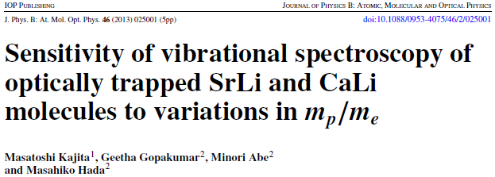
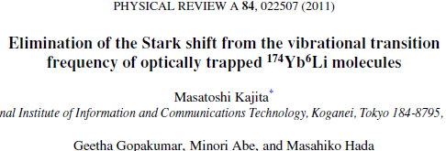
Candidates suitable for ultracold matter studies
MgLi : Ground state PDM - large but cooling of Mg atom difficult
CaLi : Ground state PDM – large; cooling of Ca already achieved
(T. Binnewies et al, PRL, 87, 123002 (2001)
SrLi : Ground state PDM – moderate ; cooling of Sr already achieved
(H. Katori et al, PRL, 82, 1116 (1999)
Simultaneous cooling and trapping of Li and Sr for electron EDM measurements
(Torri et al, 5th International workshop on FPUA 2011, p-121-123)
BaLi: Ground state PDM – small – cooling of Ba already achieved
(De Subhadeep, Phd Thesis, TRIuP facility at KVI, Netherlands)
Vibrational transition frequency
<number>

Slide 44
Implication of variance of m
Grand unification theory implies the possibility of variance of various natural fundamental dimensionless constants.
One example
[d(mp/me)/dt] /mp/me = Rc [dα /dt ]/α
20 < Rc <40 : depends on the detail of GUT
where α is the fine structure constant α = e2/ hc4πε0
To determine Rc , information of variation of α and mp/me is required.
<number>

Slide 45
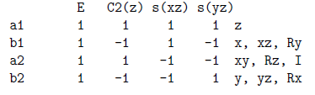
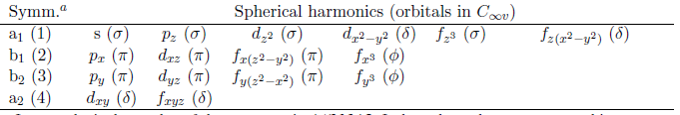
Calculation details – Ground and excited states of
Program : MOLCAS 7.2 version.
Hamiltonian : Relativistic spin free 3rd Order Douglas-Kroll Hamiltonian
Correlation : Spin free multi-state CASPT2 followed by first order Spin-Orbit effect using RASSI (RAS State Interaction Program) – SO-MS-CASPT2
Symmetry : C2v
Active Space for CASSCF : 3 electrons in 8 orbitals
(4s and 5p of Ca and 2s and 2p of Li) – (4,2,2,0)
[ a1: (Ca -4s, 4pz; Li – 2s, 2pz) b1/b2 : Ca – 4px/4py; Li 2px/2py; a2 - 0 ]
Number of roots for state averaged CASSCF :
(2a1 ：3, 2b1 ：2, 2b2 ：2 : 4a1 ：1, 4b1 ：1, 4b2 ：1)
Number of roots for spin-orbit CASPT2
(2a1 ：4, 2b1 ：3, 2b2 ：3 : 4a1 ：1, 4b1 ：1, 4b2 ：1)
Basis : ROOS-ANO-RCC
(Ca) 20s16p6d4f – 10s9p6d4f
(Li) 14s9p4d3f1g - 8s7p4d2f 1g
Character table for C2V
<number>

Slide 46
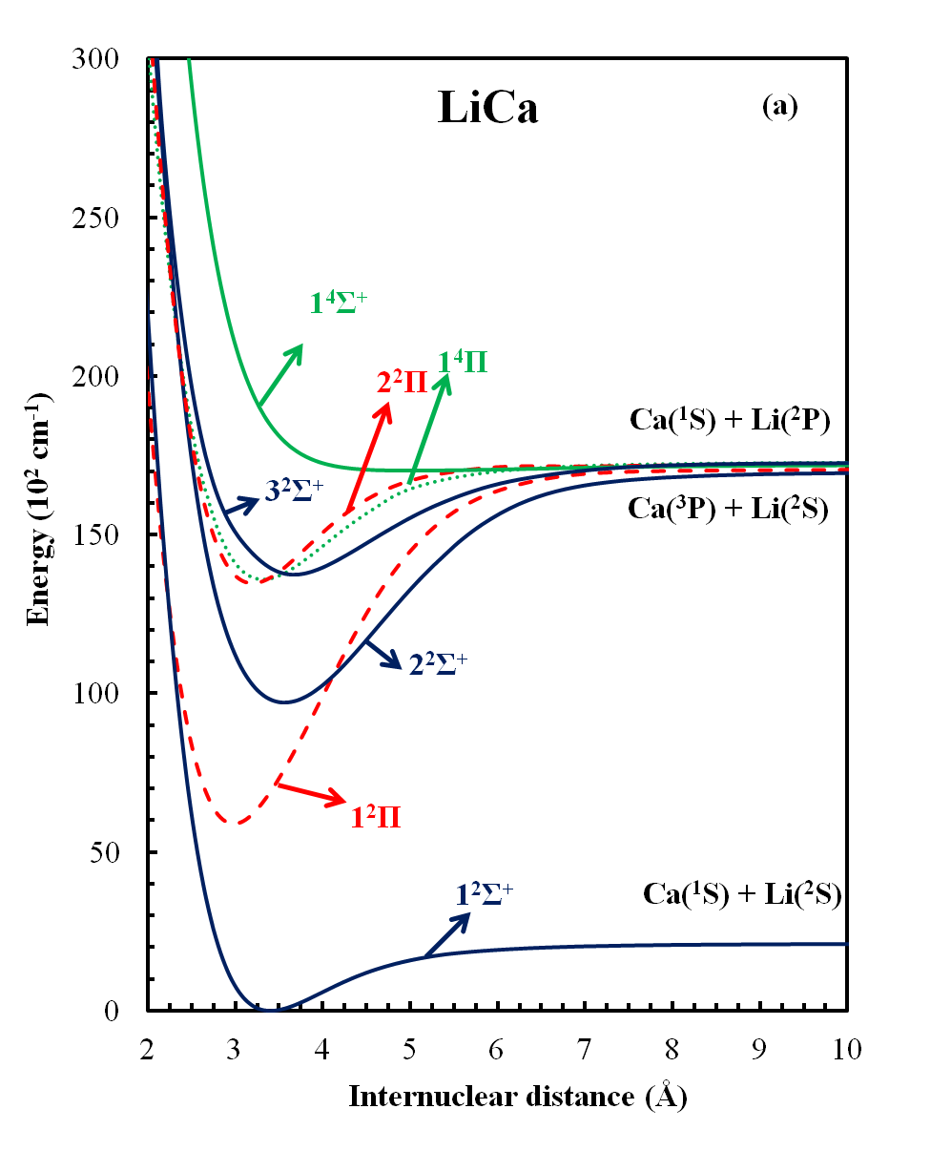
CaLi spin-free CASPT2 PECs + spectroscopic constants
Te
De
Spin-free excitation energies
Inclusion of 3d in CAS space
EE of 3P = 15310 cm-1
<number>

Slide 47
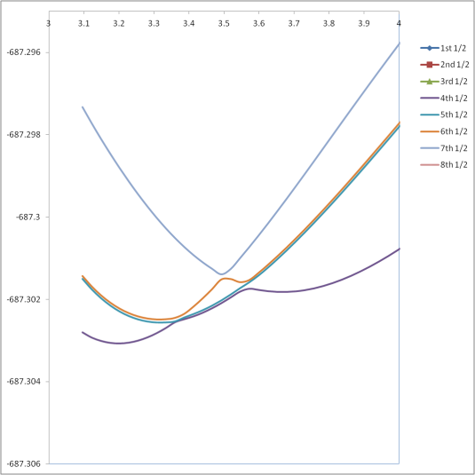



CaLi spin-orbit CASPT2 PECs + spin-free Transition dipole moment
Ω=1/2
Ω=3/2
Spin-orbit effects leads to several states with double minima due to avoided crossings
Atomic limits - Order of 3P and 2P states are not obtained - (325 cm-1)
Molecular regions - character of states are obtained as expected
Excitation energy error < 3%
spectroscopic constant error <1%
2P (2s-2p) transition dipole moment
100 a.u - 2.37 a.u. NIST – 2.36 a.u.
<number>

Slide 48

Spin-free
Spin-orbit
Moderate spin-orbit effect – crossing of 4Σ, 2Σ and 2Π
<number>

Slide 49


Spontaneous emission rate (sec-1)
(a) – 12Σ to 12Π
– 140000 /sec –not
easy experimentally
(b) – 12Σ to 22Σ
– 600000 /sec – not easy but ok
(sensitive detectors in UV)
(c) – 12Σ to 22Π
– 14000000 /sec - good
observe fluorescence
(d) – 12Σ to 32Σ
- 30000000 /sec - very good
- more than 107 /sec
Observe LIF spectrum using laser diode or Ti: Sapphire laser
<number>

Slide 50

Takahashi sensei – talk @
FPAU – 19-20-May-2012

Slide 51

Takahashi sensei – talk @
FPUA – 19-20-May-2012

Slide 52
Atomic calculations (validating whether the basis sets can represent the ground and excited states of atoms) – MS-CASPT2 – largest ANO-RCC basis sets
Excitation energy error estimate (3rd Calculation)
1S, 3P, 1P, 3D, 3S and 1S < 4%
1D < 5%
<number>

Slide 53


Excitation energy error estimate
3P < 5% and 1P < 2%
HgYb Ground state - State specific CASPT2 method
RAS space: 4220 (8 orbitals – 6s,6p – Yb and 7s,7p - Hg) – 4 electrons
RAS space: 5220 (9 orbitals – 6s,*s, 6p –Yb 7s,7p - Hg) – 4 electrons
Re = 6.63 a.u.
Ωe = 35.6 cm-1
De = 2397.14 cm-1
Re = 6.62 a.u.
Ωe = 36.7 cm-1
De = 2340.39 cm-1
<number>

Slide 54





CASPT2 (7331)-State specific –ground state
CASPT2 (7331) – State average –ground state
SCF and CASSCF (scaled) do not have minimum
Comparison of CASPT2 (7331)(state specific/average) with CCSD(T) –
ground state of HgYb molecule
State specific
Re = 6.52 a.u.
Ωe = 38.7 cm-1
De = 2349.46 cm-1
State average
Re = 6.70 a.u.
Ωe =29.59 cm-1
De = 2213.23 cm-1
CCSD(T)
Re = 7.06 a.u.
Ωe = 28.3 cm-1
De = 1064.80cm-1
<number>

Slide 55
Computation of excited states: What should we check?
Order of excited states with respect to energy in comparison with NIST atomic data
How many states to be included in optimization at CASSCF level?
How many states to be included at CASPT2 level?
Smooth curves starting from binding regions to dissociation regions !
Molecular excitation energy @100 a.u. in comparison with atomic excitation energies?
Atomic calculations RAS space: Yb (5221) + Hg (2110) >>>> YbHg (7331)
Program : MOLCAS 7.2 version.
Method : Spin free 3rd Order Douglas-Kroll Hamiltonian
Correlation : Spin free multi-state CASPT2 followed by first order Spin-Orbit effect using RASSI (RAS State Interaction Program) – SO-MS-CASPT2
Symmetry : C2v
Active Space for CASSCF : 4 electrons in 14 orbitals
(6s, 6p, 7s and 5d of Yb and 7s and 7p of Hg) – addition of 5d to get good Yb atomic limits
Frozen core : 46 orbitals (1s to 4d of Yb (en ~7.561 au) and 1s to 4d of Hg (en ~ 14.352 au)
Active orbitals in CASPT2: 5s,6s,5p,4f (Yb) and 5s,6s,5p, 4f, 5d(Hg)
Basis : ROOS-ANO-RCC – 379 basis functions
(Yb) 25s22p15d11f4g2h – 12s11p8d7f4g2h
(Hg) 25s22p16d12f4g2h – 10s10p9d6f4g2h
Order of excited states 7331- RAS space
How many states at CASSCF level of optimization?
55232311: Between 6 to 5 a.u unsmooth PECs for 1-1Σ, 2-3Σ and 1-3Π states
43222211: Ground (1Σ) has
discontinuity at 6.5a.u.
53222211: (used this CASSCF calculation for CASPT2 (55232311)
- lowest 20 spin-free states
<number>
22 spin-free states

Slide 56

Spin-free-HgYb singlet excited states
All low lying Yb excited states required are
reproduced correctly
Due to state averaging procedure(optimization)
some states may not be accurate
(5) singlet Sigma, (2) singlet Pi and (1) singlet Delta
Blue lines: Singlet Sigma states
Dotted red lines : Singlet Pi states
Purple lines : Singlet Delta states
<number>

Slide 57

Spin-free-HgYb triplet excited states
Yb(3D) + Hg(1S)
Yb(3P) + Hg(1S)
Blue lines: Triplet Sigma states
Dotted red lines : Triplet Pi states
Purple lines : Triplet Delta states
Yb (triplet Sigma) states dissociating to 3S are missing.
(4) triplet Sigma and (5) triplet Sigma are not the states required.
All low lying Yb excited states are not reproduced
correctly (red shaded)
Hg excited (triplet Pi states) are obtained but
triplet Sigma states are missing.
<number>

Slide 58
Spin-free spectroscopic constants
(3)1Σ and (4)1Σ has avoided crossing at smaller nuclear distance
5th 1Σ and (3)3Π state has a broad maximum ~
due to non inclusion of higher excited states
All states are strongly bound in comparison with the ground state
<number>

Slide 59


Permanent dipole moment, ground state dissociation energy
Ground state pdm ~ 1.1 D to 1.3 D
CASPT2 method produces more bound molecule in
comparison with CCSD(T)
<number>

Slide 60
HgYb spin orbit excited states
First check: Atomic excitation energy with 100 a.u. data
Yb: 1s2…..5s25p64f146s2
Hg : 1s2…..5s25p64f146s2 5d107s2
Hg (7s2) ground + Yb (6s2) ground
(j=0) (j=0)
Total Mj values possible: 0
Hg (7s2) ground + Yb (6s16p1) excited
(j=0) (j= 0,1,2)
Total Mj values possible: 0,±1,0,±2,±1,0
Hg(7s2) ground + Yb(6s15d1) excited
(j=0) (j= 1,2,3)
Total Mj values possible: ±1,0,±2, ±1,
0,±3,±2,±1,0)
Hg (7s2) ground + Yb(6s16p1) excited
(j=0) (j=1)
Total Mj values possible: 0,±1
Hg (7s2) ground + Yb(6s15d1) excited
(j=0) (j=2)
Total Mj values possible: 0, ±2,±1
Hg (7s2) ground + Yb (7s2) excited
(j=0) (j=0)
Total Mj values possible: 0
Hg (7s2) ground + Yb (7s2) excited
(j=0) (j=1)
Total Mj values possible: 0,±1
Hg (7s7p) excited + Yb (6s2) ground
(j=0,1,2) (j= 0)
Total Mj values possible: 0,±1,0,±2,±1,0
Hg (7s7p) excited + Yb (6s2) ground
(j=0,1) (j= 0)
Total Mj values possible: 0,±1
Proper dissociation channel for the lowest
31 states out of 46 spin-orbit states
Excitation
Energy < 5%
<number>

Slide 61

Spin-orbit MS-CASPT2 PECs
Blue lines – omega – 0
Red dashed lines – omega – 1
Yellow dotted lines – omega – 2
Green lines – omega - 3
<number>

Slide 62

Transition Dipole moment – spin free level – check (lifetime calculations)
Electric dipole transition possible
from ground (1S) to (1P) state (at
dissociation limits)
All other transitions are forbidden at spin-free level.
TDM ~ 3.114 a.u.
Lifetime of 1P state (expt.)
~ 5.7 nsec
100 a.u calculations
~ 4.5nsec
Molecular regions:
Large TDM connecting ground(1S) with (4)1Σ (yellow) and (2)1Π(green) states at binding regions ((4)1Σ and (2)1Π dissociates to Yb 1D excited state)
Possible candidate for stabilization step in photo association experiment
<number>

Slide 63
Fundamental Physics applications starting from chemistry
Lifetime of excited meta stable states for the possibility of PA experiment in excited states
Fitting the theoretical PECs with experiment to obtain accurate values of long range parameters (C6, C8..)
With long range parameters find scattering length – important parameter in laser cooling experiments
Parity Non Conservation in Chiral molecules – PNC NMR properties
Electron EDM in open shell molecules
Nuclear EDM in closed shell molecules
so on….
Thank you
<number>

